Slide 1
Delivering on higher ambition for energy efficiency and renewables
Brian Motherway
Head, Energy Efficiency and Inclusive Transitions
Stockholm, 27 October 2023

Slide 2
Five pillars to keep 1.5 °C alive
Installed renewables (GW)
Energy intensity improvement
Fossil fuel
demand (EJ)
Fossil fuel
methane (Mt)
Clean energy investment in EMDE* (Tn USD)
12 000
5%
500
125
2.5
3x
3x
2x
9 600
4%
400
100
2.0
-25%
7 200
3%
300
75
1.5
4 800
2%
200
50
1.0
-75%
2 400
1%
100
25
0.5
2022
2030
2022
2030
2022
2030
2022
2030
2022
2030
A comprehensive energy package for COP28 needs to drive the growth in clean energy,
support emerging and developing economies in the transition, and recognise the need to reduce fossil fuel demand
* EMDE = emerging market and developing economies

Slide 3
Faster permitting is key to significantly accelerate RE deployment
European Union solar PV and wind capacity average annual additions 2016-21, forecast 2022-27, vs. 2030 REPowerEU target needs
Annual renewable capacity additions in the EU must grow at least 10 GW per year to reach 2030 REPowerEU targets.
Facilitating permitting for all technologies will be crucial

Slide 4
Policy priority areas to achieve renewables tripling by 2030
Adapting existing policies and incentives to changing market and macroeconomic conditions
Streamlining permitting and reducing development lead times
Planning and accelerating investment in grids & other power system flexibility to securely integrate rising shares of variable renewables solar PV and wind
Designing new policies in more emerging and developing economies to de-risk investment and significantly accelerate deployment

Slide 5
Grids are becoming a bottleneck for energy transitions
Capacity of renewable energy projects in connection queues
Capacity of advanced stage projects in queues
GW
2 000
GW
2 000
1 800
1 600
1 500
1 400
1 200
1 000
1 000
800
600
500
400
200
0
0
Solar PV
Wind
Bioenergy
Hydro
Advanced stage projects
Advanced stage
Early stage/unlikely
United States
Europe
Japan
Others
At least 1500 GW are wind and solar projects around the world are in an advanced stage of development.
While investment in renewables has almost doubled in the last decade, investment in grids has remained stagnant.

Slide 6
Power systems are changing

Slide 7
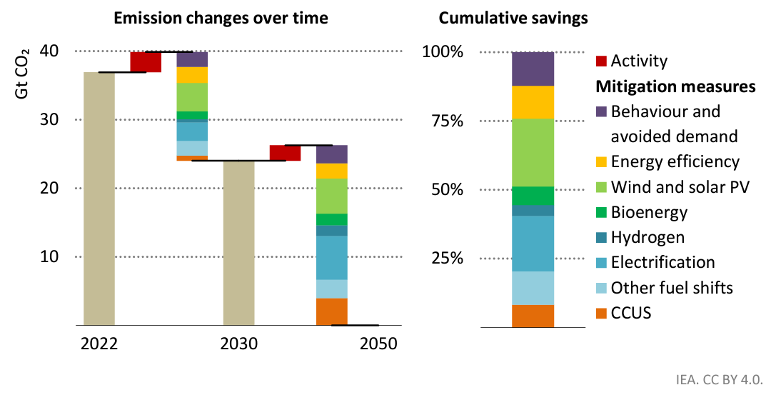
Efficiency, renewables and electrification key for 2030 and 2050
CO2 emissions reductions by mitigation measure in the IEA Net Zero Emissions by 2050 Scenario, 2022-2050
Key actions to reduce energy intensity - improvement in the efficiency of buildings and equipment, material efficiency and behavioural change, and electrification - contribute to nearly half of all the reductions achieved in 2030

Slide 8
Doubling efficiency progress requires a step-up across the world
Annual improvement in Energy Intensity (EI) related to 2021 Total Energy Supply (TES) per country, World, 2012-2021
Between 2012 and 2021, only China achieved an average annual EI improvement higher than 3%.

Slide 9
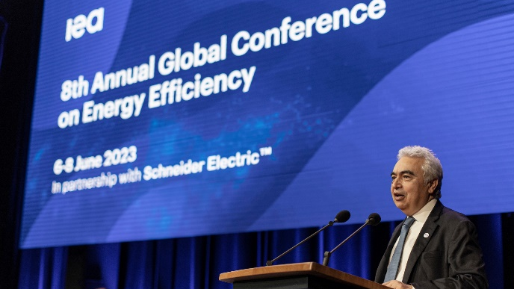
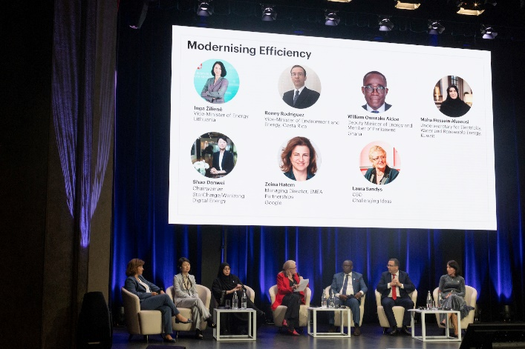

Political appetite for doubling is widespread
46 governments endorsed the doubling goal at the IEA 8th Annual Global Conference on Energy Efficiency in June
The Versailles Statement supports “stronger policies and actions towards the goal of putting the world on track to achieving a doubling of the global average annual rate of energy efficiency improvements this decade”

Slide 10
Doubling is within reach of all countries
Proportion of countries to surpass a 4% annual energy intensity improvement one or more times, 2012-2021
During the past 10 years, more than 50% of countries have surpassed an annual 4% Energy Intensity improvement at least three times.

Slide 11
In most regions, the required technologies are already on the market
Market sample of air conditioners by efficiency performance in selected regions and in the Net Zero Scenario, 2023
Affordable, net zero-compatible AC models are already widely accessible in major cooling growth markets

Slide 12
The required policies also already exist
Governments would achieve doubling if they adopted policies that matched
Lighting standards in South Africa
Building codes in Türkiye
Air conditioner regulations in China
Car fuel economy standards in the United States
Electric motor regulations in the European Union
Policies for heavy industry in India
…as a package of policies, covering all key sectors, with a strong focus on policy implementation and enforcement.

Slide 13










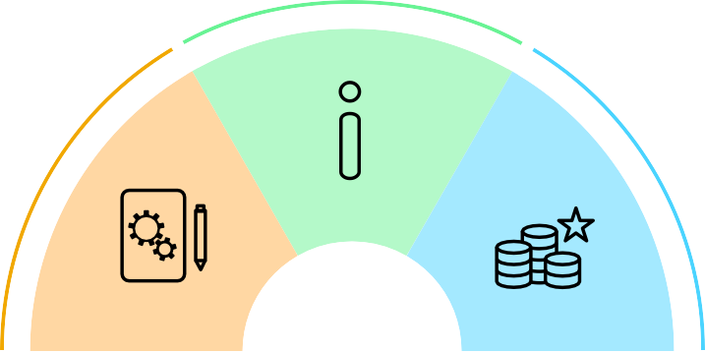


Policy Packages for Energy Efficiency
In all sectors the greatest efficiency gains are achieved by a package of policies that combine three main types of mechanisms:
Regulation
,
information
and
incentives
. Careful design and implementation will deliver efficiency’s full potential to enhance
energy security, create jobs, increase living standards, cut energy bills and reduce emissions.
Policies are more effective when they are set in the context of clear strategies and targets.
Long-term
Targets
Near-term
Information helps people make more efficient choices in what they buy and how they use energy.
Regulation is essential to exclude the worst performing equipment and practices from the market, to drive average
efficiency levels up, and to set rules for measurement of performance.
Incentives make efficient options more attractive and speed up the upgrade and replacement of appliances, buildings and vehicles.
They also encourage the use of new technologies and practices.
Essential elements
Key Policies
Implementation is as important as policy design.
Ensuring that the resources are in place to put
policies into action.
Address vital elements such as capacity building, enforcement, monitoring.
It is important to continually assess policies and programmes so as to keep up to date with technology developments.

Slide 14
People-Centred Clean Energy Transitions
Decent jobs and worker protection
Social and economic development
Equity, social inclusion and fairness
People as active participants

