Slide 1


COMPRESSED AIR SYSTEM OPTIMIZATION

Slide 2






COMPRESSED AIR SYSTEM OPTIMIZATION
Compressed air is widely used in industrial processes from chemical, pharmaceutical, and steel production to packaging and food and beverage

Slide 3
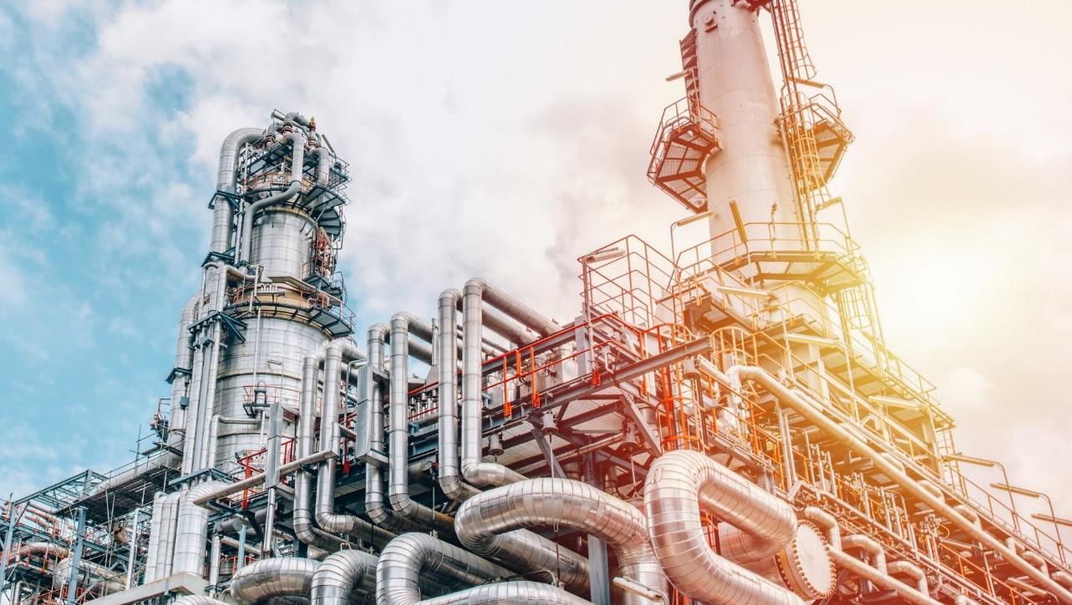
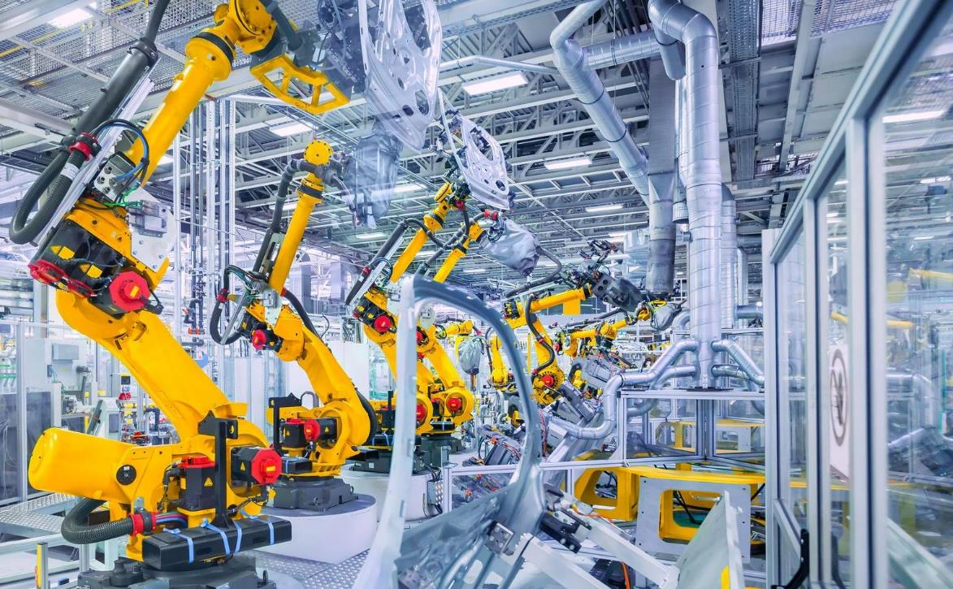

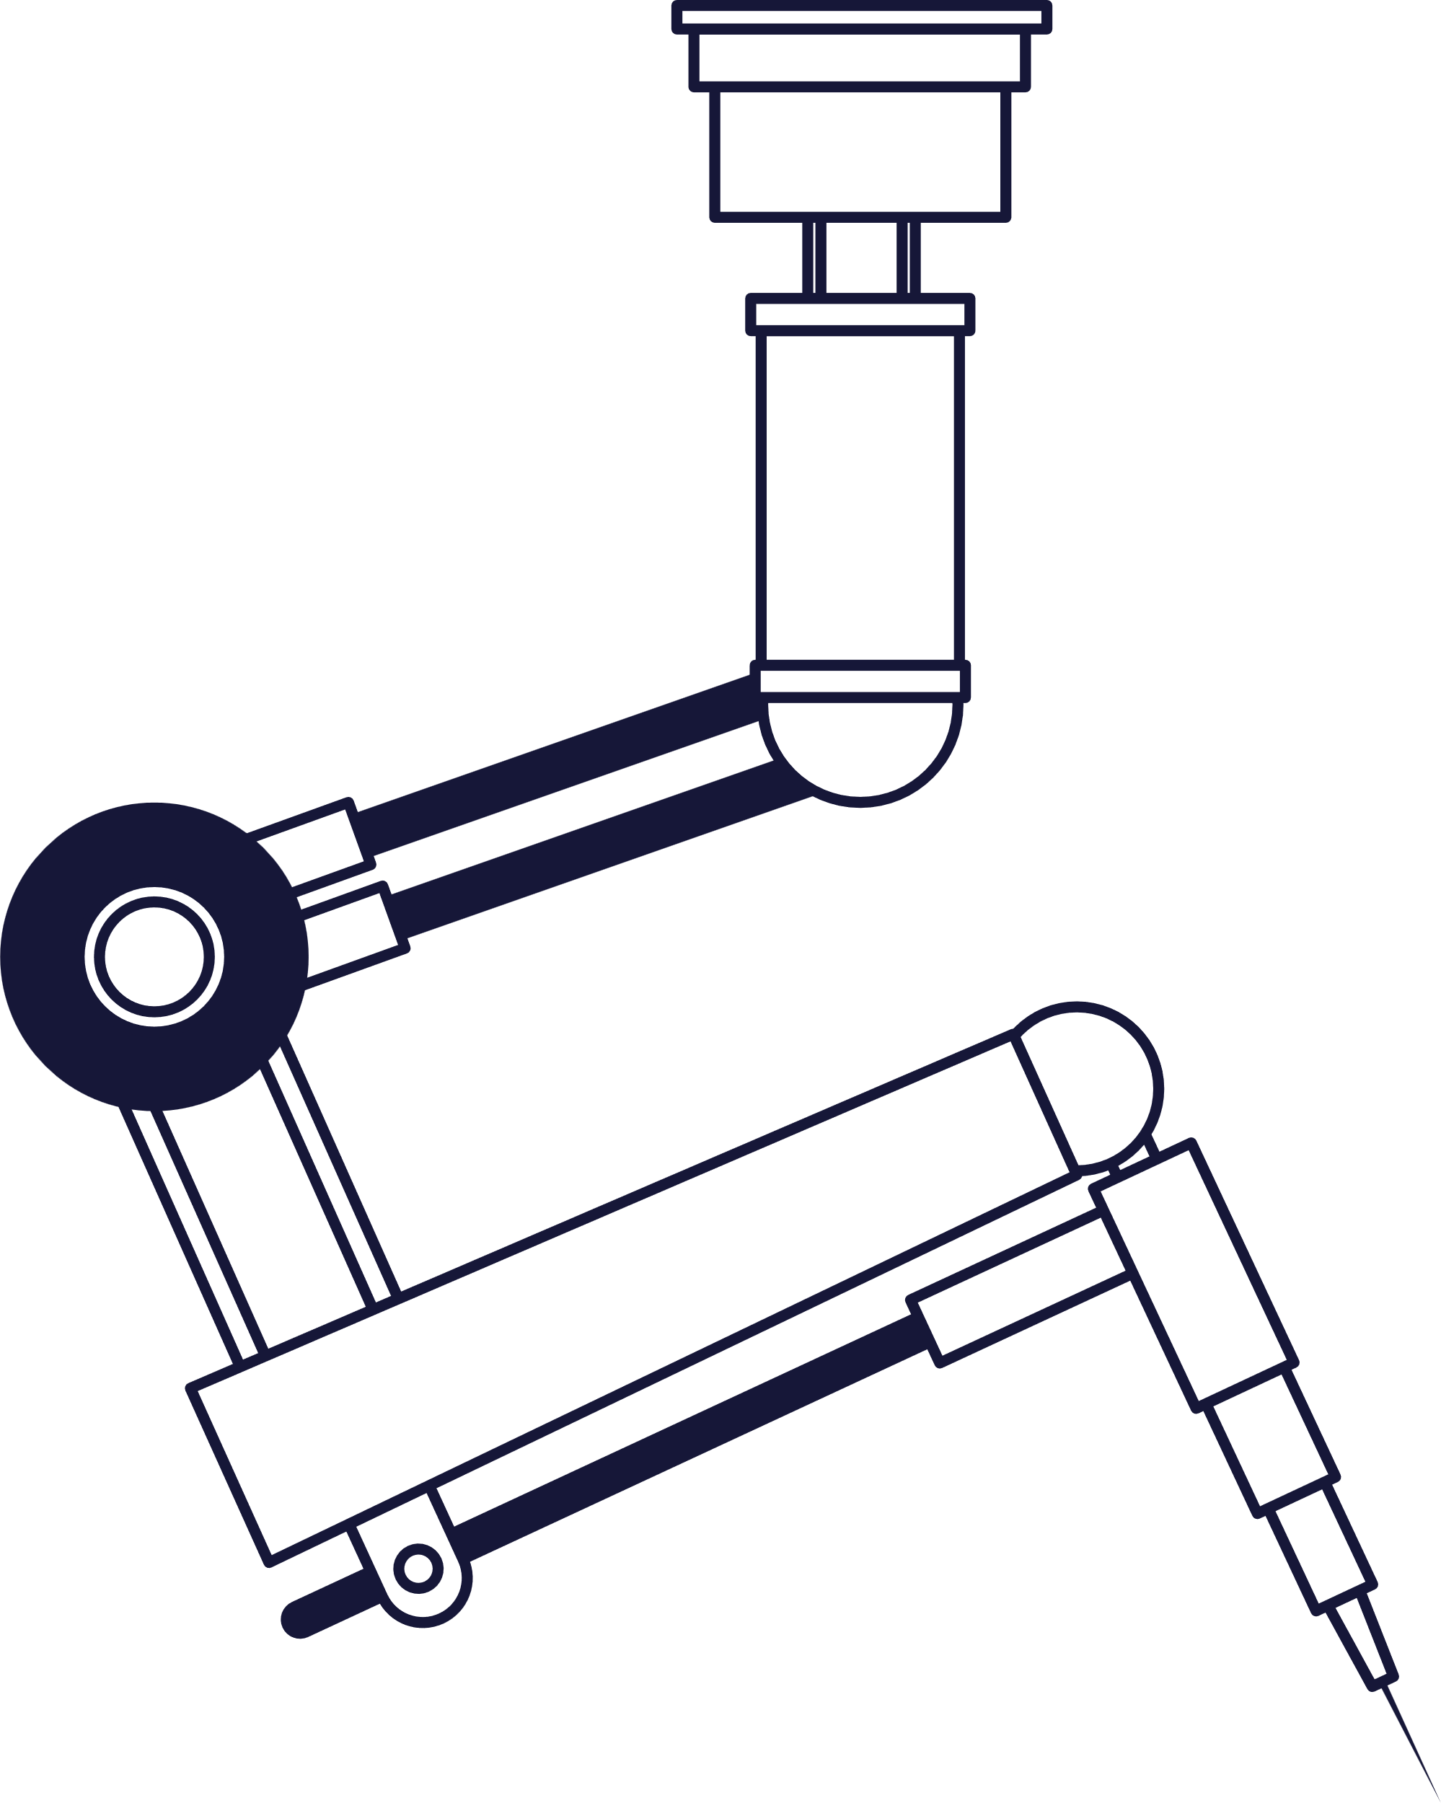

COMPRESSED AIR SYSTEM OPTIMIZATION
INDUSTRIAL PLANT
MACHINE SUPPLIERS

Slide 4
INDUSTRIAL PLANT
MACHINE
MACHINE

Slide 5
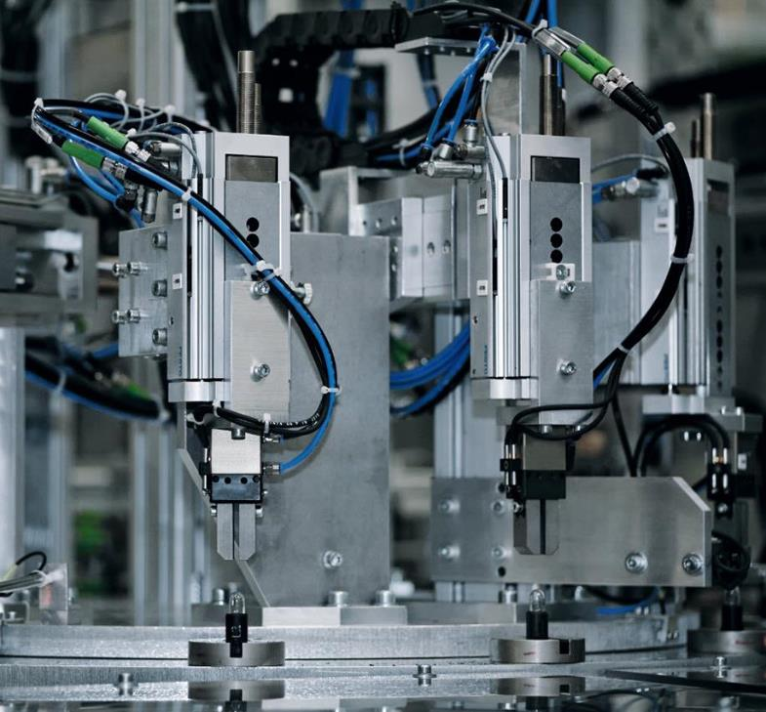
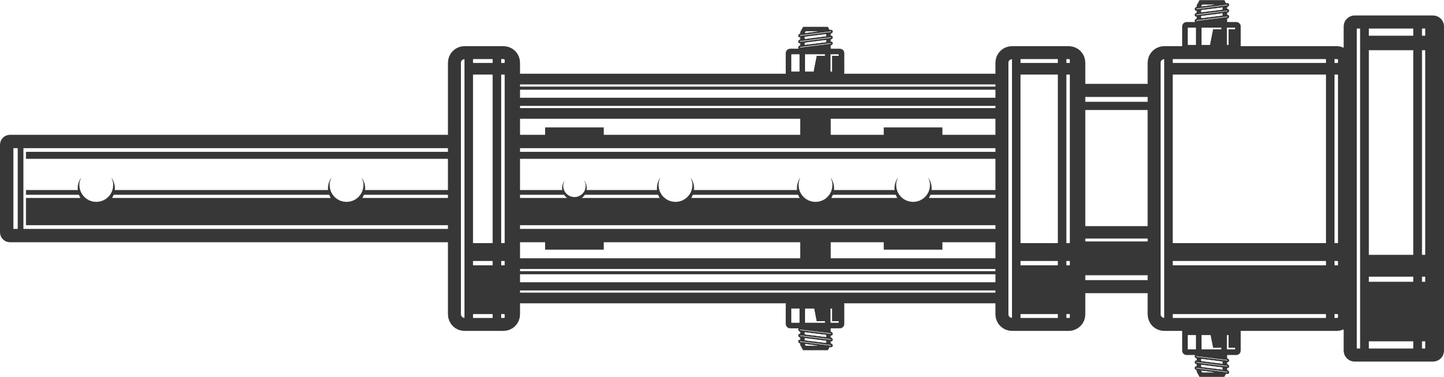
INDUSTRIAL PLANT
MACHINE
INSTRUMENT
WHICH IS OPERATED BY A COMPRESSED AIR GENERATED BY A COMPRESSOR

Slide 6
INDUSTRIAL PLANT
MACHINE
INSTRUMENT
WHICH IS OPERATED BY A COMPRESSED AIR GENERATED BY A COMPRESSOR

Slide 7






AUTOMOTIVE
CHEMICAL
PHARMA
INDUSTRIAL PLANT
STEEL
MACHINE
INSTRUMENT
WHICH IS GENERATED BY COMPRESSOR THAT SUPPLIES AN ENTIRE PLANT
CEMENT
FOOD

Slide 8







Подписать все иконки / убрать текст/ добавить внизу фразу and more
AUTOMOTIVE
CHEMICAL
20%
COMPRESSED AIR USAGE
COMPRESSED AIR
CONSUMPTION
PHARMA
STEEL
CEMENT
FOOD
Compressed air is widely used in industrial processes from chemical, pharmaceutical, and steel production to packaging, food and beverage and cement

Slide 9
COMPRESSED AIR SYSTEM OPTIMIZATION
INDUSTRIAL AIR CONSUMPTION
AUTOMOTIVE
CHEMICAL
COMPRESSED AIR USAGE
20%
Compressed air is widely used in industrial processes from chemical, pharmaceutical, and steel production to packaging and food and beverage
PHARMA
STEEL
COMPRESSED AIR CONSUMPTION
CEMENT
FOOD
60%
ENERGY SAVING POTENTIAL OF COMPRESSED AIR

Slide 10
20%
COMPRESSED AIR CONSUMPTION
Compressed air is widely used in industrial processes from chemical, pharmaceutical, and steel production to packaging and food and beverage
60%
ENERGY SAVING POTENTIAL OF COMPRESSED AIR

Slide 11
20%
COMPRESSED AIR CONSUMPTION
60%
Compressed air is widely used in industrial processes from chemical, pharmaceutical, and steel production to packaging and food and beverage
ENERGY SAVING POTENTIAL OF COMPRESSED AIR
20%
REDUCTION DUE TO LEAK REPAIR
40%
REDUCTION DUE TO CORRECT DESIGN

Slide 12

20%
COMPRESSED AIR CONSUMPTION
TRENDS AND CHALLENGES
60%
ENERGY SAVING POTENTIAL OF COMPRESSED AIR
10%
ENERGY AUDITS
Compressed air is widely used in industrial processes from chemical, pharmaceutical, and steel production to packaging and food and beverage
50%
EFFICIENCY IMPROVEMENT OF THE SUPPLY CHAIN

Slide 13




SIMILAR TO HOUSEHOLD
20%
COMPRESSED AIR CONSUMPTION
TRENDS AND CHALLENGES
60%
ENERGY SAVING POTENTIAL OF COMPRESSED AIR
EFFICIENT DESIGN
EFFICIENT APPLIANCES
10%
ENERGY AUDITS
Compressed air is widely used in industrial processes from chemical, pharmaceutical, and steel production to packaging and food and beverage
EFFICIENT
SYSTEM DESIGN
EFFICIENT
MACHINES
50%
EFFICIENCY IMPROVEMENT OF THE SUPPLY CHAIN
INNOVATIVE TECHNOLOGIES
ENERGY-SAVING HABITS AND AUDITS

Slide 14


SIMILAR TO HOUSEHOLD
LINEAR SUPPLY CHAIN
EFFICIENT APPLIANCES
EFFICIENT DESIGN
EFFICIENT
SYSTEM DESIGN
EFFICIENT
MACHINES
ENERGY-SAVING HABITS AND AUDITS
INNOVATIVE TECHNOLOGIES
EFFICIENCY AVAILABLE
EFFICIENCY NOT IMPORTANT
EFFICIENCY IS IN TOP PRIORITY
HIGH PRICE
LOW PRICE
HIGH PRICE

Slide 15
SIMILAR TO HOUSEHOLD
LINEAR SUPPLY CHAIN
EFFICIENT DESIGN
EFFICIENT APPLIANCES
EFFICIENT
SYSTEM DESIGN
INSTRUMENT SUPPLIERS
EFFICIENT
MACHINES
MACHINE SUPPLIERS
INDUSTRIAL PLANT
EFFICIENCY AVAILABLE
EFFICIENCY NOT IMPORTANT
EFFICIENCY IS IN TOP PRIORITY
ENERGY-SAVING HABITS AND AUDITS
INNOVATIVE TECHNOLOGIES
HIGH PRICE
LOW PRICE
HIGH PRICE
MULTIPLE PROS OF COMMITTING TO ENERGY-EFFICIENT INVESTMENTS

Slide 16



Expanded market opportunities
Competitive advantage in the market
Enhanced reputation for innovation
Attraction of environmentally conscious customers
Industrial and policy compliance
LINEAR SUPPLY CHAIN
MACHINE SUPPLIERS
Increased profitability
Potential for long-term partnerships
Enhanced customer relationships
Sustainability support
MULTIPLE PROS OF COMMITTING TO ENERGY-EFFICIENT INVESTMENTS
Industrial and policy compliance
Reduced energy and operating cost
Higher production capacity
Lower carbon products
INSTRUMENT SUPPLIERS
INDUSTRIAL PLANT
Improved safety measures
Higher-quality work environment
Improved product quality and consistency
EFFICIENCY AVAILBLE
EFFICIENCY NOT IMPORTANT
EFFICIENCY IN TOP PRIORITY
HIGH PRICE
LOW PRICE
HIGH PRICE

Slide 17



Expanded market opportunities
Competitive advantage in the market
Enhanced reputation for innovation
Attraction of environmentally conscious customers
Industrial and policy compliance
MULTIPLE PROS OF COMMITTING TO ENERGY-EFFICIENT INVESTMENTS
MACHINE SUPPLIERS
Increased profitability
Potential for long-term partnerships
COST
VALUE
Enhanced customer relationships
Sustainability support
Industrial and policy compliance
Reduced energy and operating cost
Higher production capacity
Lower carbon products
INSTRUMENT SUPPLIERS
INDUSTRIAL PLANT
RISK
Improved safety measures
Higher-quality work environment
Improved product quality and consistency

Slide 18
Expanded market opportunities
Competitive advantage in the market
Enhanced reputation for innovation
Attraction of environmentally conscious customers
Industrial and policy compliance
MULTIPLE PROS OF COMMITTING TO ENERGY-EFFICIENT INVESTMENTS
MACHINE SUPPLIERS
Increased profitability
Potential for long-term partnerships
COST
VALUE
Enhanced customer relationships
Sustainability support
Industrial and policy compliance
Reduced energy and operating cost
Higher production capacity
Lower carbon products
INSTRUMENT SUPPLIERS
INDUSTRIAL PLANT
RISK
Improved safety measures
Higher-quality work environment
Improved product quality and consistency

Slide 19
MULTIPLE PROS OF COMMITTING TO ENERGY-EFFICIENT INVESTMENTS
Expanded market opportunities
Competitive advantage in the market
Enhanced reputation for innovation
Attraction of environmentally conscious customers
MACHINE SUPPLIERS
Industrial and policy compliance
Increased profitability
Potential for long-term partnerships
COST
VALUE
Enhanced customer relationships
Sustainability support
Industrial and policy compliance
Reduced energy and operating cost
Higher production capacity
Lower carbon products
INSTRUMENT SUPPLIERS
INDUSTRIAL PLANT
RISK
Improved safety measures
Higher-quality work environment
Improved product quality and consistency

Slide 20
MULTIPLE PROS OF COMMITTING TO ENERGY-EFFICIENT INVESTMENTS
Expanded market opportunities
Competitive advantage in the market
Enhanced reputation for innovation
Attraction of environmentally conscious customers
MACHINE SUPPLIERS
Industrial and policy compliance
Increased profitability
Potential for long-term partnerships
COST
VALUE
Enhanced customer relationships
Sustainability support
Industrial and policy compliance
Reduced energy and operating cost
Higher production capacity
Lower carbon products
INSTRUMENT SUPPLIERS
INDUSTRIAL PLANT
RISK
Improved safety measures
Higher-quality work environment
Improved product quality and consistency

Slide 21


MULTIPLE PROS OF COMMITTING TO ENERGY-EFFICIENT INVESTMENTS
MULTIPLE PROS OF COMMITTING TO ENERGY-EFFICIENT INVESTMENTS
Expanded market opportunities
Competitive advantage in the market
Expanded market opportunities
Competitive advantage in the market
Enhanced reputation for innovation
Attraction of environmentally conscious customers
Enhanced reputation for innovation
Attraction of environmentally conscious customers
MACHINE SUPPLIERS
MACHINE SUPPLIERS
Industrial and policy compliance
Industrial and policy compliance
Increased profitability
Potential for long-term partnerships
Increased profitability
Potential for long-term partnerships
VALUE
COST
VALUE
COST
Enhanced customer relationships
Sustainability support
Enhanced customer relationships
Sustainability support
EFFICIENCY CURVE
Implementation uncertainty
Industrial and policy compliance
Industrial and policy compliance
Reduced energy and operating cost
Reduced energy and operating cost
Higher production capacity
Lower carbon products
Higher production capacity
Lower carbon products
INDUSTRIAL PLANT
INSTRUMENT SUPPLIERS
INDUSTRIAL PLANT
INSTRUMENT SUPPLIERS
RISK
RISK
Energy efficiency
Improved safety measures
Higher-quality work environment
Improved product quality and consistency
Improved safety measures
Higher-quality work environment
Improved product quality and consistency

Slide 22





Challenges to implement efficient solutions
MULTIPLE PROS OF COMMITTING TO ENERGY-EFFICIENT INVESTMENTS
Expanded market opportunities
Competitive advantage in the market
Enhanced reputation for innovation
Attraction of environmentally conscious customers
MACHINE SUPPLIERS
ISO STANDARDS
Industrial and policy compliance
Increased profitability
Potential for long-term partnerships
POLICY INTEGRATIONS
COST
VALUE
Enhanced customer relationships
Sustainability support
NEW EFFICIENT TECHNOLOGIES
EFFICIENCY CURVE
EXPERTISE
Implementation uncertainty
Industrial and policy compliance
Reduced energy and operating cost
BEHAVIOURAL CHANGE
Higher production capacity
Lower carbon products
DIGITALIZATION
INSTRUMENT SUPPLIERS
INDUSTRIAL PLANT
RISK
Energy efficiency
Improved safety measures
Higher-quality work environment
Improved product quality and consistency

Slide 23
MULTIPLE PROS OF COMMITTING TO ENERGY-EFFICIENT INVESTMENTS
Expanded market opportunities
Competitive advantage in the market
Challenges to implement efficient solutions
Enhanced reputation for innovation
Attraction of environmentally conscious customers
MACHINE SUPPLIERS
ISO STANDARDS
Industrial and policy compliance
Increased profitability
Potential for long-term partnerships
POLICY INTEGRATIONS
COST
VALUE
Enhanced customer relationships
Sustainability support
NEW EFFICIENT TECHNOLOGIES
EFFICIENCY CURVE
EXPERTISE
Implementation uncertainty
Industrial and policy compliance
Reduced energy and operating cost
BEHAVIOURAL CHANGE
DIGITALIZATION
Higher production capacity
Lower carbon products
INSTRUMENT SUPPLIERS
INDUSTRIAL PLANT
RISK
Energy efficiency
Improved safety measures
Higher-quality work environment
Improved product quality and consistency

Slide 24

SOLUTIONS TO BOOST INTEGRATION OF ENERGY-EFFICIENCY
Challenges to implement efficient solutions
ISO STANDARDS
POLICY INTEGRATIONS
NEW EFFICIENT TECHNOLOGIES
EFFICIENCY CURVE
EXPERTISE
Implementation uncertainty
OBJECTIVE
BEHAVIOURAL CHANGE
DIGITALIZATION
Energy efficiency

Slide 25

SOLUTIONS TO BOOST INTEGRATION OF ENERGY-EFFICIENCY
Challenges to implement efficient solutions
ISO STANDARDS
POLICY INTEGRATIONS
NEW EFFICIENT TECHNOLOGIES
EXPERTISE
BEHAVIOURAL CHANGE
DIGITALIZATION
ENERGY-EFFICIENT MEASURES
Enhanced reputation for innovation
Attraction of environmentally conscious customers
Industrial and policy compliance
Increased profitability
Potential for long-term partnerships
COST
VALUE
Enhanced customer relationships
Sustainability support
EFFICIENCY CURVE
Implementation uncertainty
Industrial and policy compliance
Reduced energy and operating cost
OBJECTIVE
Higher production capacity
Lower carbon products
INSTRUMENT SUPPLIERS
INDUSTRIAL PLANT
RISK
Energy efficiency

Slide 26

SOLUTIONS TO BOOST INTEGRATION OF ENERGY-EFFICIENCY
Promotion and integration
of efficient solutions
Software for efficient design
Education
Networking and collaboration
Need for support of policy
Makers, energy agencies, governments,
ENERGY-EFFICIENT MEASURES
COLLABORATIVE PLATFROMS

Slide 27


SOLUTIONS TO BOOST INTEGRATION OF ENERGY-EFFICIENCY
Promotion and integration
of efficient solutions
Software for efficient design
Education
Networking and collaboration
Need for support of policy
Makers, energy agencies, governments,
COLLABORATIVE PLATFROMS
ENERGY-EFFICIENT MEASURES

Slide 28
CARBON SINK TO BIO PRODUCTS
Natasha Yamamura
natasha.yamamura@algae-scope.com
Dr. Elvira Rakova
elvira.rakova@algae-scope.com

Slide 29


SOLUTIONS TO ENABLE
FASTER INTEGRATION OF RENEWABLES
CARBON SINK TO BIO PRODUCTS

Slide 30






SOLUTIONS TO ENABLE
FASTER INTEGRATION OF RENEWABLES
CARBON SINK TO BIO PRODUCTS
Energy companies
Limited resources
Policies and technologies
for net zero
future
Economical challenges
PROCESSING

Slide 31

SOLUTIONS TO ENABLE
FASTER INTEGRATION OF RENEWABLES
Energy companies
Limited resources
Policies and technologies
for net zero
future
LINEAR SUPPLY CHAIN
Economical challenges
EXTRACTION
PROCESSING
CO2 CAPTURING
AND OFFSETTING

Slide 32





COLLABORATIVE APPROACH
FOR REGENARITVE BIOMASS
SOLUTIONS TO ENABLE
FASTER INTEGRATION OF RENEWABLES
Limited resources
Energy companies
Policies and technologies
for net zero
future
Economical challenges
LINEAR SUPPLY CHAIN
EXTRACTION
PROCESSING
CO2 CAPTURING
AND OFFSETTING

Slide 33






CULTIVATED SEAWEED AS
A REGENERATIVE BIOMASS
CLIMATE CHANGE:
CHALLENGES AND OPPORTUNITIES?
SUSTAINABLE FUELS, BUILDING MATERIALS, AND FERTILIZERS
CARBON
SEQUESTRATION
WATER REMEDIATION
NEW
REVENUE
STREAMS
CARBON-NEUTRAL PRODUCTS
JOB
CREATION

Slide 34
COLLABORATIVE APPROACH
FOR REGENARITVE BIOMASS
CLIMATE CHANGE:
CHALLENGES AND OPPORTUNITIES?
SUSTAINABLE FUELS, BUILDING MATERIALS, AND FERTILIZERS
OCEAN
HEALTH AND
ENVIRONMENT
CARBON
SEQUESTRATION
INDUSTRIES RELY ON FOSSIL FUELS
WATER REMEDIATION
NEW
REVENUE
STREAMS
CARBON-NEUTRAL PRODUCTS
JOB
CREATION
COASTAL CITIES AND
COMMUNITIES

Slide 35
COLLABORATIVE APPROACH
FOR REGENARITVE BIOMASS
CLIMATE CHANGE:
CHALLENGES AND OPPORTUNITIES?
SUSTAINABLE FUELS, BUILDING MATERIALS, AND FERTILIZERS
OCEAN
HEALTH AND
ENVIRONMENT
CARBON
SEQUESTRATION
INDUSTRIES RELY ON FOSSIL FUELS
WATER REMEDIATION
NEW
REVENUE
STREAMS
CARBON-NEUTRAL PRODUCTS
JOB
CREATION
COASTAL CITIES AND
COMMUNITIES

Slide 36
TODAY'S ENERGY-EFFICIENT AND BIO-BASED SOLUTIONS
AWAIT GOVERNMENT AND POLICY MAKERS' SUPPORT
FOR SEAMLESS INTEGRATION

Slide 37


MAKE ENERGY-EFFICIENCY PROFITABLE
Dr. Eng. Elvira Rakova
Managing Director
elvira.rakova@direktin.com

