Slide 1

Funding the renewable energy transition in the Netherlands
Marc Londo
the Netherlands Association for Renewable Energy

Slide 2


From fossil to renewables:
From fuel costs to capital costs
Source: EIA

Slide 3
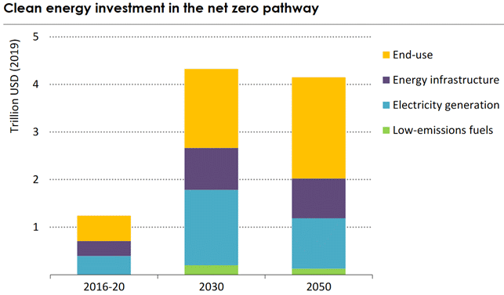
Massive increase in investments
Source: IEA Net Zero by 2050 Roadmap

Slide 4
Investments in uncertain times:
Risks matter
Volume
Power sector:
Strong growth in demand and supply
Interdependency of both
What will market prices do?
Demand
Supply
Time

Slide 5
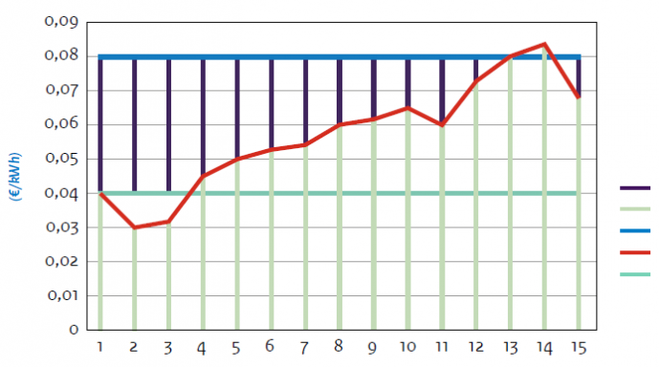
Dealing with risk:
Public policy solutions
Flexible subsidy (SDE++, SCE)
Contracts for Difference
Combined tenders:
  Demand + Supply e.g.
    Offshore wind +
    Industrial electrification
Subsidy
Market price
Production costs
Correction rate
Base price
Project runtime (yr)
Source: RVO

Slide 6
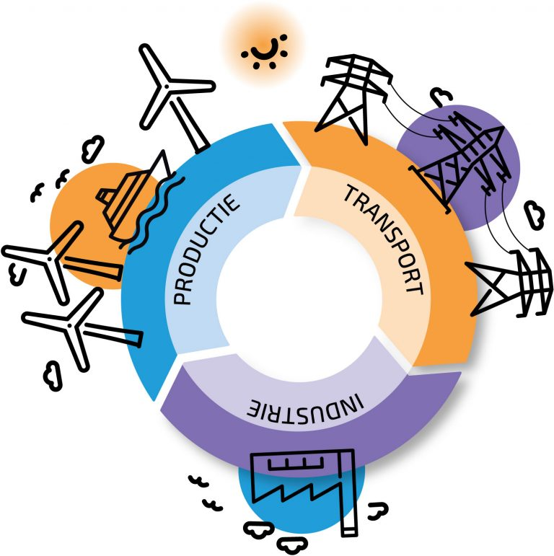
Market-based solutions
Power Purchase Agreements (PPAs)
Full-chain projects (demand-supply)
Trends:
  From stand-alone projects towards chain integrated approaches
  From government risk takeover to market-based solutions
  From technology specific support to generic policy instruments
  Crucial role of infrastructure: a challenge to deal with
Source: Energie-NL

Slide 7
Thank you
Marc Londo
marclondo@nvde.nl
www.nvde.nl
Interested in our monthly newsletter (in Dutch)?
Apply here

