Slide 1
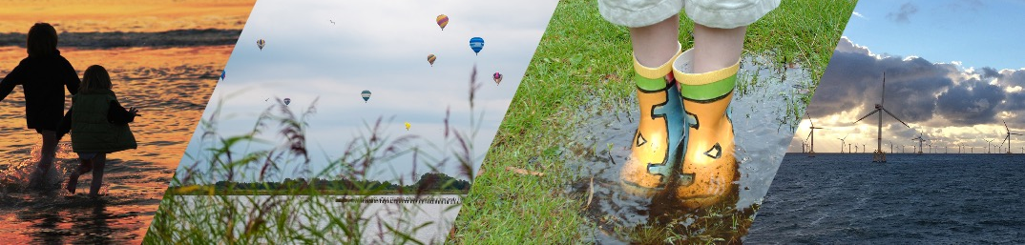
Towards a 100% Renewable Energy system in the Netherlands: the challenge of achieving a Rapid Roadmap
NETHERLANDS ASSOCIATION FOR RENEWABLE ENERGY
Teun Bokhoven – President NVDE
December 8, 2021

Slide 2
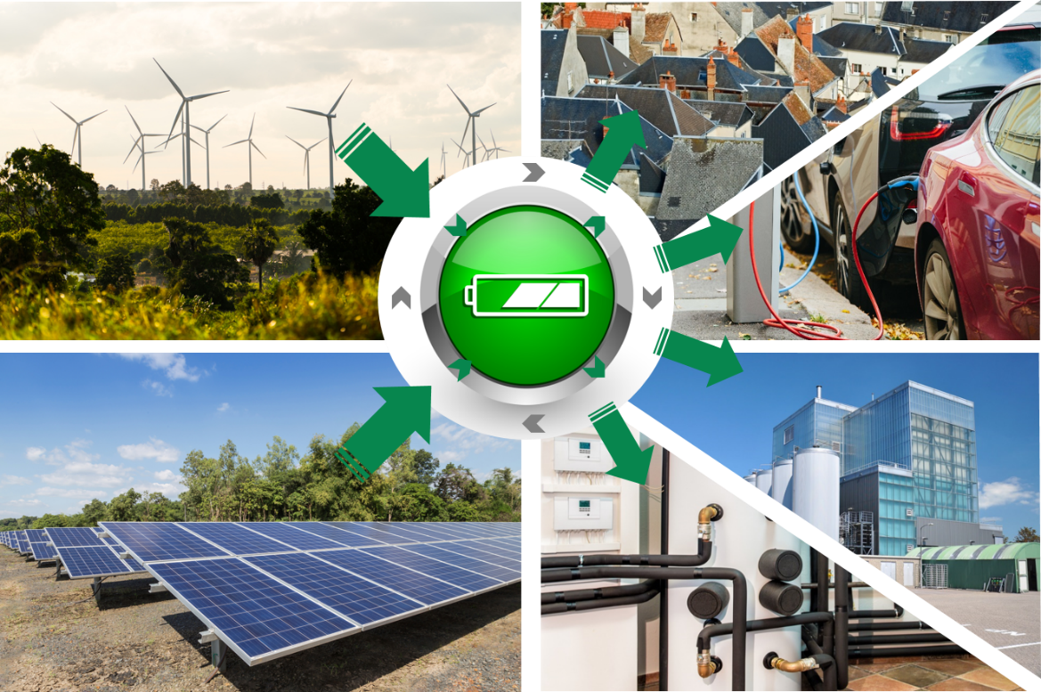
Decarbonizing the energy system
  Decarbonisation calls for renewables
  Electricity moves into the heart of the system
  System integration required for sector coupling
  Provide energy at the right place, time and form
  Additional infrastructure and flexibility options required to bridge the gap in time

Slide 3
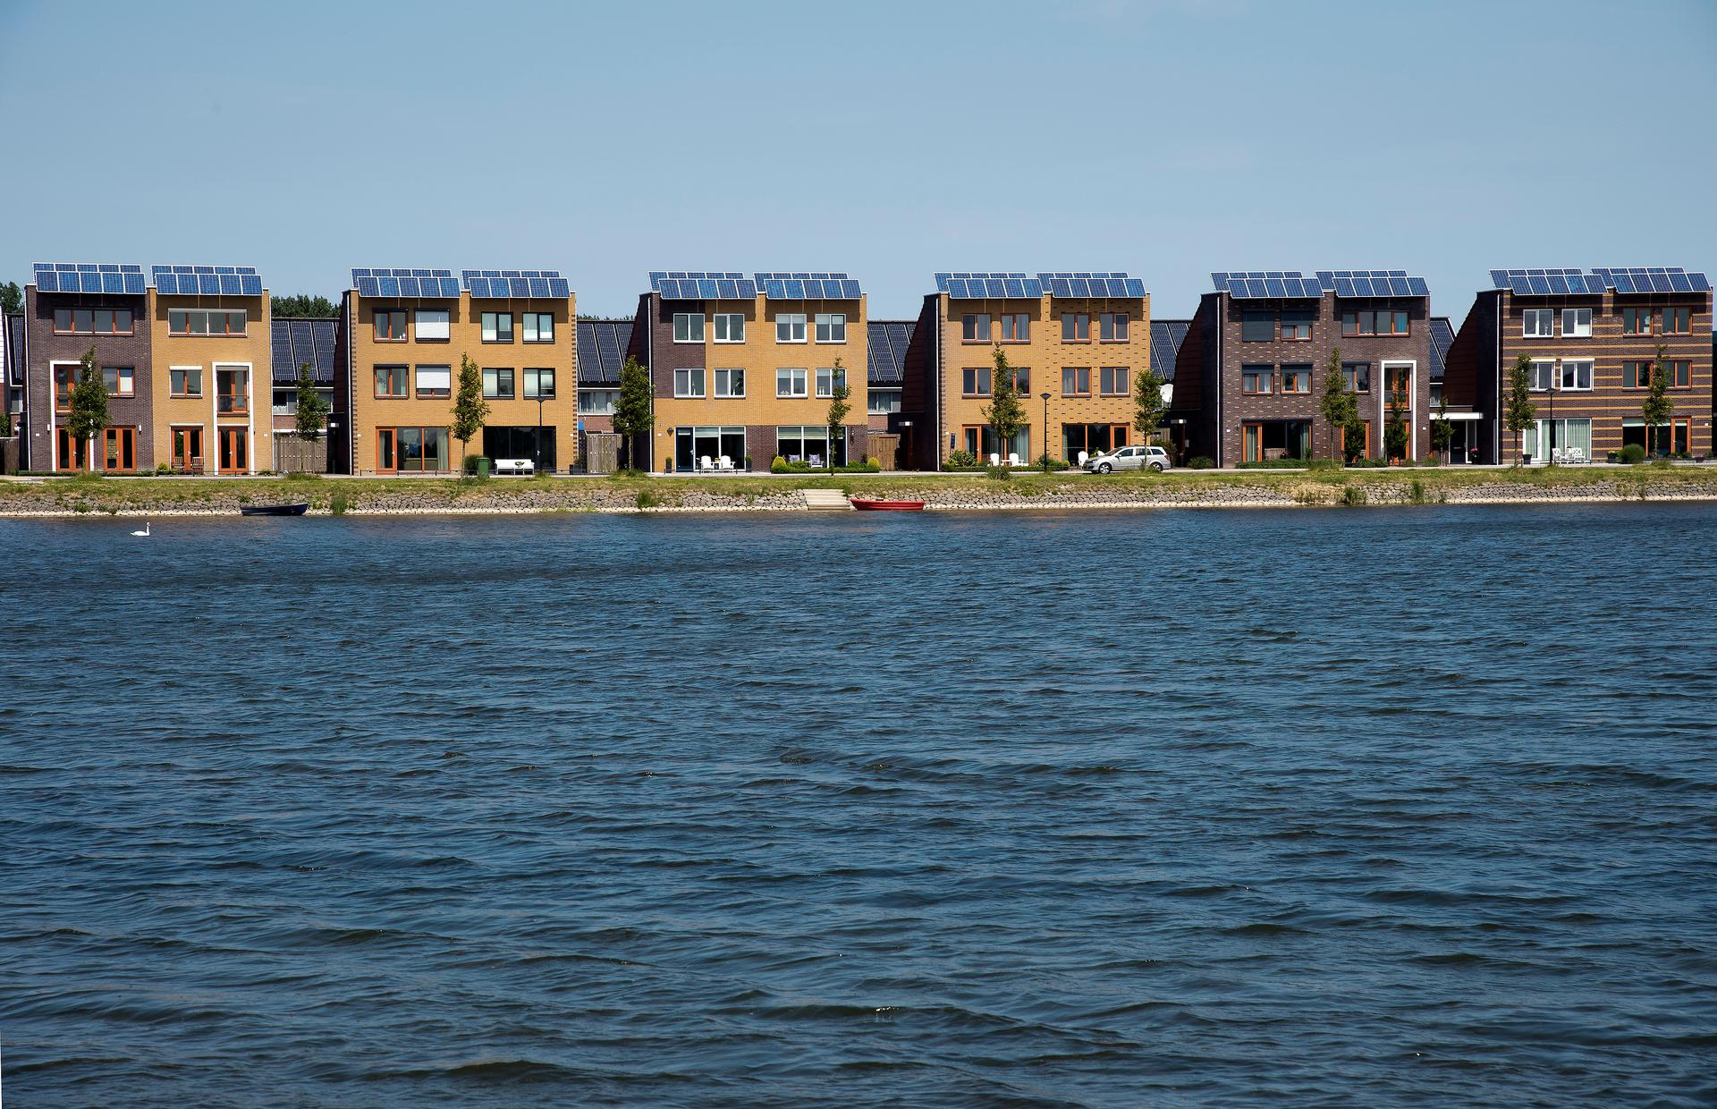
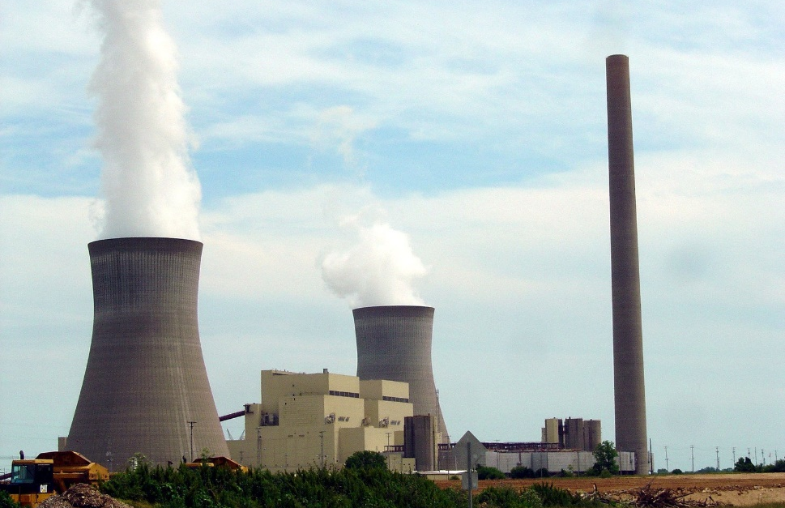
Some Dutch challenges
  Densely populated
  Energy intensive industries
  Geographical limits for renewables
  Crowded infrastructure
  Transition, away from natural gas

Slide 4
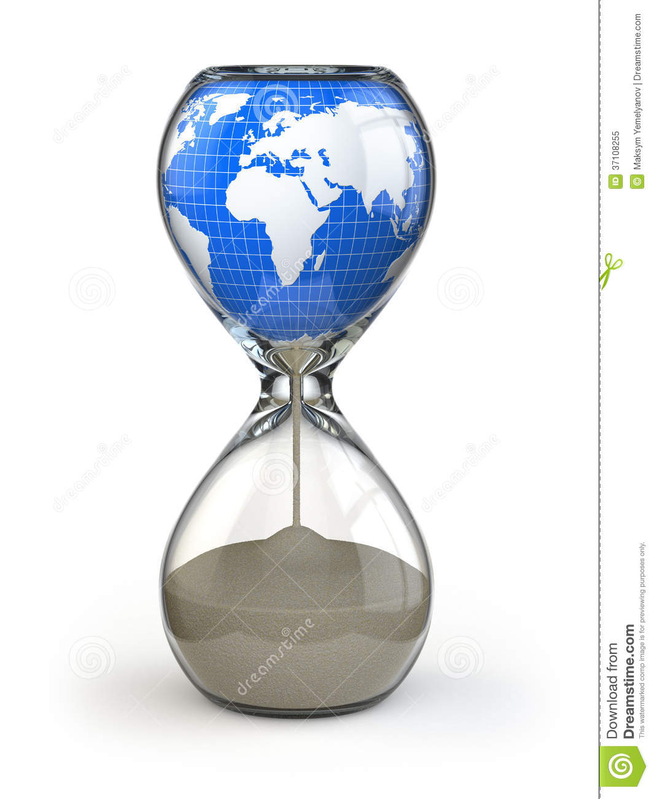
Urgency
  NL behind schedule (RES, CO₂ reduction)
  Fit for 55% → exponential challenge
  Legislation not fit for new challenges (slow and complex)
  Time for choices and (financial) commitment
Source: EIA

Slide 5
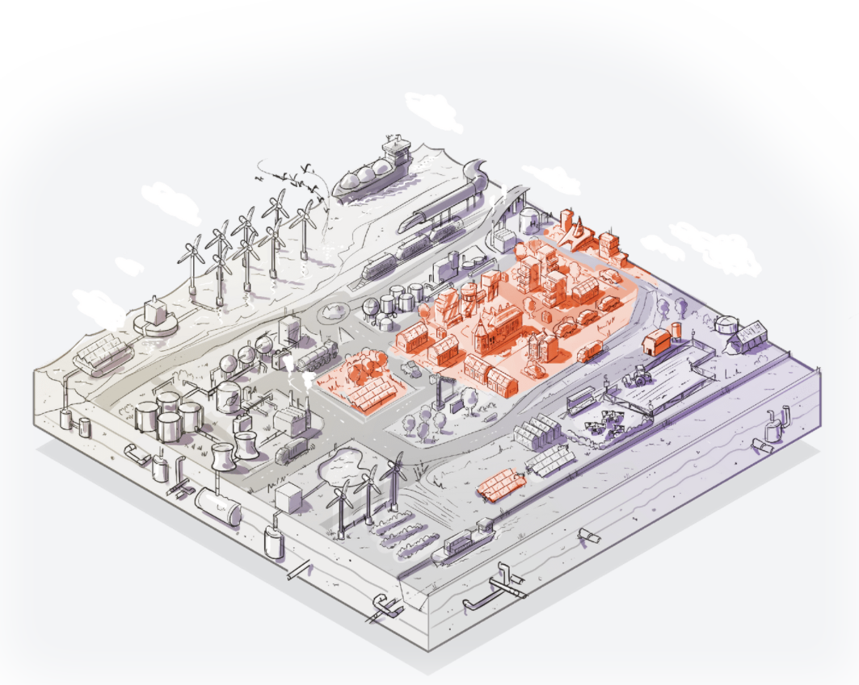
What, who and how
  What: targets for infrastructure, flexibility, spatial planning, legislation, etc
  Who: Public, Private + Politics for crucial choices
  How: Roadmap to fill in the ambition and targets + commitment to do what is required
Source: EIA

Slide 6
NVDE
https://www.nvde.nl/

