Slide 2
An EU perspective on how to get Member States on board for ambitious energy efficiency policies
Paolo Bertoldi
Senior Expert
European Commission Joint Research Centre

Slide 3
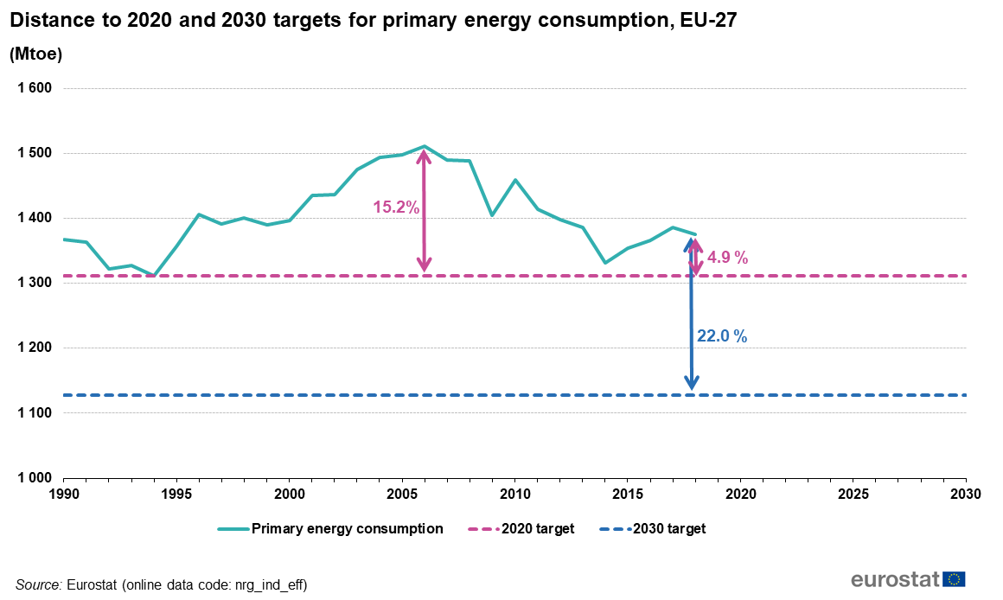
EU 2030 Energy Efficiency Targets
Energy Efficiency target for 2020 set at 32.5% compared to BaU scenario

Slide 4
Barriers to Energy Efficiency

Slide 5
Key Policies Instruments
Regulatory | Building codes; Minimum energy performance standards (MEPS) for new and existing buildings; Energy efficiency standards for appliances & equipment; Refurbishment obligations; Procurement regulations; Phase-out of inefficient equipment. Mandatory energy labelling
Financial and fiscal | Grants/subsidies; Preferential loans; Tax incentives; Energy taxation.
Information and awareness | General Information; Information campaigns; Information Centres; Energy Audits; Energy labelling schemes; Governing by Example; Information exchange; Awareness campaigns; Demonstration programmes; Energy consumption feedback; Smart meters and smart billing
Qualification, training and quality assurance | Professional training; Training courses; Vocational education, Quality standards.
Market-based | Incentives facilitating Third Party Financing / ESCOs; Energy Efficiency Obligation Schemes (EEOSs); White certificates; Incentives for the producers of innovative technologies; Technology deployment schemes.
Voluntary action | Voluntary certification and labelling programs; Voluntary and negotiated agreements.
Infrastructure investments | Investments in transportation infrastructure (e.g. railways, road networks), energy infrastructures (e.g. generation plants, electrical grid, substations, and local distribution); Smart meter roll-out.
Other | Other measures that do not fall under one of the above categories.

Slide 6
Main EU policies for Energy Efficiency
Energy Performance of Buildings Directive (started in 2002, last amended in 2018)
Building standards for new and existing buildings; EPC; LTRSs;
Energy Efficiency Directive (started in 2012, last amended in 2018)
Art 7, MSs’ Targets, Central Gov. Building, Audits, Metering, EnPC
Ecodesign Directive (started in 2005, last amended in 2009)
Many products are now covered
Governance Regulation (2018)
NECPs (before NEEAPs under EED)

Slide 7
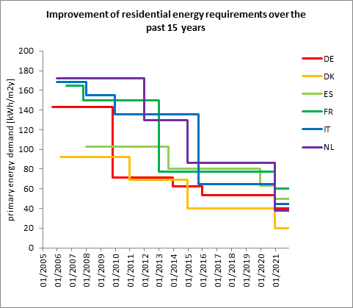
Impact of the EPBD

Slide 8
Building Renovation Strategy
Existing buildings are the major part of the building stock, many built before any building code or performance standard was in place, hence poor energy performances. Many of these building will be still in place by 2050.
Energy renovation is around 1% per year of the existing building stock, it will take about 100 years to renovate these buildings.
There is the urgent need to increase the renovation wave >3% per year and the depth of the renovation, towards NZEBs.
The Green Deal has proposed the Building Renovation Wave. Key issue is removal of barriers and financing.

Slide 9
Co-benefits of Energy Efficiency
Building renovations will increase the value of the property and will also improve the indoor climate and air quality.
Reduction of heating demand will also improve outdoor air quality in cities (big problem in some regions in Europe)
Energy efficiency will reduce energy poverty, i.e. household not able to pay for the energy bill (even more important after the Covid-19 crisis). It is estimated that more than 50 million households in the European Union are experiencing energy poverty.
Energy efficiency will results in creation of local jobs in particular related to the renovation of the buildings.

Slide 10
Policies Considerations
Some policy instruments may be better suited than other for the building renovation, but there is no single policy that alone will be enough. Examples are:
Energy Company Obligations
Targeted subsidies for energy poor households for insulation, efficient boilers and appliances. Better use of public money for investing in EE than subsidizing energy.
Tax deduction schemes and zero interest loans.
Energy tax, but could also be difficult to implement, as may have an heavy impact.
Attention to distributional impact of current EE policies and the rebound effect after the EE measure has been implemented (EE measure increasing energy consumption).
Energy refurbishment of rented apartments may lead to gentrification if rent is substantially increased.

Slide 11
Conclusions
Energy Efficiency is key for the de-carbonisation of the EU economy. In particular in the building sector.
MSs Energy Efficiency measures and policy complement the EU ones and are reported in the NECPs. Final NECPs are under analysis by the EC.
Measures for buildings in place and planned are reported in the 2017 LTRSs, and will also feature in the new 2020 LTRSs.
There are many co-benefits due to Energy Efficiency .

Slide 12
Thanks
Contact paolo.bertoldi@ec.europa.eu

