Slide 1
New opportunities for Renewable Energies for Slovakia in the context of Recovery Ján karaba / SAPI

Slide 2
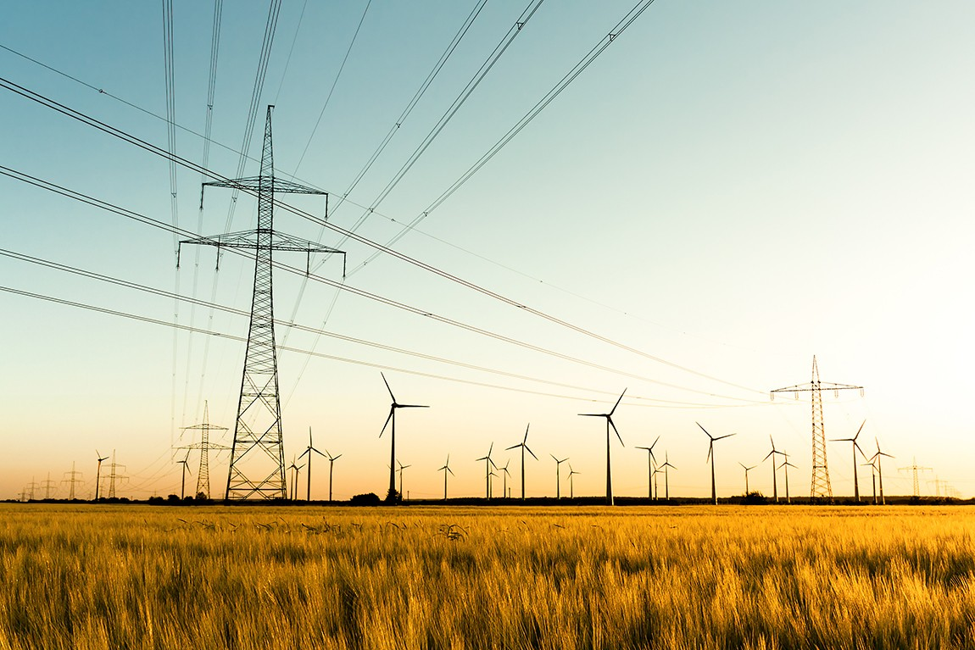
Main reasons for RES limp in Slovakia
Stop status for grid connection since 2013: still in place for RES above 10 kW with direct grid feed-in or above 500 kW (excl. CHP for district heating) in general
Network charges: not in line with EU Regulation 2019/943:
Grid connection fees at 100 – 120 EUR/kW for mid voltage level (22 kV)
G-charge way above 0,5 EUR/MWh at DSO level, complaint to European commission submitted on Oct 13, 2020
No completed auction for new RES: crucial for large-scale RES, especially wind energy
Technical, administrative and legislative barriers:
Complicated and lengthy grid connection process
Prosumers prohibited from entering energy market and providing energy services
Support for RES minimized, complicated permitting process (especially EIA)

Slide 3
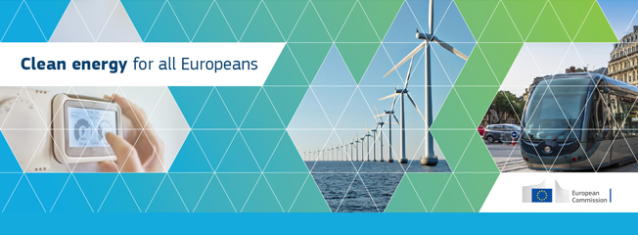
New opportunities for RES
NECP
targets
trajectories
action plan
REDII
Support framework for RES
Auctions for RES
Technical, administrative and financial barriers incl. permitting
GOs
District heating & cooling
Electricity regulation
Access to electricity markets
Priority for RES
Network charges
Internal market design
Active consumers
Prosumers from RES
CECs and RECs
Aggregators
Energy storage

Slide 4
Sustainable and ambitious RES
Prosumers
Huge untapped potential
Awaiting Clean Energy Package implementation
Minimization of barriers is necessary
Also in heating & cooling
Auctions for new RES
Legislation already in place
Necessary conditions: minimization of barriers and predictability
Suitable mostly for large scale PV and wind projects
Corporate power purchase agreements (PPAs)
For commercial and industrial consumers
Enabling framework is required
GO market
RES in 2030
PV: 1200 MW (NECP) / 1500 MW (SAPI)
Wind: 500 MW (NECP) / 830 MW (SAPI)
22,9 % of RES
in gross final energy
is possible

Slide 5
Thanks for your attention
Slovak association of PV industry and RES (SAPI)
Budyšínska 94/36
831 02 Bratislava, Slovakia
E-mail: jan.karaba@sapi.sk
Clean energy for a clean world

