Slide 1


EUFORES Workshop
Towards a new and sustainable Spanish energy system
Floating offshore Wind in Spain & some structural measures
14th Jan 21

Slide 2
Offshore Wind
Energy & Industrial Opportunity
EU = Global leading Role
Policies to keep European Supply Chain
Recovery Plans to promote big industrial & transformational projects
New mechanisms required (Deep & fast)

Slide 3

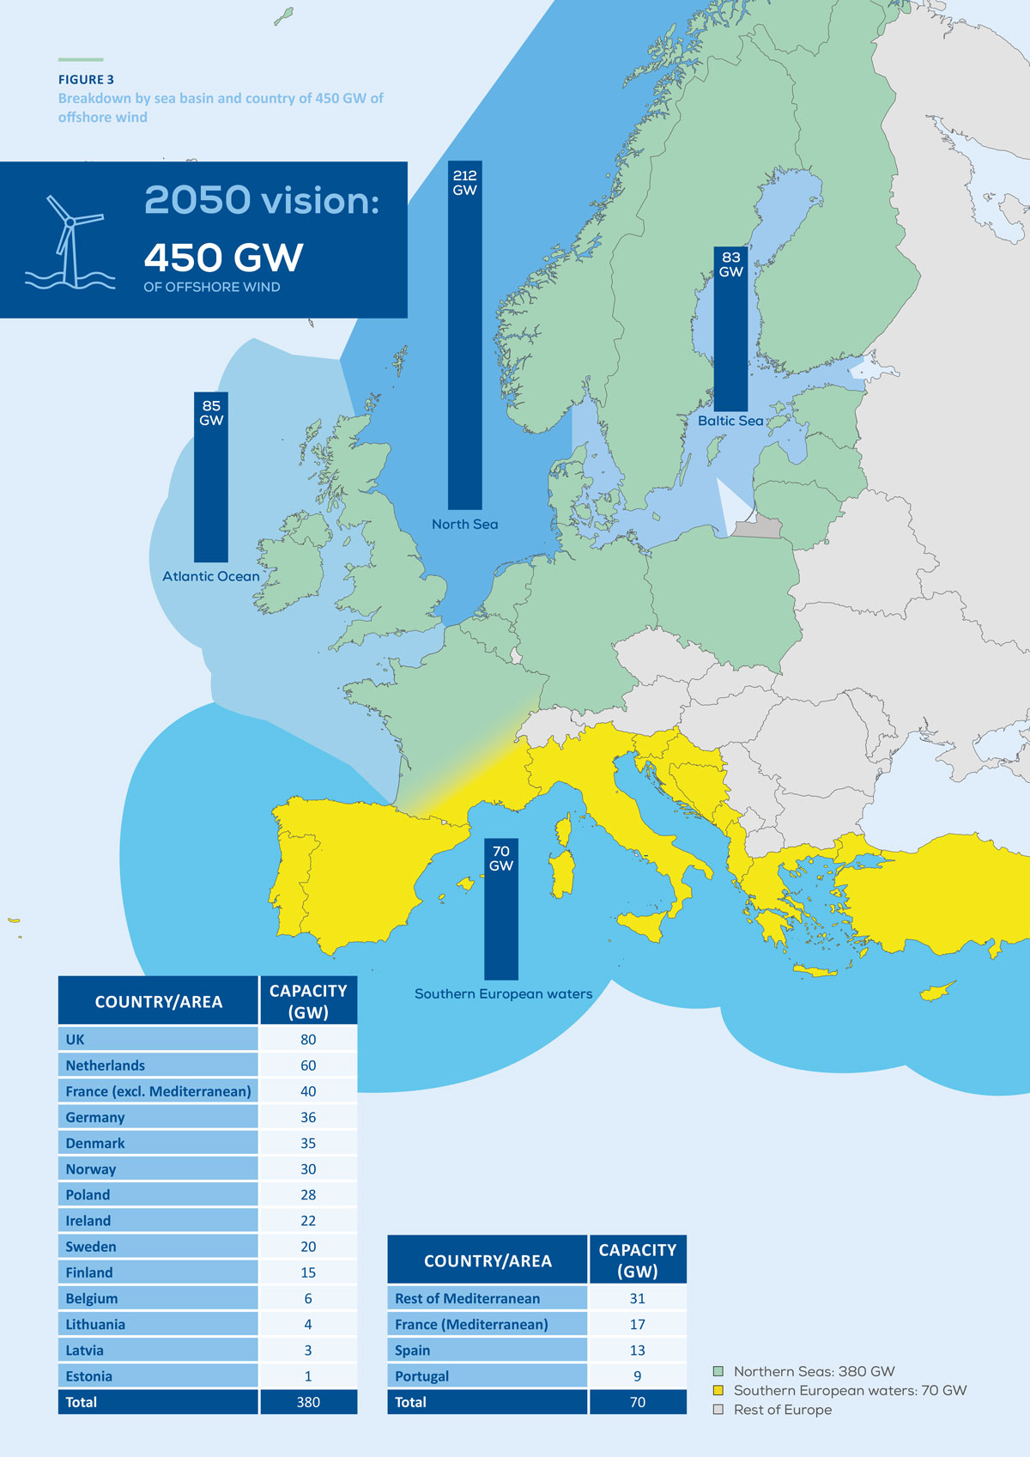
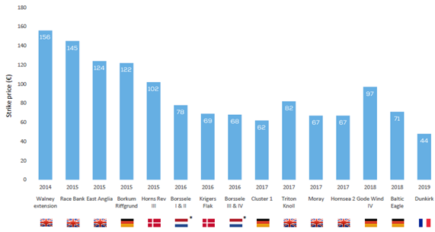
Offshore Wind European vision
44 €/MWh
Offshore Wind Auctions results

Slide 4
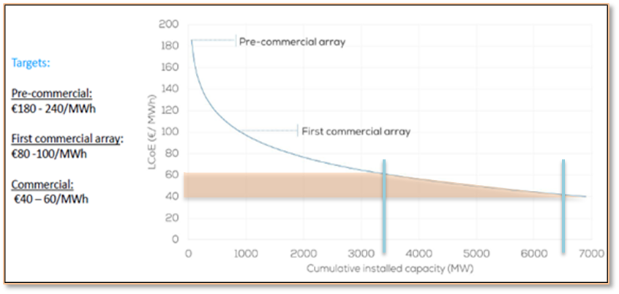
Cost reduction. Floating Offshore wind
Fuente: WindEurope

Slide 5


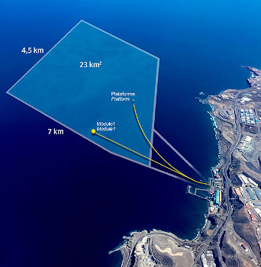
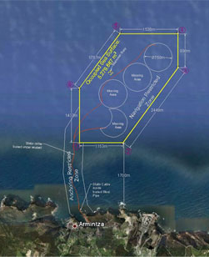
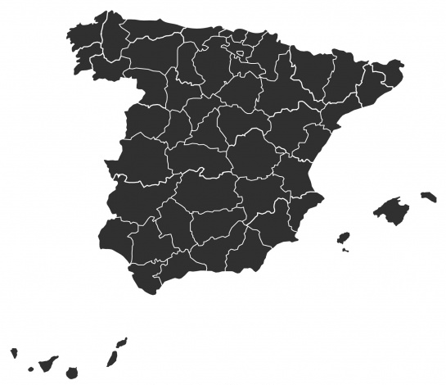
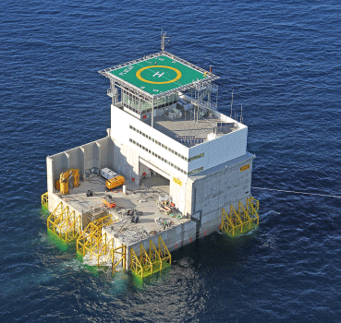
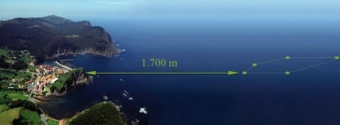
Spain. FOW Innovation Hub
Vasque Country
Canary Islands

Slide 6
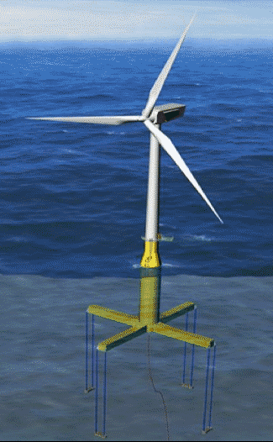
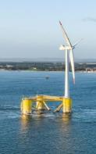
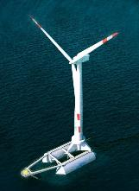
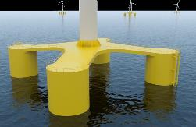
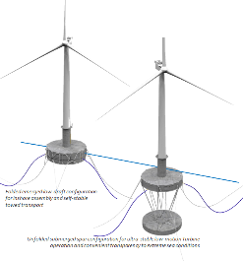
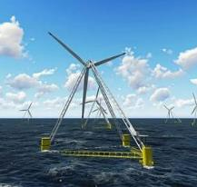
Spain. FOW Innovation Hub. Patents leadership
7 Spanish solutions out of the 27 existing patents in the World
SAITEC – SATH: Barge floating Technology. Prototype 1:6 testing in Santander (2020)
ENEROCEAN - W2POWER: Floating Wind Mulitplatform. Prototype 1:6 tested in PLOCAN (2019)
IBERDROLA - TLPWIND: TLP Design
COBRA Flotant
X1 WIND – PivotBuoy: Floating Wind power platform. Prototype 1:3 testing scheduled for 2020 (PLOCAN)
NAUTILUS: Semi-sumersible Steel floating substructure
ESTEYCO - Telwind: Improved spar tecnology

Slide 7
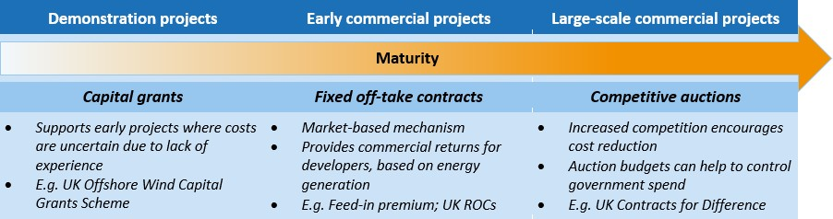
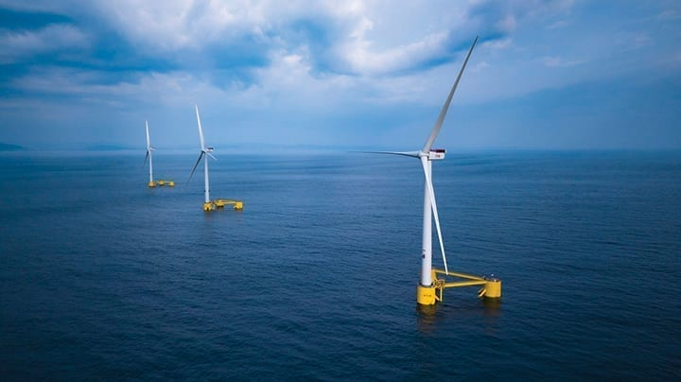
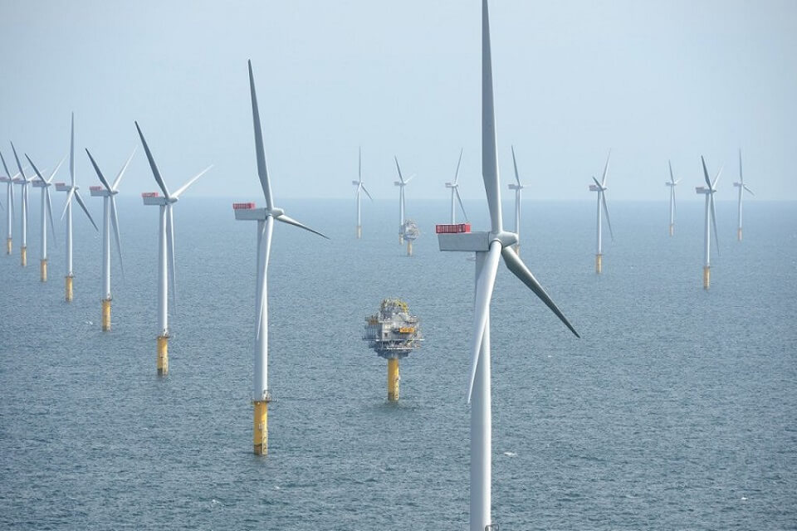
Offshore Wind schemes
Approach based on different support mechanisms depending on the Technology Maturity levels. Still under development
Source: IEA-RETD
Prototypes. CAPEX support
Experimental FOW FarmsP (3-4 uds). Specific Auction
Commercial size FOW Farms
Competitive Auction

Slide 8
Challenges
URGENT
URGENT
National Offshore Wind Strategy – 1Q 2021. 2.000 MW – 3.000 MW – specific 2030 FOW Goal
Update regulation & Policy (Zone Reserve + permitting + Auction design) – 2/3Q 2021
Already competitive in some specific locations (e.q: Canary islands) due to higher generation costs
FOW first Spanish Auction – TBD ¿2021?
NEW FOW Deep water Testing Facilities
FOW Wind Farm – Industrial Supply Chain Traction effect – First mover
Recovery Plan FOW projects

Slide 9
Wind Energy in SP – Structural challenges
Permitting – Clarify, Simplify, Coordinate, visibility – Royal Decree Law + Royal Decree.
New Auction design – next auction 26th JAN
Auctions Calendar – 2020-2025
Measures to keep Industrial Wind supply chain – major undertaking
Recovery Plan projects – 9 proposals for Wind – NEW MECHANISMS REQUIRED to assign funds Accurate & Fast
Electrification Policies – to promote decarbonization goals

Slide 10





C/ Sor Ángela de la Cruz, 2. planta 14 D
28020, Madrid
Tel. +34 917 451 276
aeeolica@aeeolica.org
www.aeeolica.org

