Slide 1
EUFORES
“Offshore Wind and the European Supergrid”
09/16/2010
Hans-Josef Fell
Member of the German Parliament

Slide 2
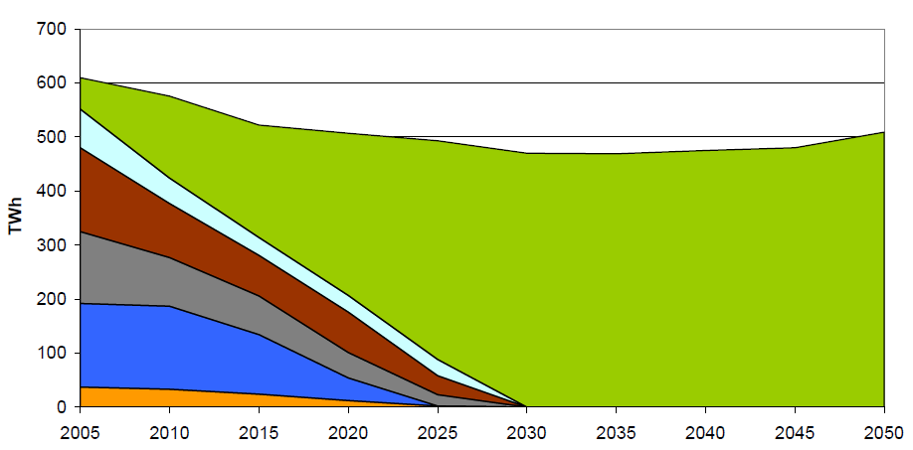
Green Power Transition 2005-2050
Nuclear
Hard Coal
Brown Coal
Natural Gas
Renewable Energies
Others
Source: Green Energy Concept 2010

Slide 3
Annual Added Capacity of Photvoltaics in Germany
- Federal Government's Energy Concept -
Projections by EWI and Co.
Source: Federal Government’s Energy Concept, BMU

Slide 4
Annual Added Capacity of Power Generation from Biomass in Germany
- Federal Government's Energy Concept -
Source: Federal Government’s Energy Concept, BMU

Slide 5
Annual Added Capacity of Onshore-Wind Power in Germany
- Federal Government's Energy Concept -
Source: BWE, Federal Government’s Energy Concept

Slide 6
Total Expansion of Offshore-Wind Power
in Germany
- Federal Government's Energy Concept -
Source: Federal Government’s Energy Concept, National Action Plan

Slide 7

Many Thanks for your Attention!

