Slide 1



EPBD – Benefits for Ireland
EUFORES National Workshop
22nd May 2024

Slide 2

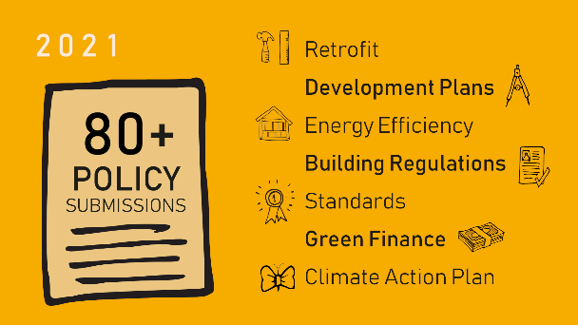
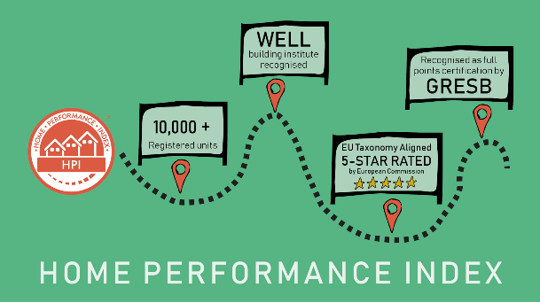

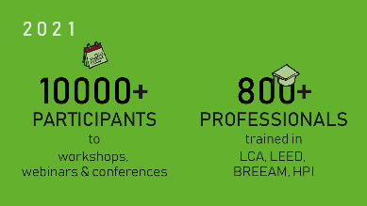
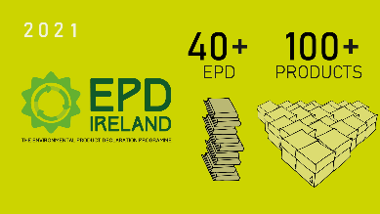




2023/ 2024
2023 / 2024
Launch of
- Healthy Homes Ireland
- Energy Poverty Report
- Upskilling Roadmap
- Building in Timber
Working Group
- Energy Renovation
Working Group
21,800 + Registered
2 1
430+
2023/ 2024
2023 / 2024
90 +
200 +
2600 +
600 +
500 + users
Communicate Collaborate Rate Educate Advocate Innovate
Introduction to Irish Green Building Council

Slide 3
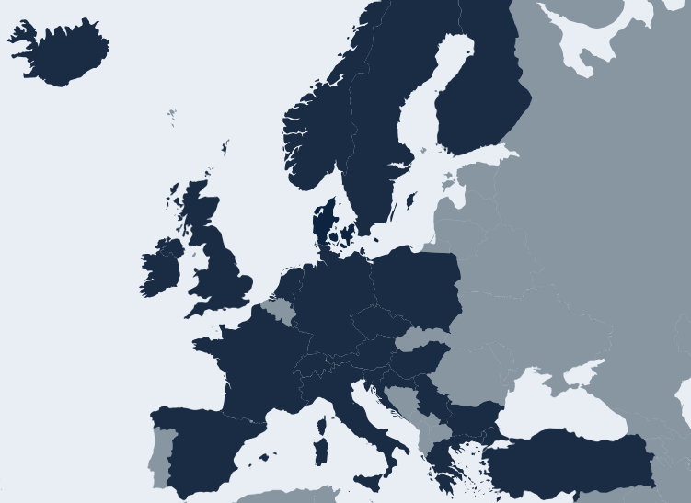


European Network of Green Building Councils

Slide 4


E v e r y p a t h t o n e t z e r o
2 0 5 0
26 years to zero carbon emissions
-6 years to halve carbon emissions

Slide 5




CO2eq
=
CO₂eq
Built environment
Agriculture
37%
Emissions
14%
Embodied CO₂eq
23%
Operational CO₂eq
Research for IGBC
UCD Kinnane, Hegarty, Wall
Impact of the Built Environment in Ireland

Slide 6
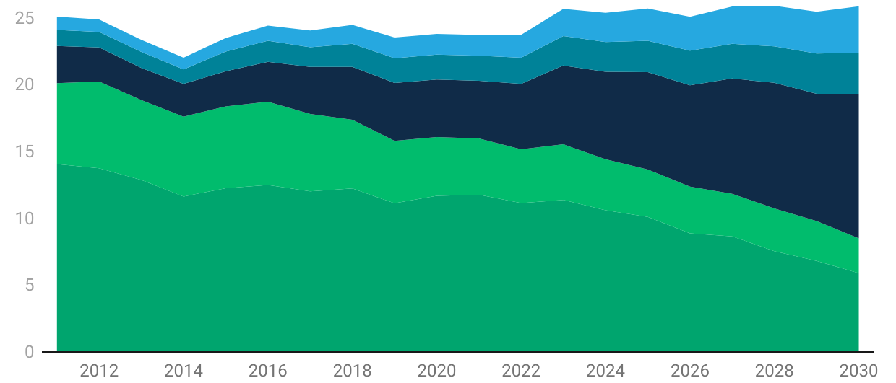
Business as usual : Embodied Carbon {EC} will double
Mega
tonnes
of CO₂ e
Embodied Carbon
INFRASTRUCTURE
Embodied Carbon
NON-RESIDENTIAL
Embodied Carbon
RESIDENTIAL
Operational Carbon
NON- RESIDENTIAL
Operational Carbon
RESIDENTIAL
GHG [ MtCO₂e ]
Chart: IGBC
Source: BIACE UCD
Created with Datawrapper
Notes:
This is where we are going if we don’t address embodied carbon through using circularity principles and existing vacant stock.
This graph shows carbon projections from different sectors up to 2030
The green bands at the bottom represent operational carbon, the blue bands at the top embodied carbon.
If we don’t regulate EC based on our existing policies, National Retrofit Plans and targets for new housing and infrastructure in the NDP, OC will be fully negated
In a business as usual scenario where we implement the Climate action plan, including 80% decarbonisation of electricity, and carrying out the 500,000 homes renovation we will see a fall in operational carbon, but the expansion of our construction programme will offset this unless we reduce the carbon intensity of construction. We actually see a slight rise in emissions.

Slide 7
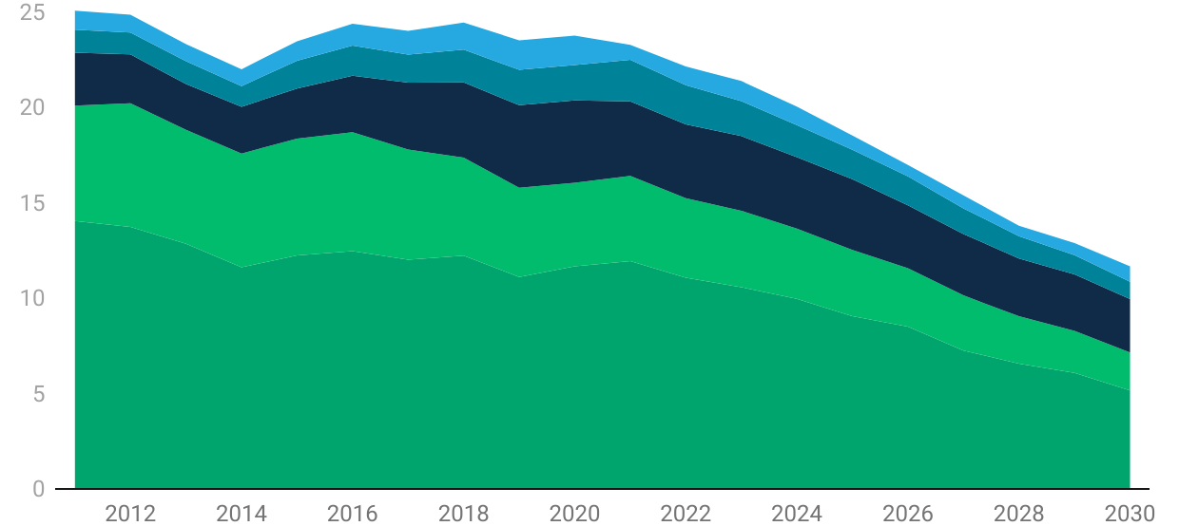
Combining additional strategies
51%
Embodied Carbon
INFRASTRUCTURE
Embodied Carbon
NON-RESIDENTIAL
Embodied Carbon
RESIDENTIAL
Operational Carbon
NON- RESIDENTIAL
Operational Carbon
RESIDENTIAL
GHG [ MtCO₂e ]
Chart: IGBC
Source: BIACE UCD
Created with Datawrapper
Notes:
Based on the Climate Act target of a 51% cut in carbon emissions we have to go further and combine a number of strategies such as reducing the area of what we need to build and reusing vacant properties.

Slide 8



Three-part strategy
Prioritise
Optimise
Reduce 50%
Prioritise Environmental
& Social needs to 2030 for ALL projects
Optimise the use of our
existing building stock
Reduce the carbon intensity
of the remaining construction
by a minimum 50% (one scenario)

Slide 9
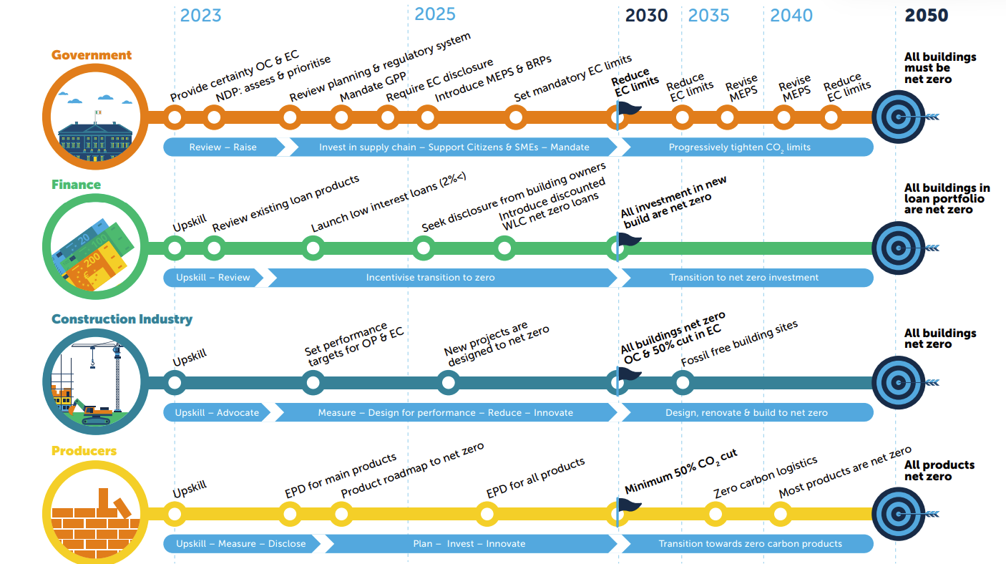
Building a ZERO Carbon Ireland

Slide 10

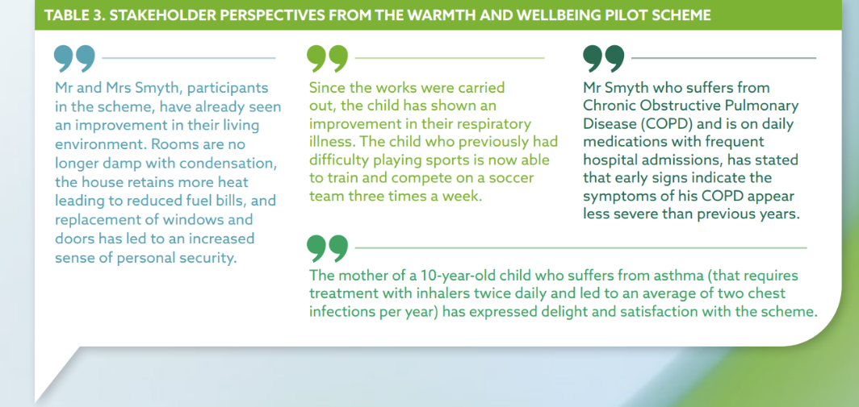
In the UK full cost to society of leaving people living in poor housing amounts to £18.5 billion (€21.3 billion) per annum.
The cost of poor housing in England –BRE 2021
Benefits of Building Renovation
Notes:
Grants available for energy audits https://www.seai.ie/business-and-public-sector/small-and-medium-business/steps-to-energy-efficienc/

Slide 11

Building renovation passport consists of two parts
1. Road map that provides you with what to do sequentially without lock-in effects
2. Log-book that will have the record of all works done , when and by whom
3. Allows effective stepped approach to MEPs
Work with Industry to develop practical implementable BRP templates.
Importance of greater level of information given to building owners for their new or refurbished home through standard Home User Manual – simple information to manage your home.
Long term planning - whole system approach
Building Renovation Passports + Home User Manual
Notes:
Quality assured and verified by highly qualified professional
Assessed and filled in by a qualified Renovation Advisor

Slide 12
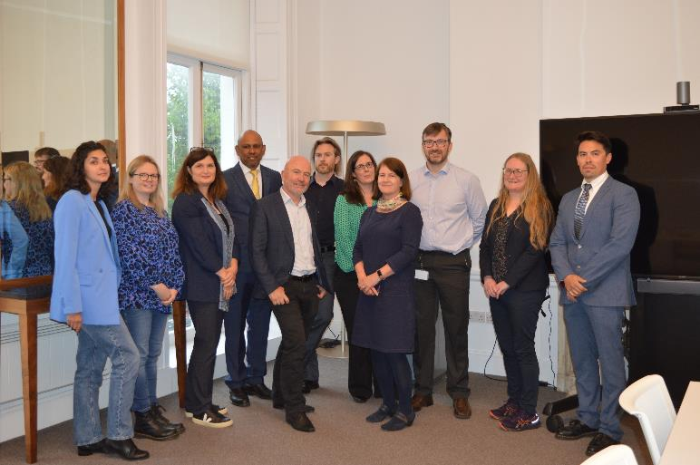


We are not waiting for Europe!
Need to move ahead of the EPBD dates
Working with RIAI (institute of architects ) to define targets for operation of ZEB buildings
but…..through designing for actual performance rather than for compliance.
IGBC working with Spain and Czechia GBCs to create the data to enable acceleration of EPBD implementation.
Ensuring that limit values for Embodied Carbon are introduced with disclosure ahead of the deadline of 2028.
Ireland can now join the leaders France, Denmark, Holland who have already done this.
Definition of ZEB buildings + GWP limits
Notes:
Quality assured and verified by highly qualified professional
Assessed and filled in by a qualified Renovation Advisor

Slide 13



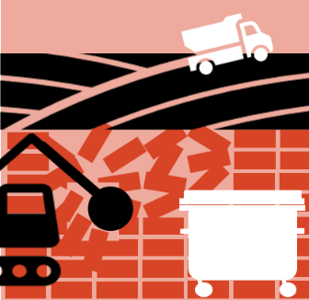














CO2
CO2
CO2
CO2
CO2
Product
Construction
Use
Maintenance
End of Life
Raw material supply
Manufacturing
Manufacturing +
Construction phase
Operations
Maintenance
Renovation + Repair
Waste Processing +Disposal
Embodied
Source: BPIE https://www.bpie.eu/ publication/whole-life-carbon-challenges-and-solutions-for-highly-efficient-and-climate-neutralbuildings/
Operational
Whole Life Carbon (GWP)

Slide 14
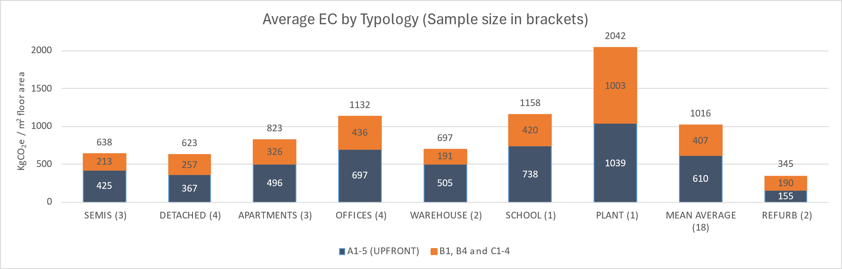

Early indicative results from #INDICATE
Notes:
EPBD mandatory measurement by 2028 at latest

Slide 15
Carbon hotspots from materials - Ireland
Key materials contributions in the total upfront embodied carbon of buildings in Ireland
Figure 3: Key materials contributions in the total upfront embodied carbon of buildings in Ireland.
Notes:
EPBD mandatory measurement by 2028 at latest

Slide 16
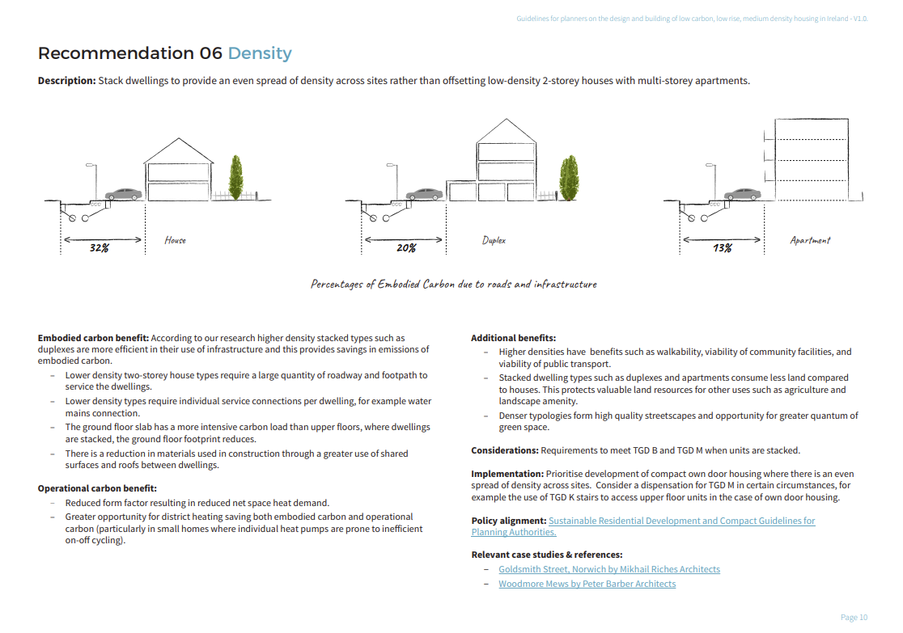
Why Typology + planning impacts embodied carbon!
Notes:
When do our emissions occur? This chart shows the carbon emissions for every year over 50 years for that same 100m2 house built to a good energy standard and meeting the RIAI target of less than 450kgCO2e per square meter up to completion – the yellow is emissions linked to the annual electricity bill….but it’s the big burp at year zero that is the elephant in the room. That is made up mainly of manufacturing materials – but also includes transporting them to site and constructing the building. There are a few more small hiccups over the years as the building is maintained, renovated and upgraded, but it is this great carbon burp at the beginning of a building’s life for which there is no real legislation. And the problem is these emissions happen now, not spread out over years with the benefit of a cleaner grid…you can see by this chart its about the same as 20 years of operational carbon…

Slide 17
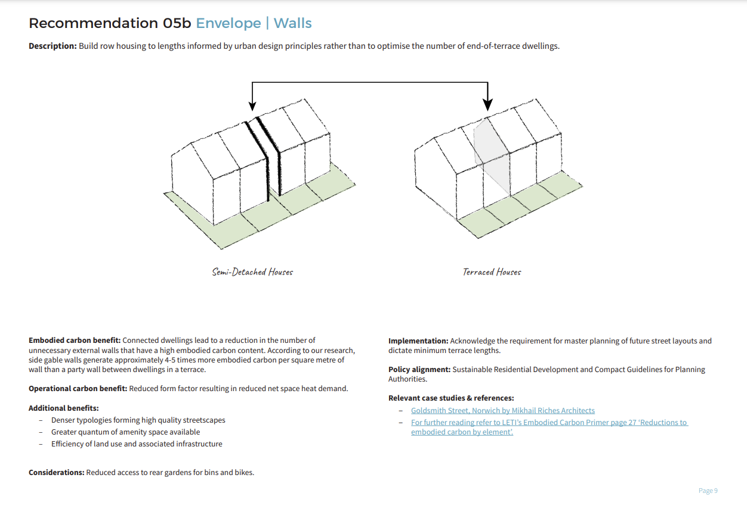

Slide 18
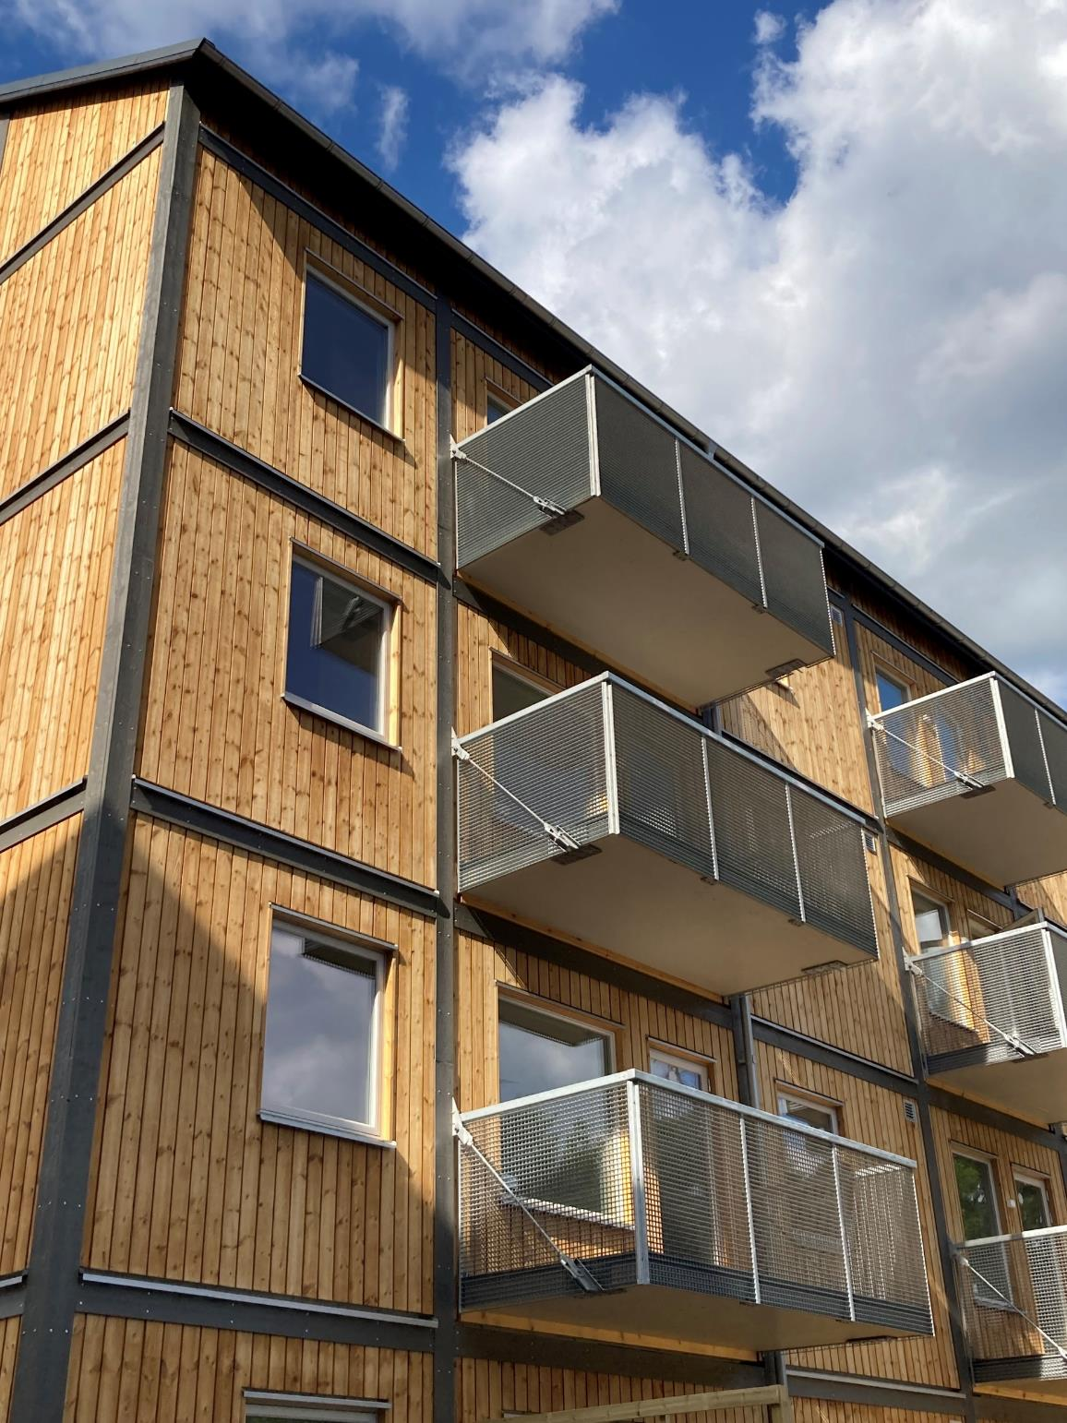
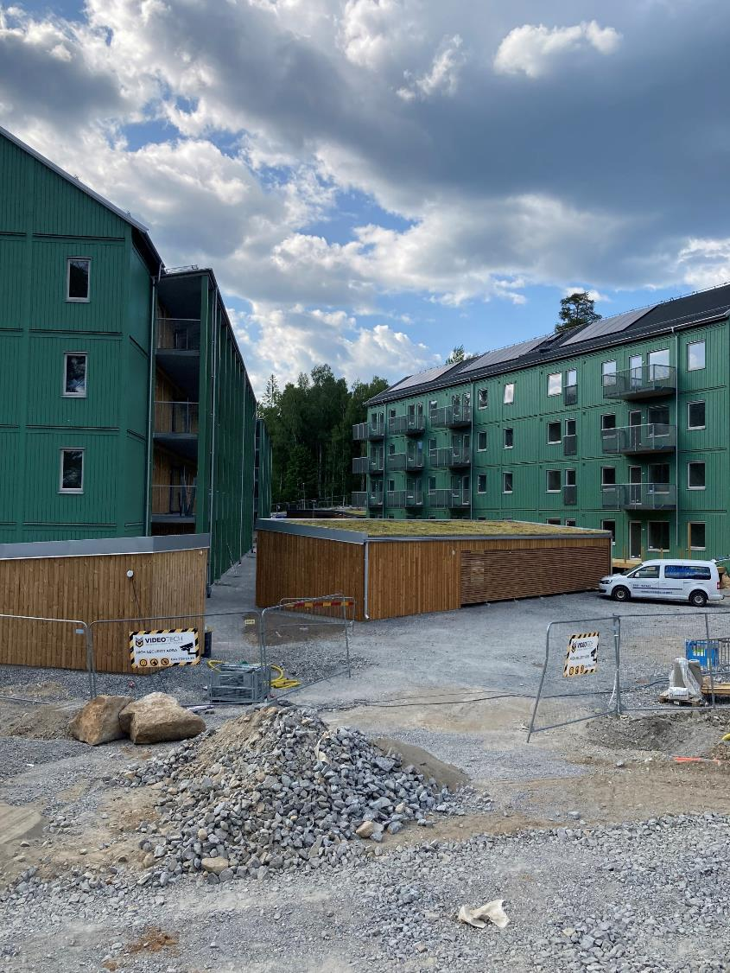

Slide 19
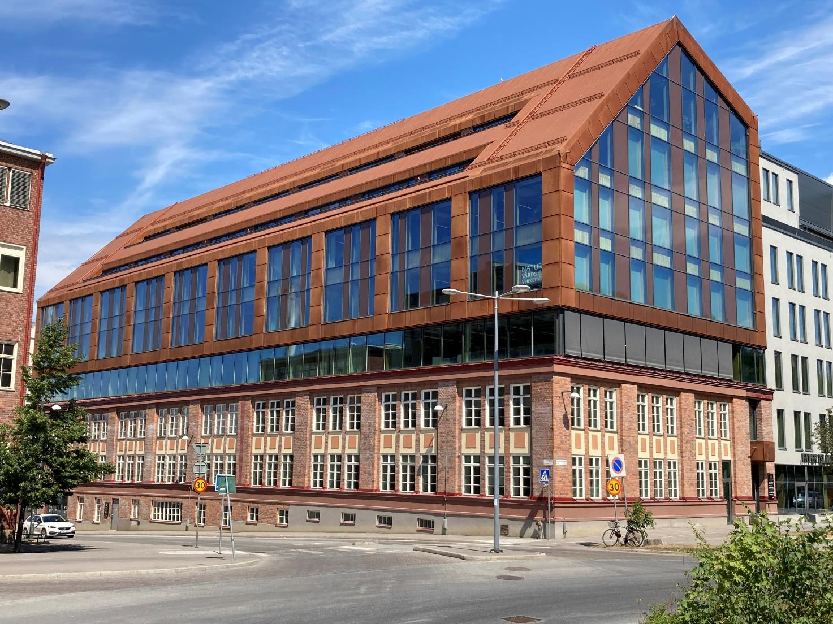
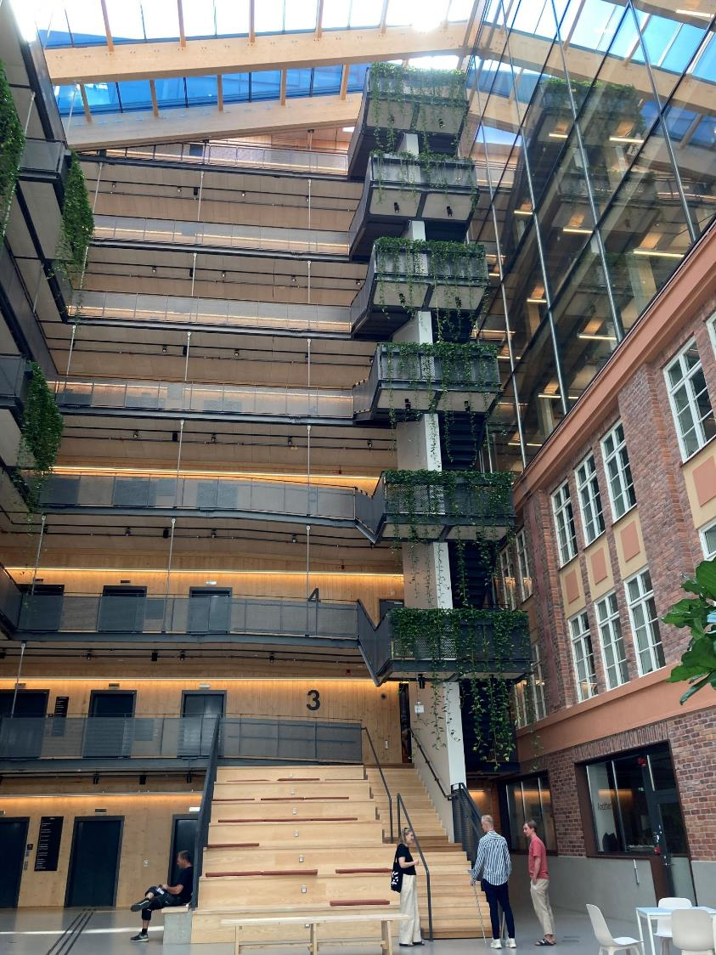
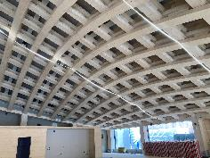

Slide 20
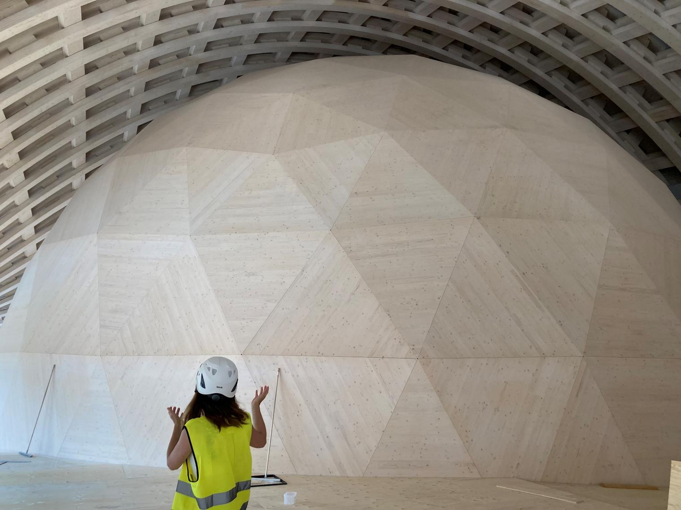
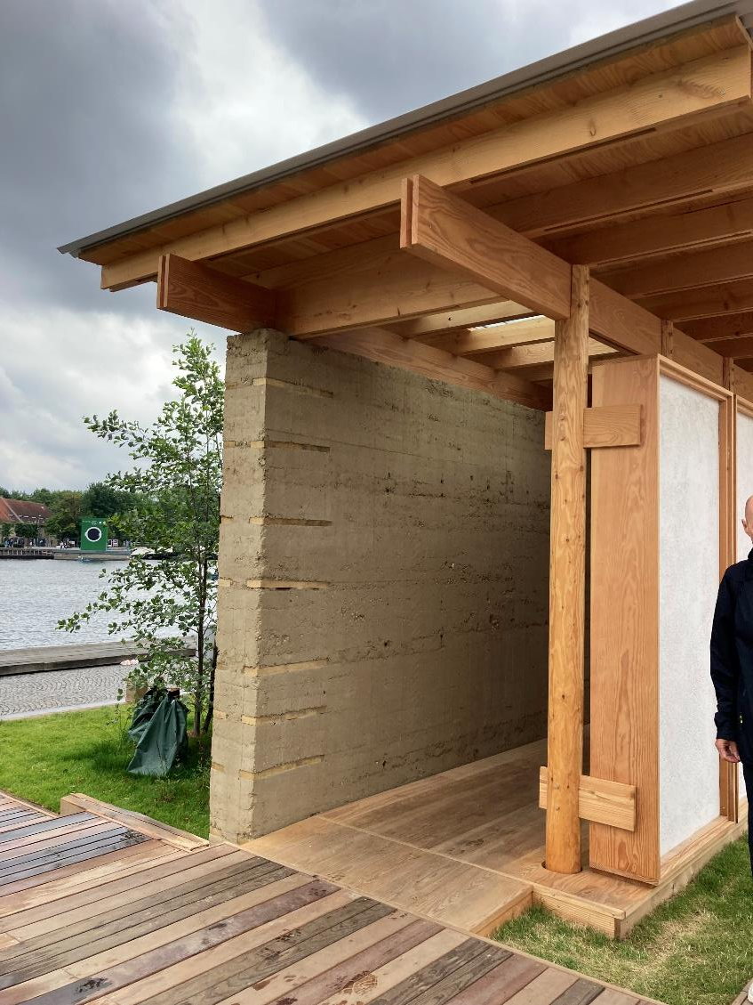

Slide 21

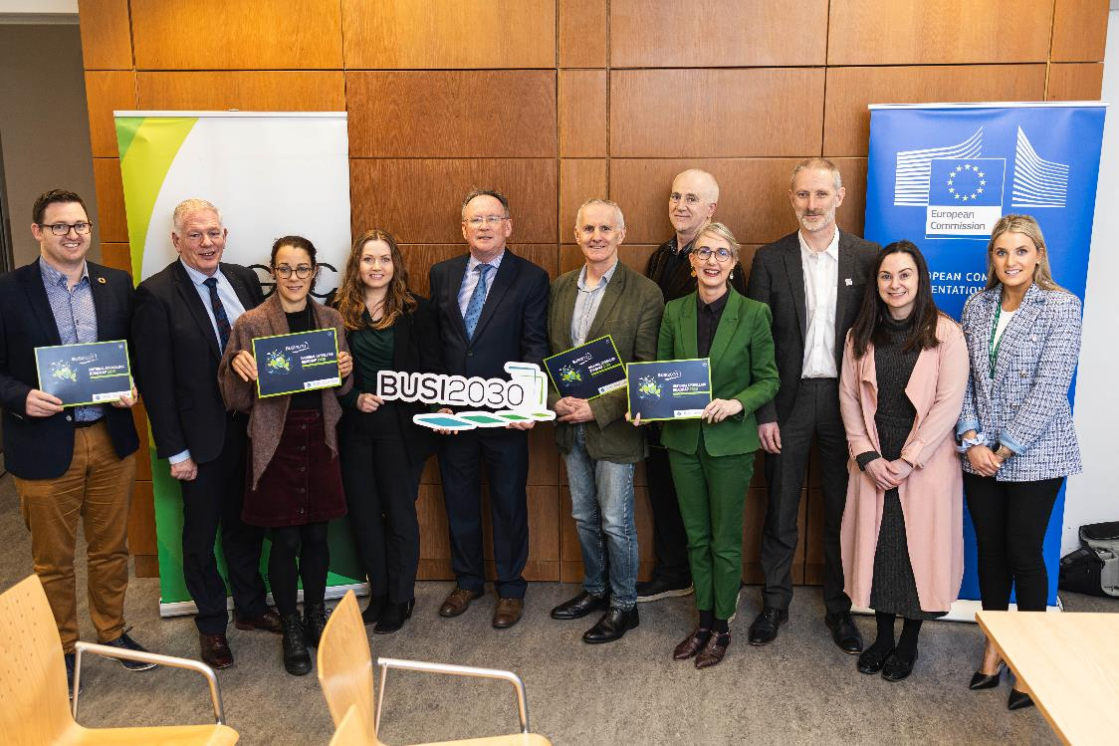


BUSI2030 TEAM
National Upskilling Roadmap: BUSI2030

Slide 22
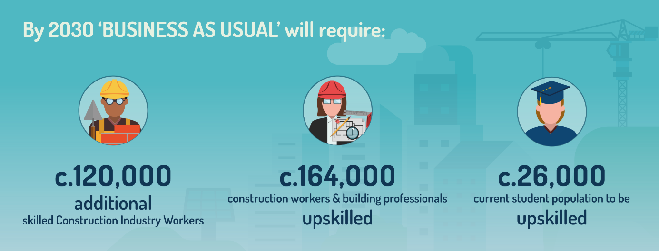
SKILLS CHALLENGES: Status Quo Report: Findings
National Upskilling Roadmap: BUSI2030

Slide 23
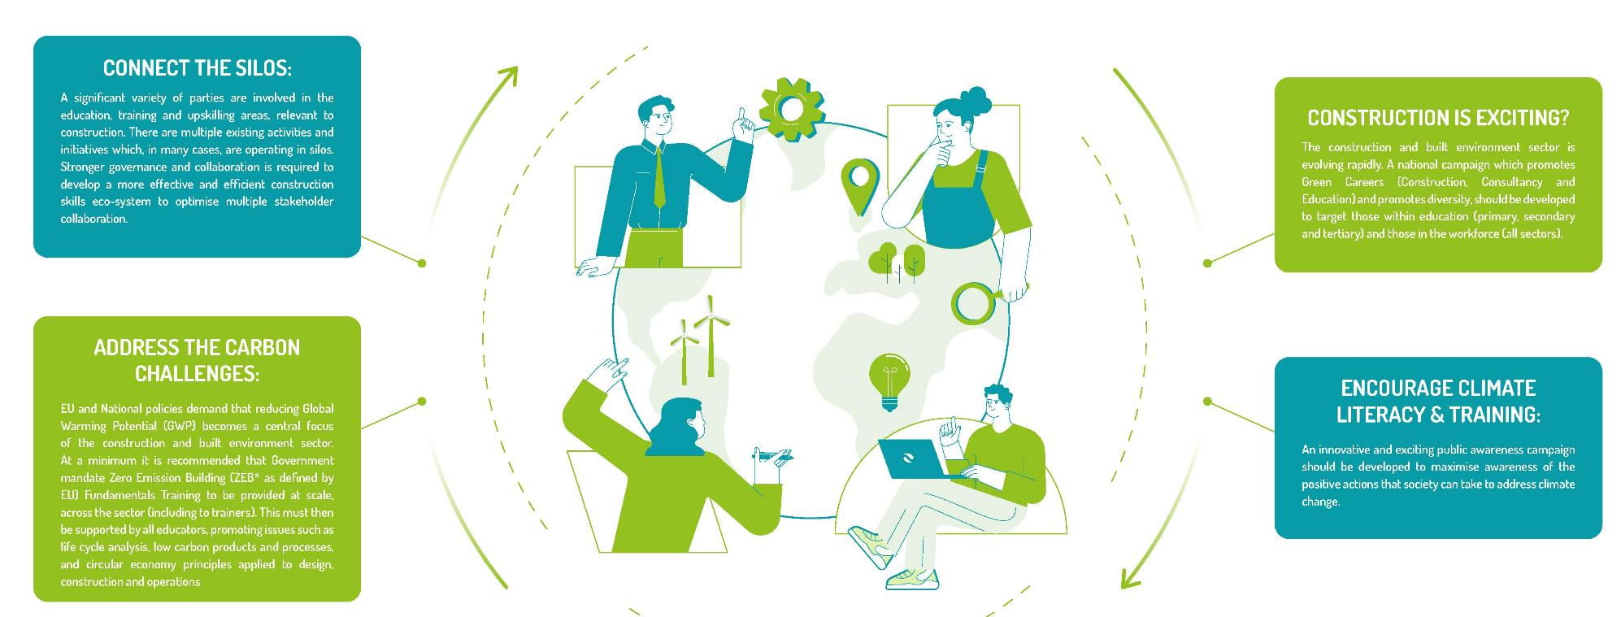
SKILLS SOLUTIONS: 4 Key Themes
Connect
the Silos
Construction
is
Exciting ?
Climate
Literacy
ZEB
Fundamentals
National Upskilling Roadmap: BUSI2030

Slide 24


Thank you
Pat Barry pat@igbc.ie

