Slide 1
Ireland’s solar revolution
22 May 2024

Slide 2
Who is the ISEA?
Introducing the trade association

Slide 3
Vision
To fully decarbonise Ireland’s electricity system
Mission
Through engagement, education and encouraging best practice, we will represent the solar industry to maximise the volumes of Irish solar generation

Slide 4
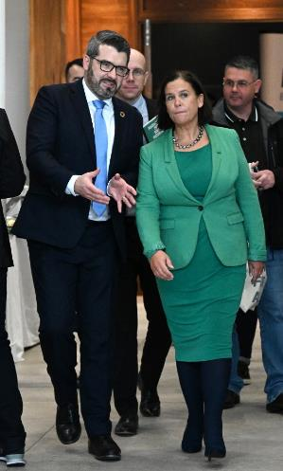
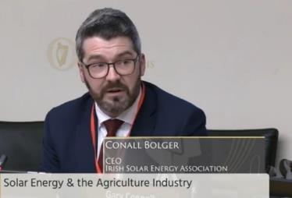
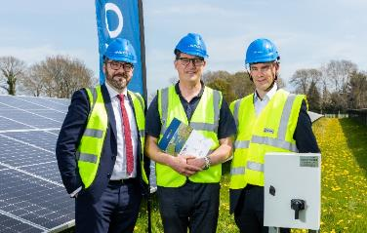
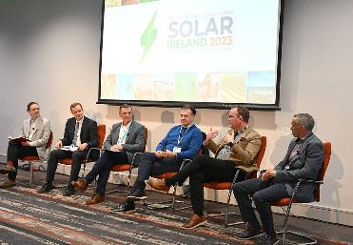
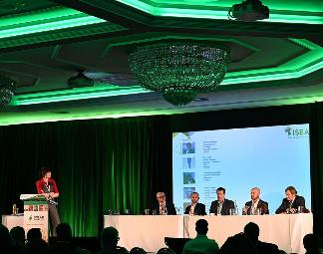
Who is the ISEA?
The Irish Solar Energy Association (ISEA) is the trade body for the solar energy industry on the island of Ireland – representing both customer and utility scale solar at local, national and European levels.
The organisation was established in 2013 to advance a policy and regulatory landscape, promoting solar as a leading renewable energy technology that will decarbonise Ireland’s electricity system, contributing to a successful and strong clean economy.
As the leading voice for the Irish solar industry, ISEA works closely with Government departments and other significant state agencies to advance the solar agenda on behalf of its members. At present, ISEA has approximately 160 members.

Slide 5
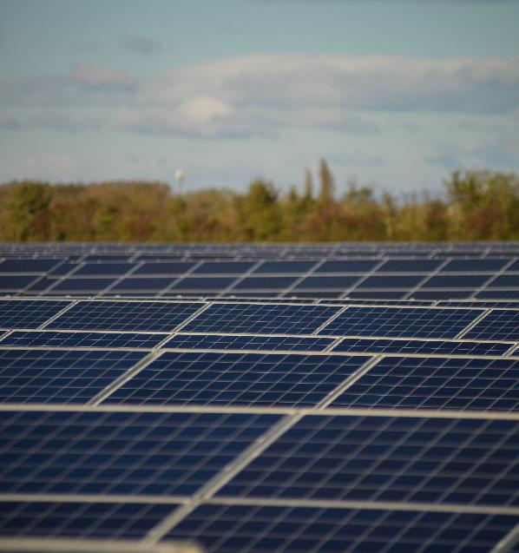
Core Values
We will pursue policies that optimise outcomes for society
Our contributions to policy will be constructive, proposing concrete positive measures that are grounded in data
We will be holistic in our view, considering solar as a significant but constituent element of the wider energy value chain
We will emphasise interventions to aid solar cost reduction
We will act ethically and with integrity

Slide 6





























































Our Members
Elite
Premium
Corporate

Slide 7
Industry status
How is Irish solar doing?

Slide 8
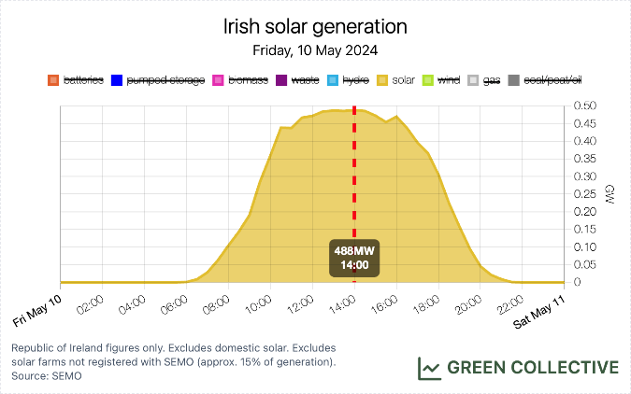
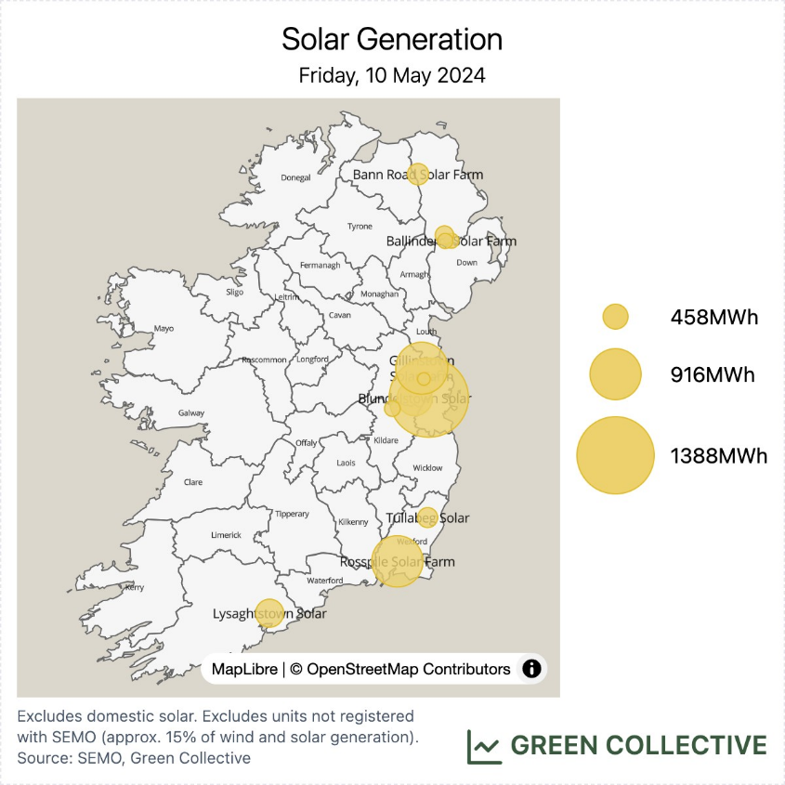
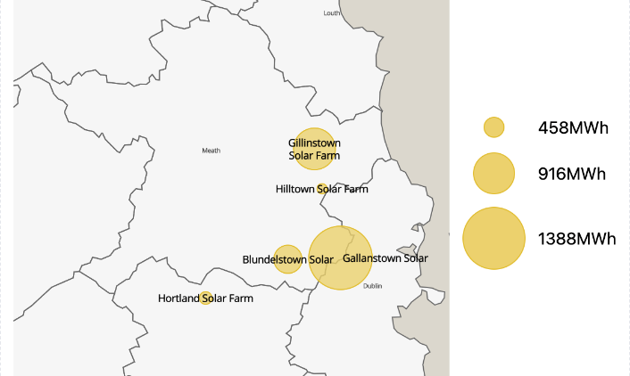

Slide 9

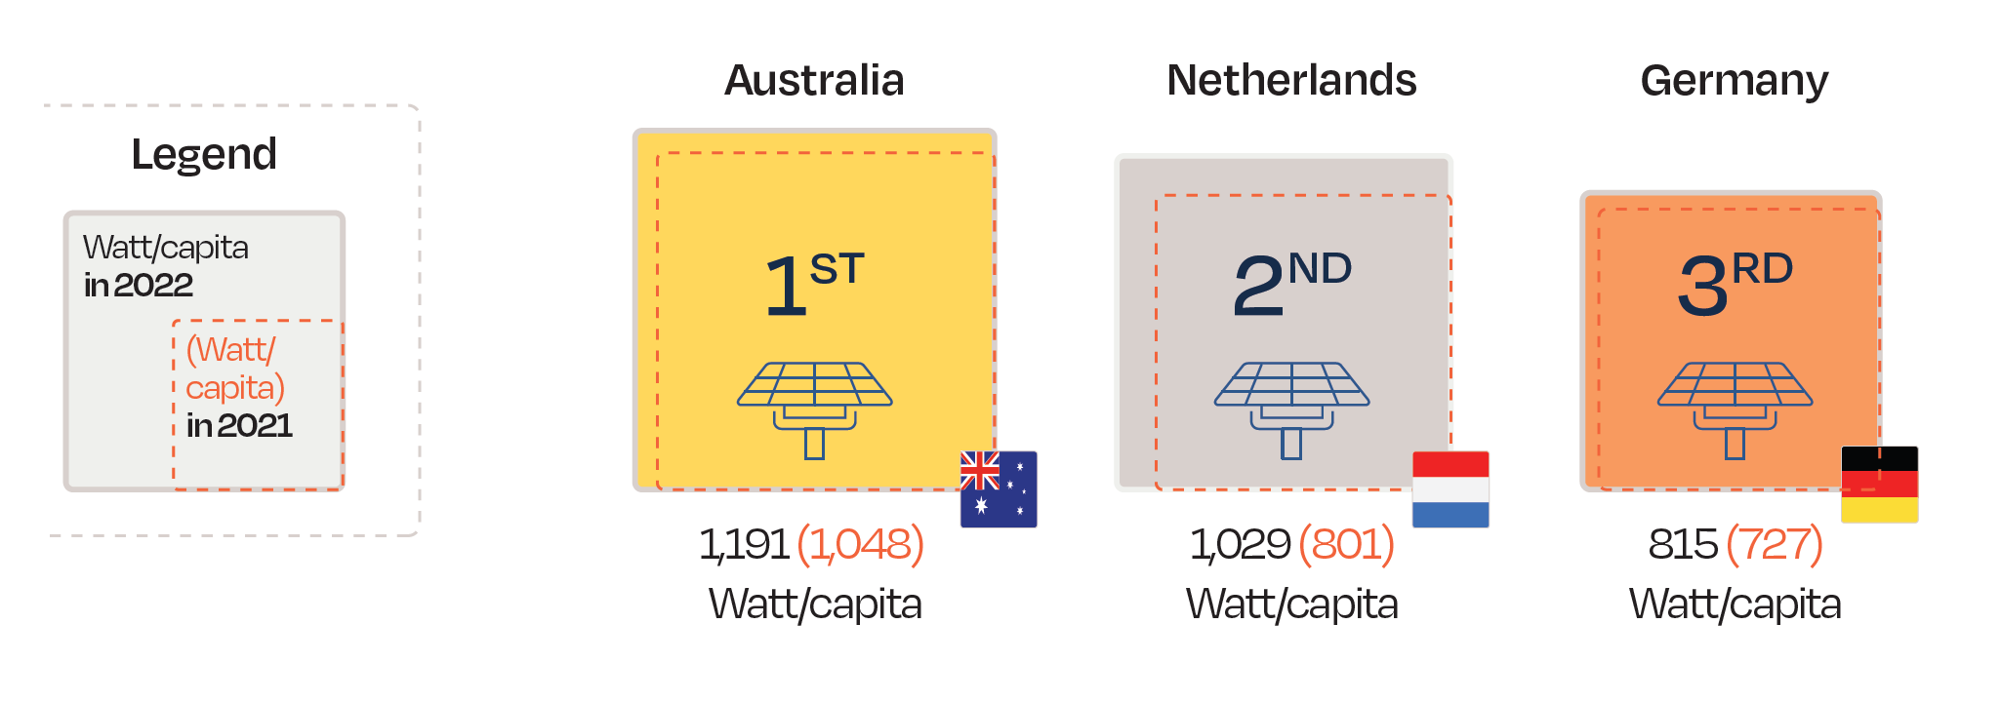
Meeting 2030 targets would put us in global solar vanguard
8GW by 2030 =
1,425 – 1,532
Watt/capita
Source: Solar Power Europe

Slide 10
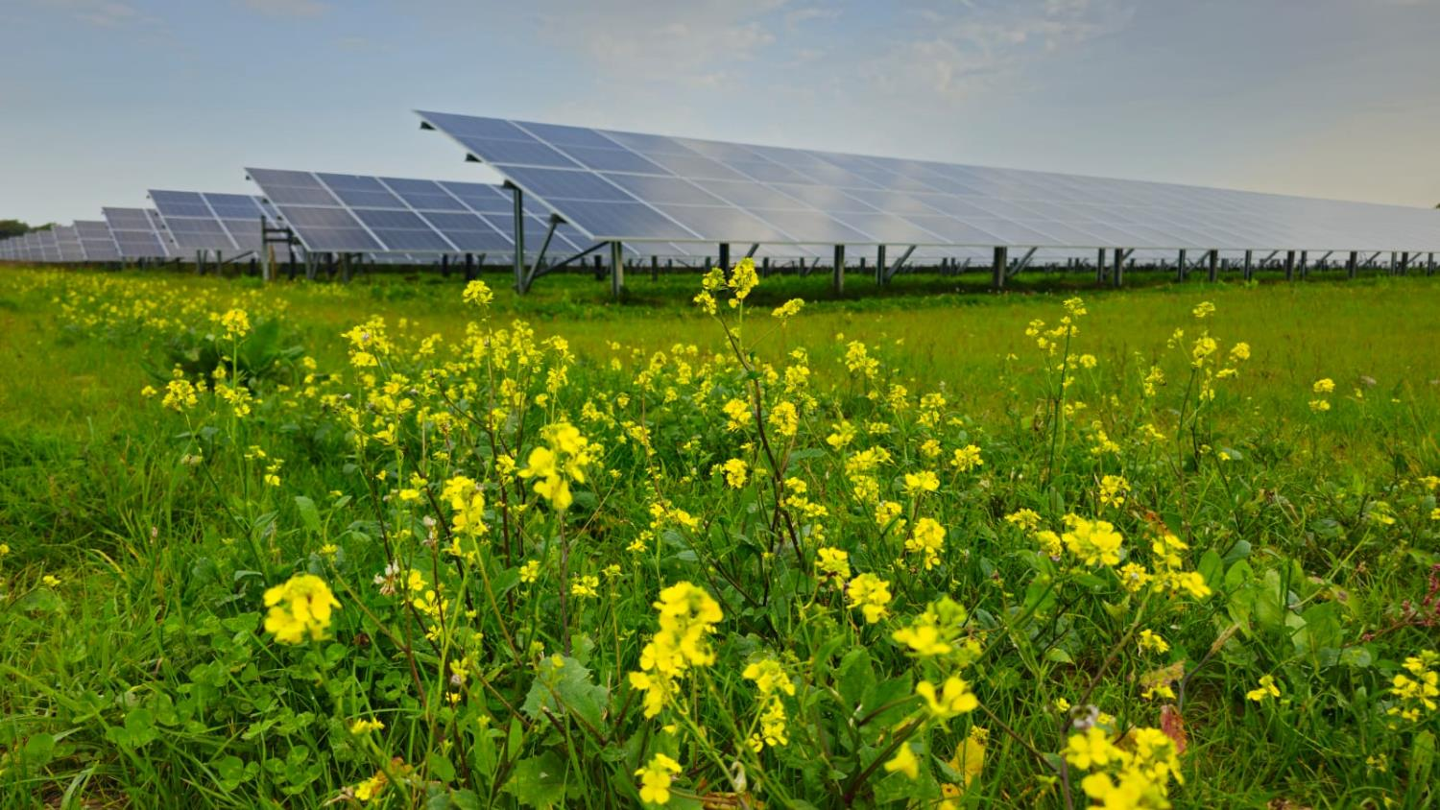
Policy changes unlocked the solar sector making it the “fastest growing renewable power source in Ireland”
Photo credit: Statkraft
Quote: ESB Networks

Slide 11
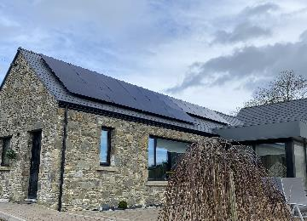
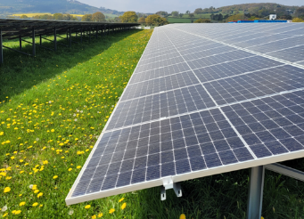
2022 – sectoral changes
Photo credits: Conall Bolger, Activ8 Solar Energies
November ‘21
2030 target of 1.5GW – 2.5GW
June ‘22
Solar awarded 1.5GW or 79% of capacity in RESS 2 auction. First auction with correction factor.
Summer ‘22
Suppliers offering export tariffs
December ‘22
2030 target increases to 8GW & 5GW by 2025
October ‘22
Residential planning restrictions removed
April ‘22
First utility scale solar farm energises at Millvale

Slide 12



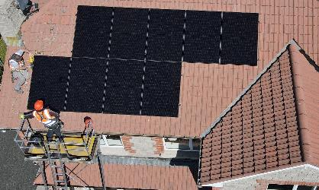
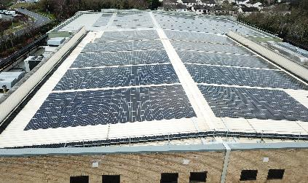
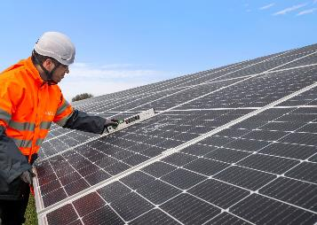
2023 – sectoral changes
Photo credits: Activ8 Solar Energies, EDF Renewables
July ‘23
EirGrid publish grid roadmap aligned with 8GW target
October ‘23
Solar clears 497.6 MW in RESS 3
May ‘23
Zero VAT on residential solar PV given effect within 1 month.
July ‘23
Launch of SEAI Non-domestic Microgeneration Grant
Sept ’23 – Mar ‘24
Commercial rates for solar at lower rate than forecast.

Slide 13
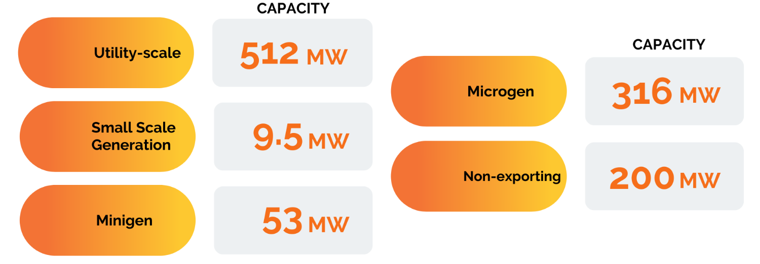

Volume of solar
1,091MW total solar capacity
Source: ESB Networks

Slide 14
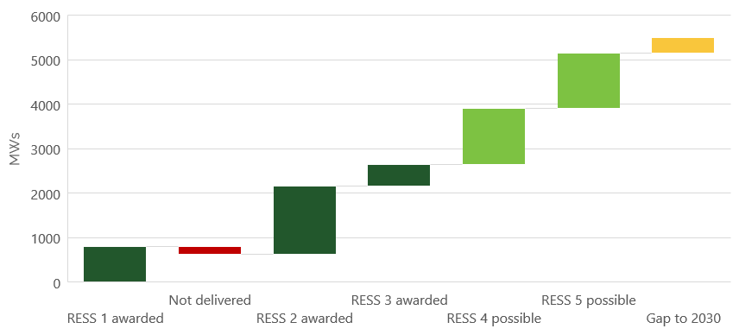
Pathway to targets – utility scale
14

Slide 15
Utility scale pipeline (MWs)
Ever growing pipeline:
10.7GW from in planning to route to market
Greenfield projects excluded
Consideration underway of future auction programme.
15
Source: Mullan Grid

Slide 16
Microgeneration – response to energy prices and policy interventions
Source: ESB Networks
16

Slide 17
Pathway to targets – onsite solar
236% increase in capacity in one year
All categories significant relative change
Microgen first mover, with commercial and industrial sector accelerating
17

Slide 18
Pathway to targets – onsite solar
Reasonably conservative outlook: ca. 2.7k commercial and industrial projects in the system
18

Slide 19
Path forward
Key challenges

Slide 20






Necessary policy enablers
Time is the enemy
Build the grid
Planning
System
Economics
Planning Bill
RES-E
Hybrid sites.
Private wires.
Connection policy
Annual auctions
Connection costs
Customer supports
Skills
Industrial policy

Slide 21

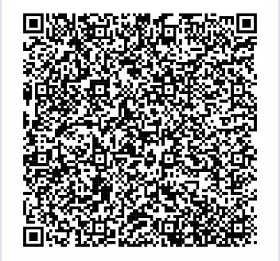
For information on ISEA membership:
membership@irishsolarenergy.org
Join us so we can build brighter futures together.

