Slide 1
Effective narratives to make energy efficiency the 1st choice
Nils Borg, CEO Borg & Co and Executive Director of eceee – The European Council for an Energy Efficient Economy

Slide 2



European efficiency policies
Sharing burden or sharing opportunity?
Climate protection
Energy security and safety
Improved economy
Making renewables (financially) possible
Jobs and growth
Less (energy) poverty
… but still hard to make countries commit to serious policies

Slide 3
Progress in Europe – but too slow
Buildings Directive – struggling to be ambitious
Opposition from Member States and parts of EP
Decent compromise reached – will “force” States to act.
Energy Efficiency Directive
Now into force, much increased ambition
IEA calls for much higher ambitions (2% → 4% annual improvement)

Slide 4
Energy Efficiency Watch project:
Looking at narratives
Since 2006 – networks and experts work together
EUFORES
Upper Austria Energy Agency
Guidehouse
Fedarene (regional network)
Borg &Co
eceee (expert policy & research network)
Strong links to Energy Cities (municipal network)

Slide 5
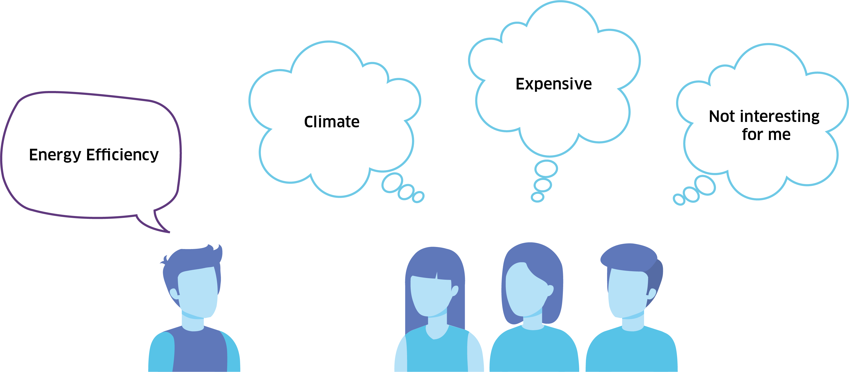
The images in people’s minds

Slide 6
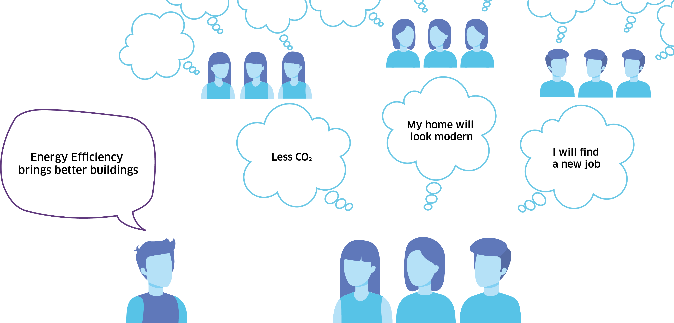
Narratives: getting buy-in from wider groups

Slide 7
Dangerous counter narratives
The poor will be disadvantaged as costs will increase.
Our industry will be less competitive and move away.
Renovating my home doesn’t pay off. And it is messy!

Slide 8
Are we talking about the right things?
And to the right people?
Are we using the right arguments?

Slide 9
WHY?

Slide 10
WHY?
What resonates with individuals,
businesses and policy makers?

Slide 11
Several approaches by the EEW project
The 2020 Energy Efficiency Watch Survey (2023 survey to be presented shortly)
10 Business stakeholder workshops
3 International parliamentary meetings
Parliamentary workshops
Network partner events (eceee, Fedarene, Energy Cities)
→ 10 narrative cases + policy recommendations

Slide 12
The Energy Efficiency Watch Survey
EU27 online survey. By sector, total 1,270 respondents

Slide 13
Among media and politicians (independent of energy and climate):

Slide 14
Is energy efficiency linked to the following topics in the public debate in your country?

Slide 15
Level of influence and attitude towards EE

Slide 16
Key input factors for narrative development
Topic |  | Importance in the public debate (ranking) |  | Topics linked to energy efficiency (ranking) | Positively discussed | Negatively discussed |  | Actor group | Influence on politics (ranking) | Supportive of energy transition | Opinion not known | Opposed to energy transition
Jobs |  | 1 |  | 6 | 72 % | 28 % |  | Associations of large industry | 1 | 47 % | 13 % | 40 %
Industrial competitiveness |  | 2 |  | 2 | 63 % | 37 % |  | Trade Unions | 2 | 37 % | 40 % | 23 %
Modernisation / investments |  | 3 |  | 1 | 44 % | 56 % |  | Chambers of Commerce | 3 | 52 % | 28 % | 20 %
Housing / living costs |  | 4 |  | 3 |  |  |  | Tabloid press | 4
Air quality |  | 5 |  | 4 |  |  |  | Farmers organisations | 5
Independence from other countries |  | 6 |  | 5 |  |  |  | NGOs | 6
Rural development |  | 7 |  | 7 |  |  |  | Churches | 7

Slide 17
Case 3: What makes a real business case?
Support real business cases → economically sustainable and expandable
Level playing field for efficiency
Synergies with renewables
Create favourable environment for specialized firms
Scale up good business cases → lower costs through upscaling
Add convincing narrative that efficiency is new mainstream despite higher complexity

Slide 18
Case 4: Adoption of new technology
  Fragmented target groups are the rule
  What shapes economic behaviour and willingness to adopt new technologies?
  Financial support: what, where, when and to whom?
  Link financial support to broad set of “image factors” (convenience, modernity, general value of a property, etc.)
  Evaluate success of existing policies, accompany by appealing narratives

Slide 19
Case 10: Just transition
  Just transition often misused
  too many feel they’re on losing side
  → “race for highest compensation”
  Expected positive welfare effects not sufficiently communicated
  Analyse weakness and strengths of societal sphrese and stakeholders
  → define who needs financial compensation and who doesn’t
  Manage expectations on a “just" transition

Slide 20
Think and act beyond traditional policy areas
How do we regard and describe change?
Communication across sectors and policy areas
Comprehensive policy packages across sectors/policy areas
Design comprehensive, multisector policies

Slide 21
Strategic planning of policy implementation
Give all policy measures a supporting narrative
Participation and dialogue
→ increase understanding and potential buy-in

Slide 22
Strengthen economic relevance of EE in energy transition
Overcome supply side dominance → Strengthen synergies w. efficiency
foster new business models → create favourable market conditions
Broader understanding of economic benefits
→ Economical beyond cost effective (resilience, supply chains, …)
Incorporate audit results in financial KPIs of companies
Analyse economic behaviour at target groups level → tailor policy instruments accordingly

Slide 23


Slide 24
Contact (and credits to Christiane and Daniel)
Nils Borg
Borg & Co / eceee
nils@borgco.se
Daniel Becker
Guidehouse
daniel.becker@guidehouse.com
Christiane Egger
O. Ö. Energisparverband
christiane.egger@esv.or.at
https://www.energy-efficiency-watch.org

