Slide 1
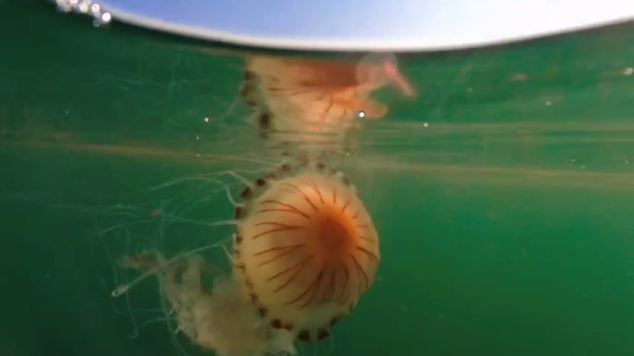
Wake up call!

Slide 2
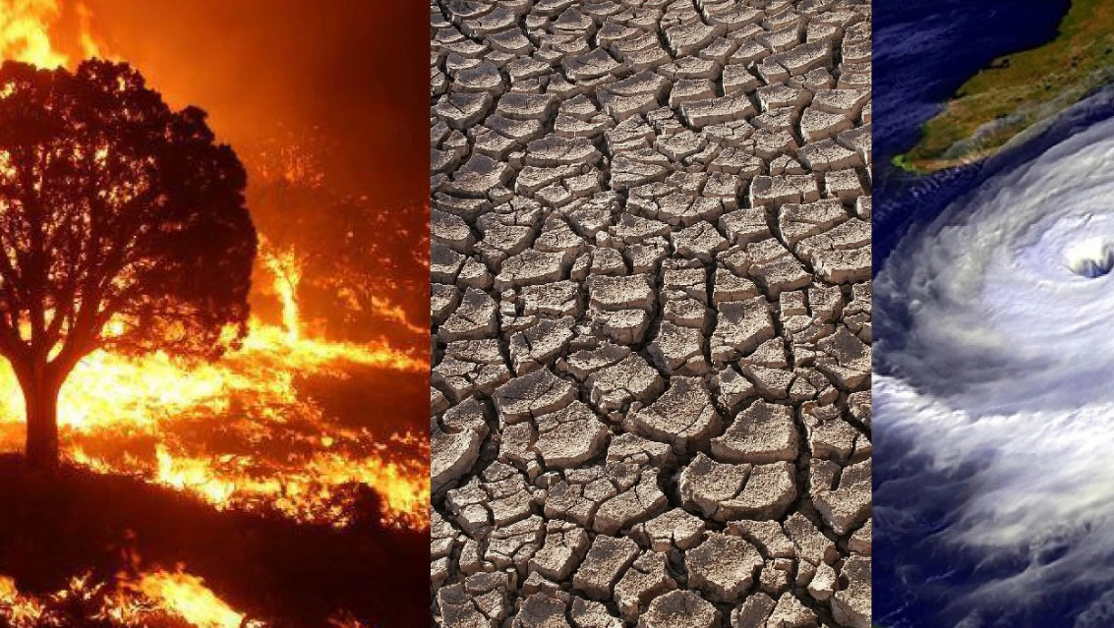

Slide 3

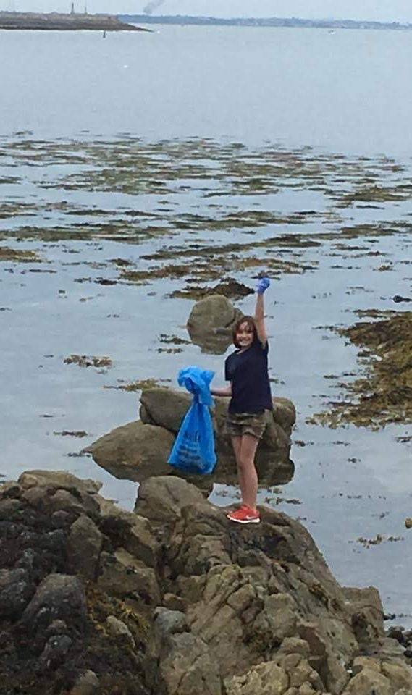
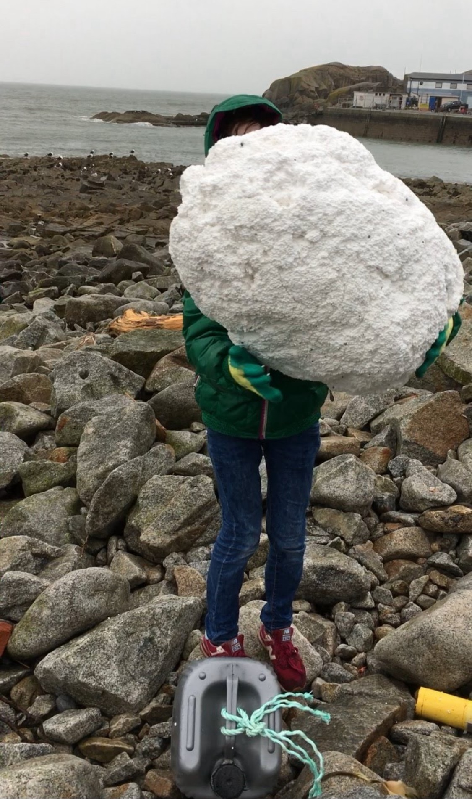
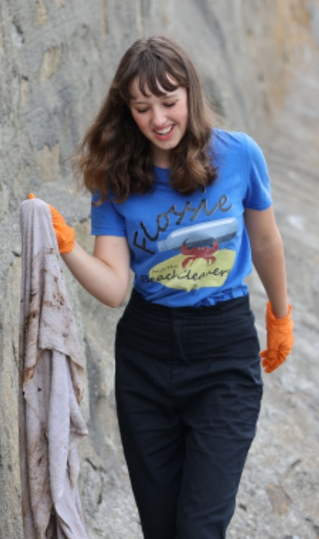
Beach cleaning

Slide 4
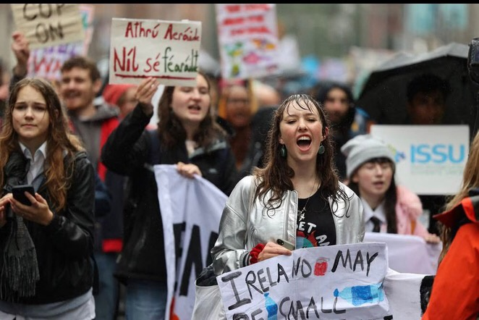

Slide 5
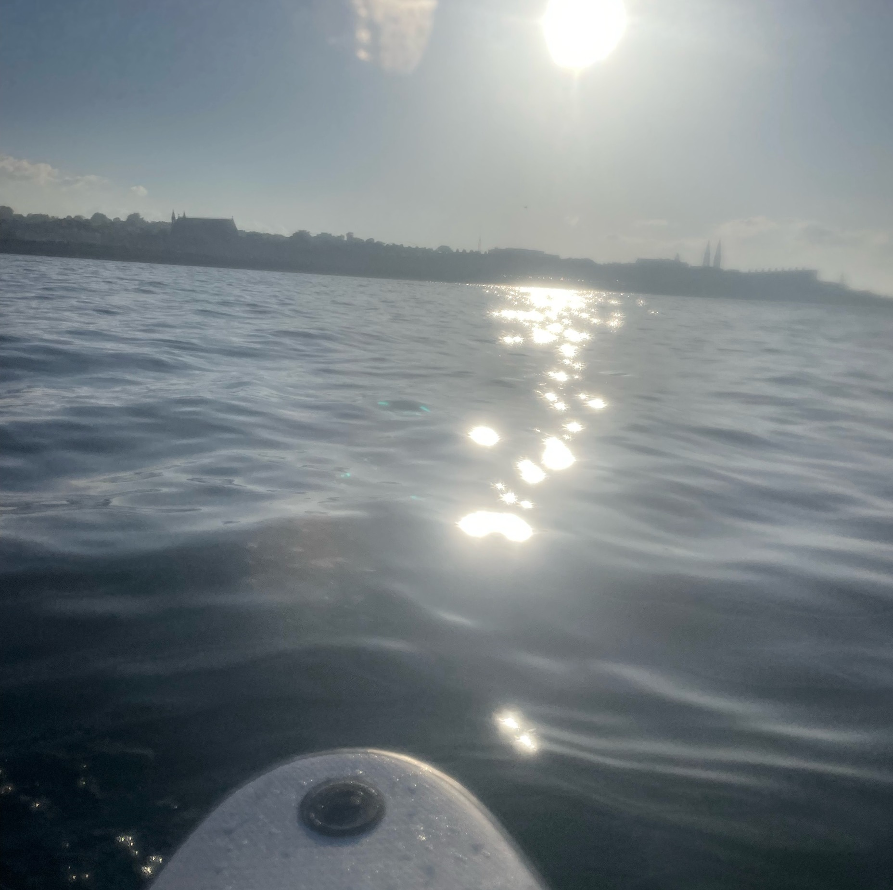
How the sea helps climate change
it stores 60 times more carbon than the atmosphere and 30% of carbon dioxide

Slide 6
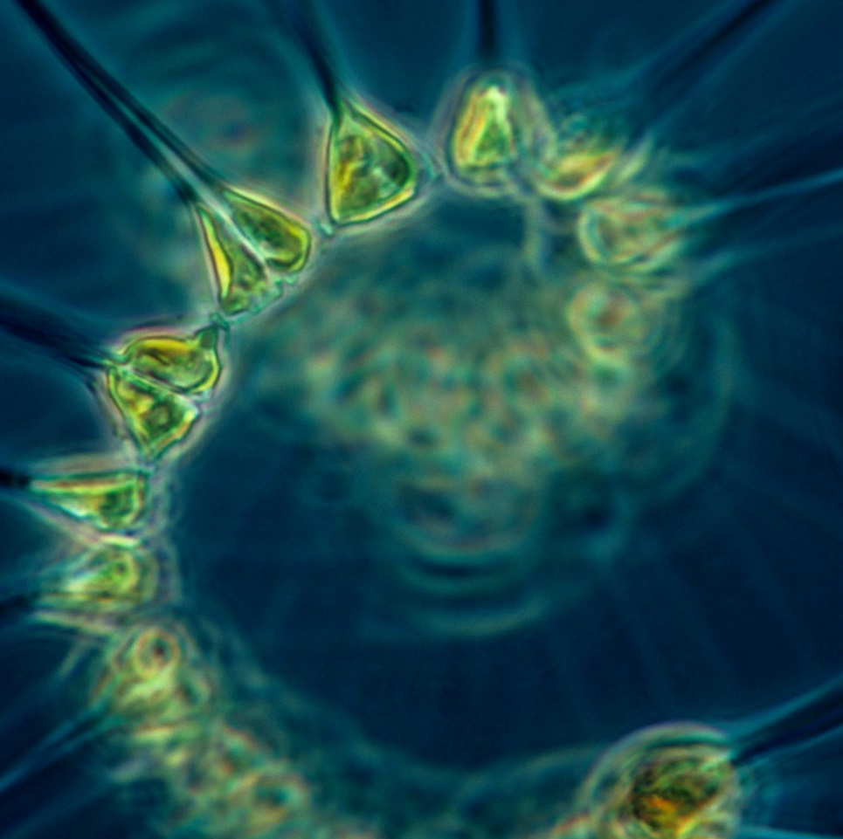
Phytoplankton
Microscopic marine algae
They convert carbon dioxide into biomass through photosynthesis
They store around 40% of carbon

Slide 7
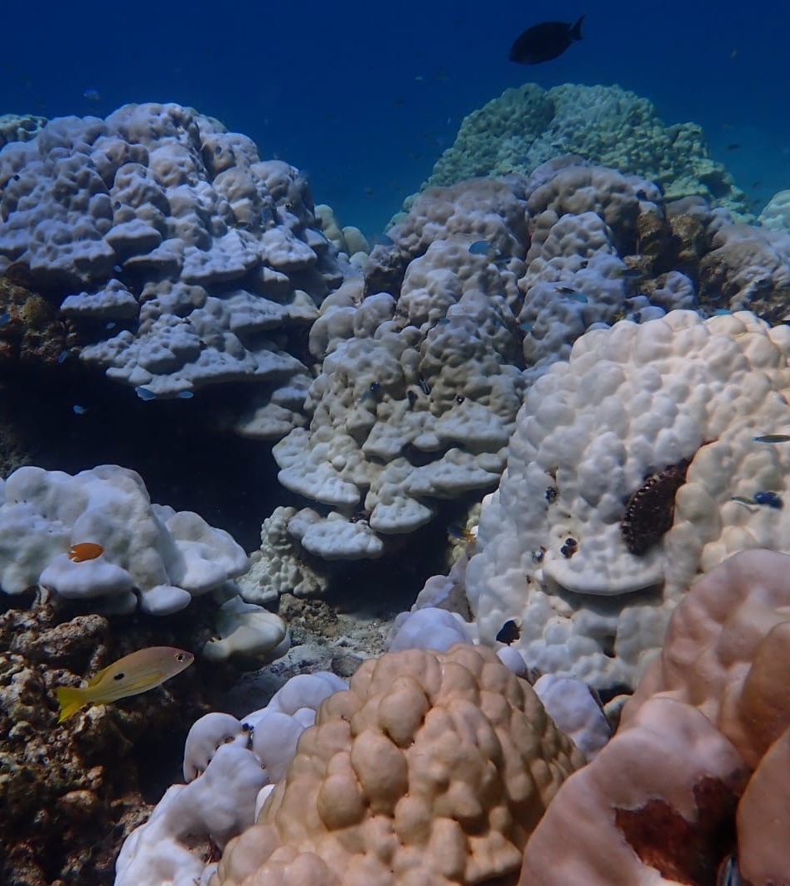
Coral
Provides homes, nursing and feeding grounds for millions of fish
Provides 50% of the worlds oxygen
Protects coastal areas by reducing wave power
El Niño
We’ve lost 50%

Slide 8
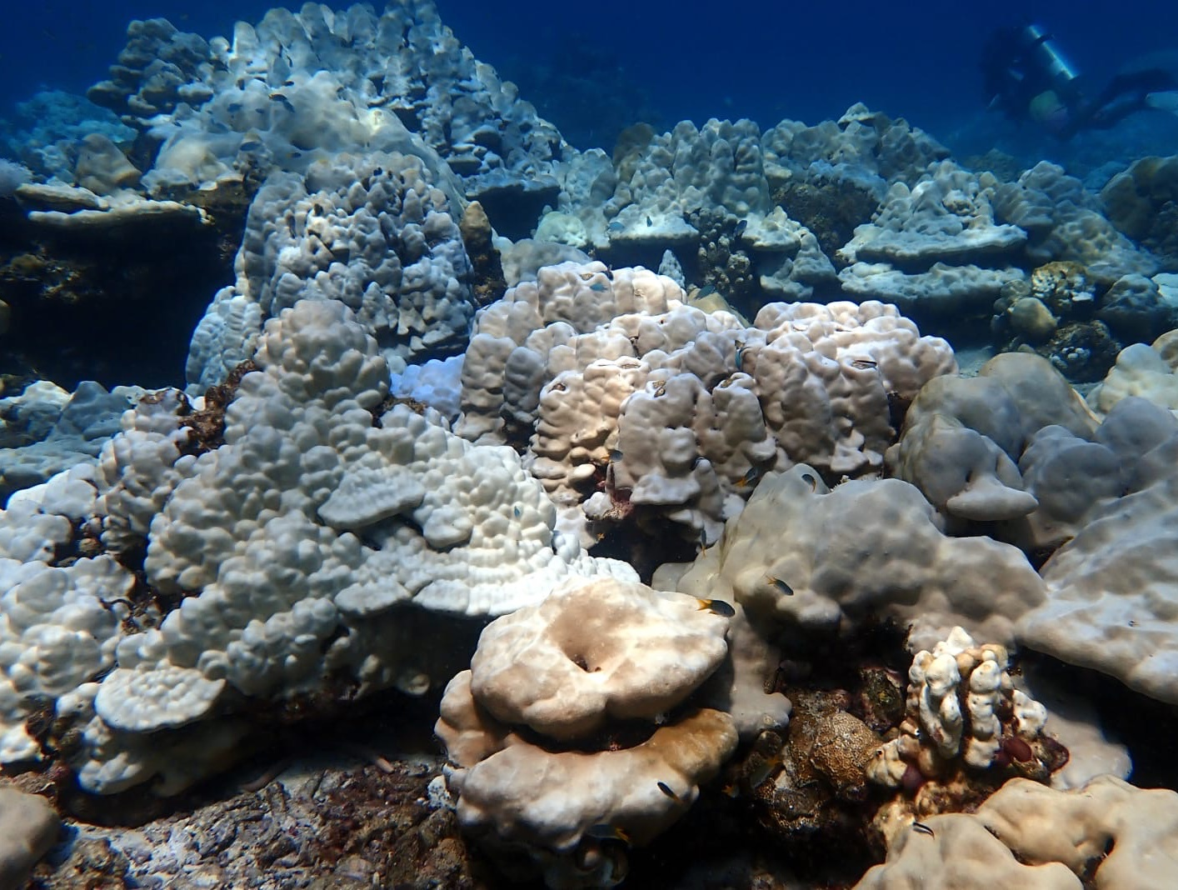
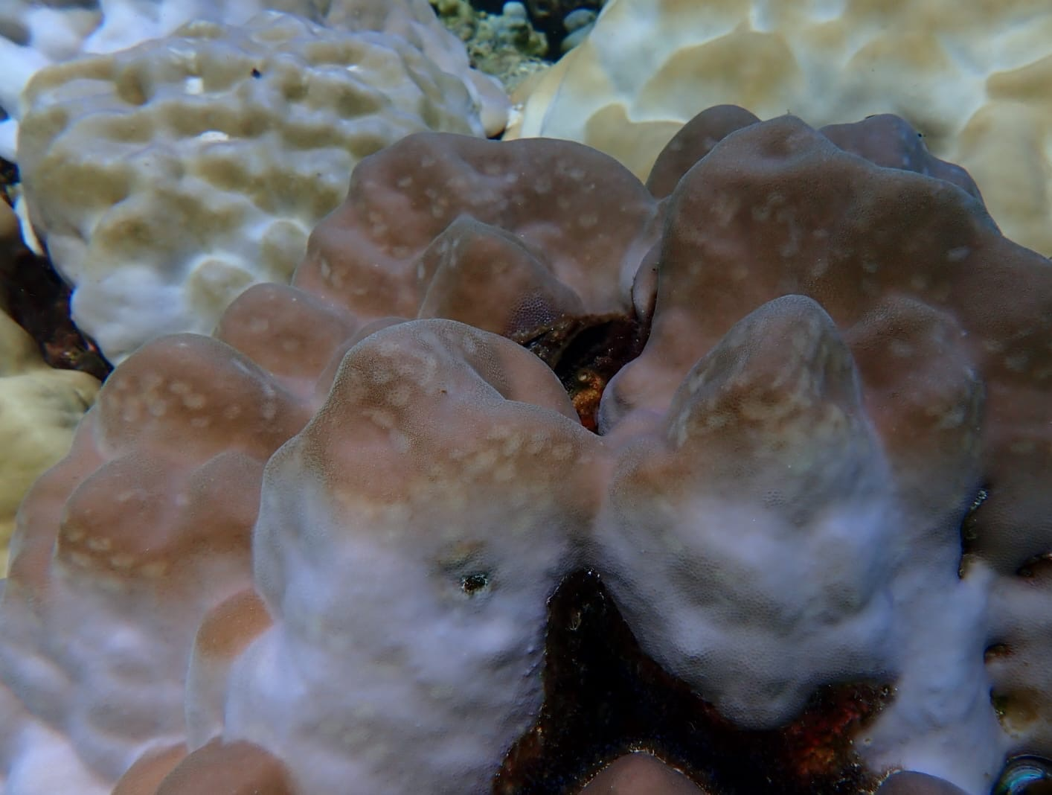
Coral

Slide 9
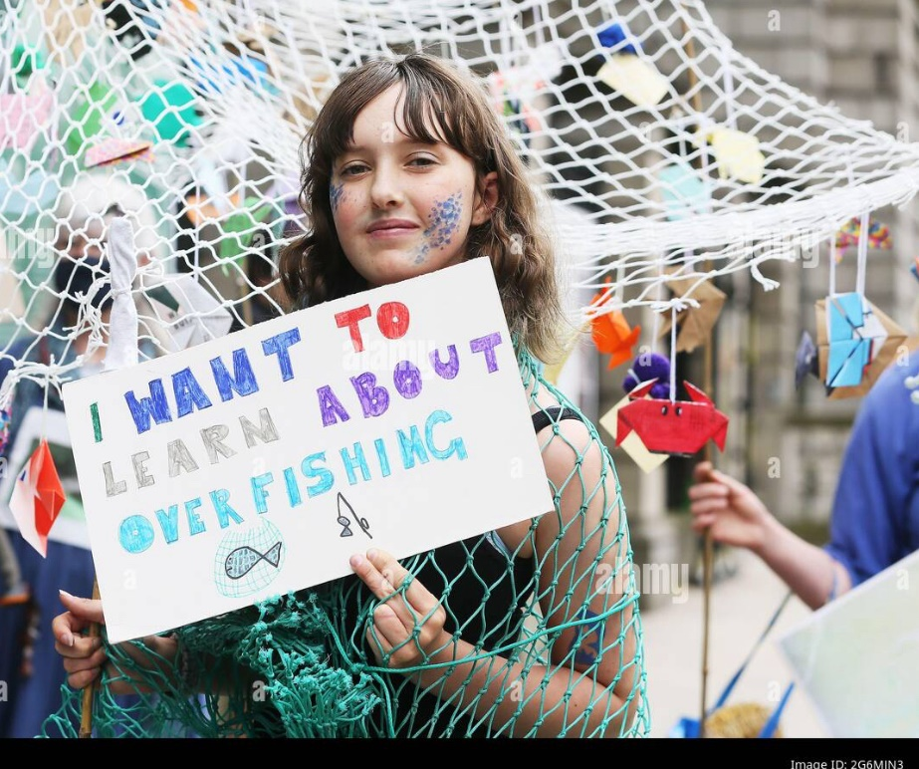
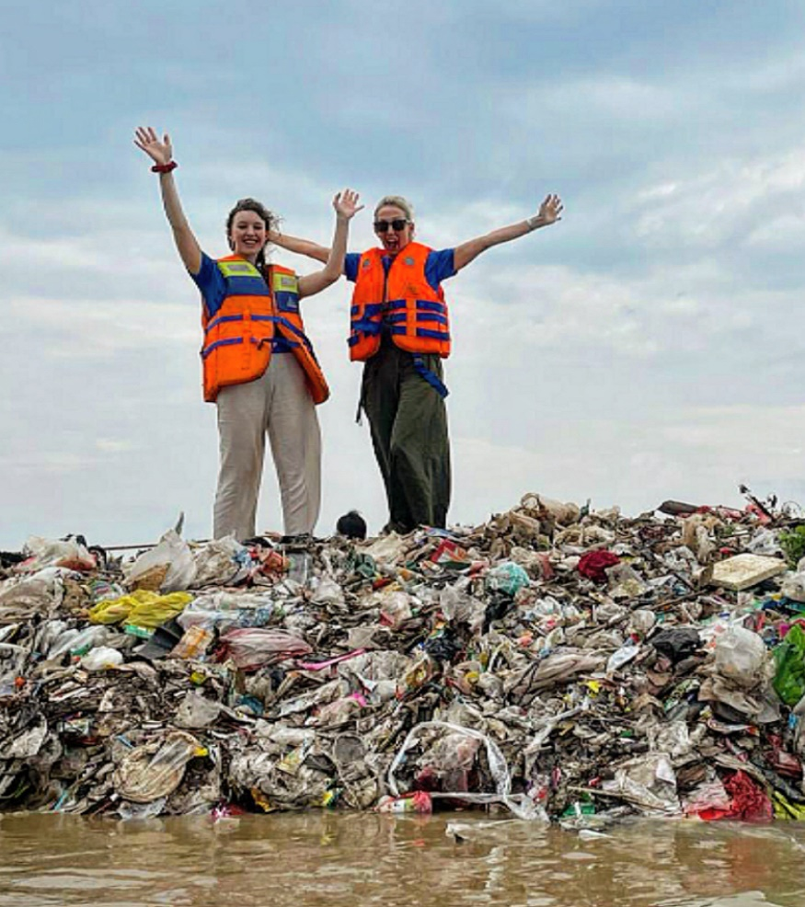
Find what you care about

Slide 10
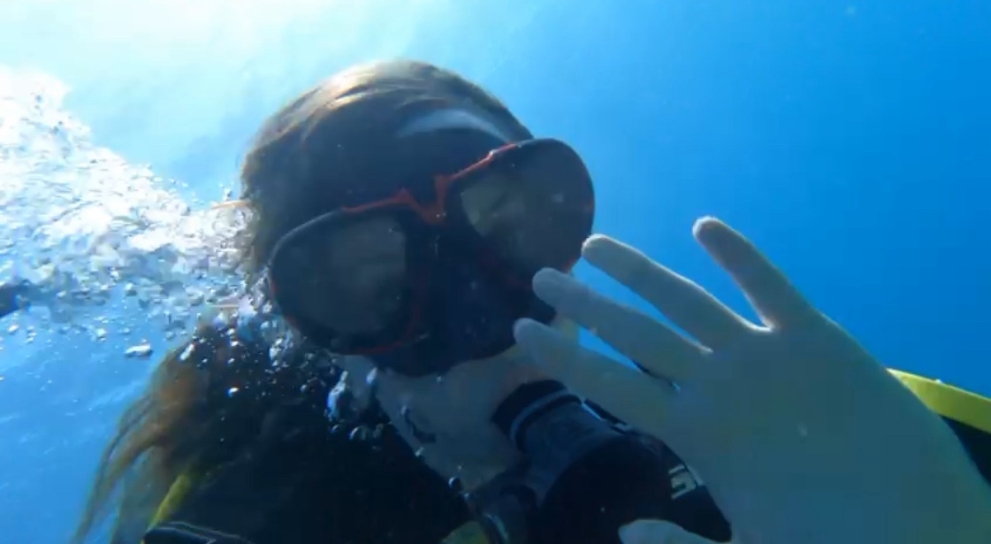
My future

Slide 11
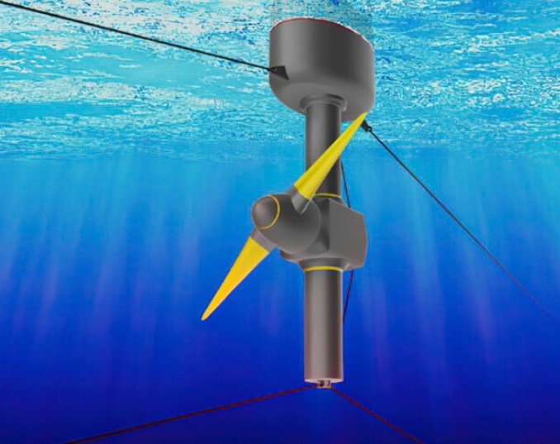
Tidal energy
Natural rise and fall of ocean tides
It’s promising and predictable

Slide 12
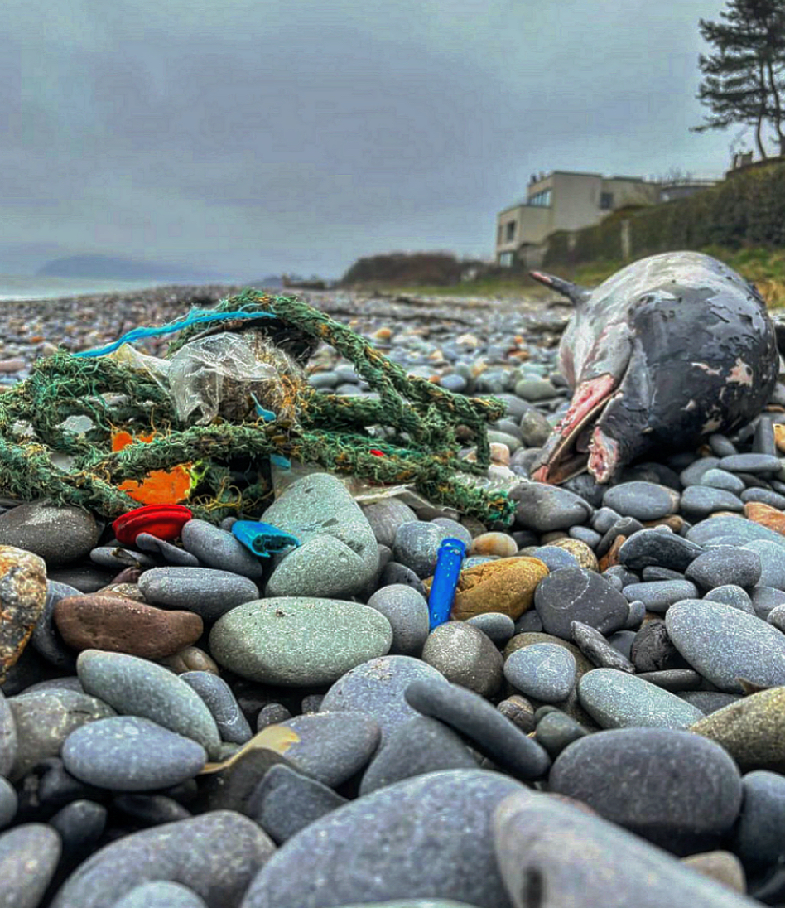
The world needs us

Slide 13
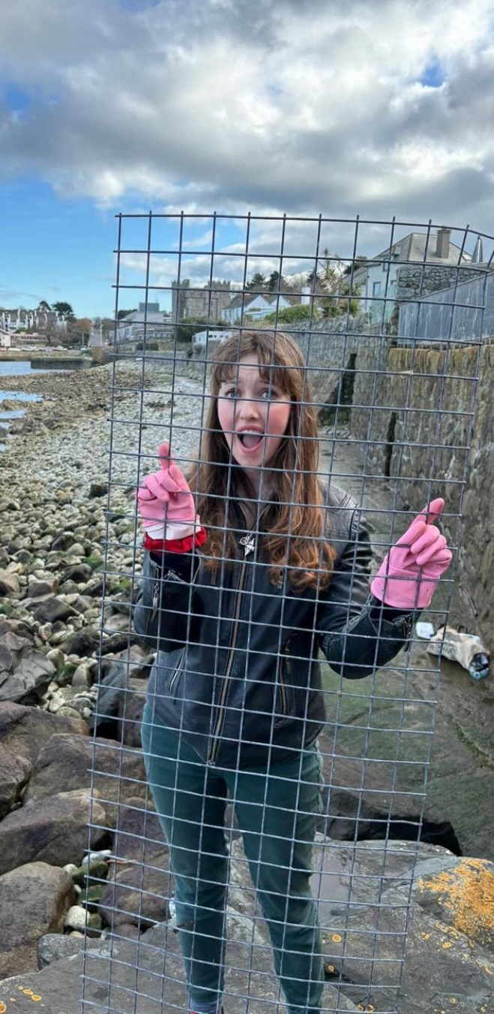
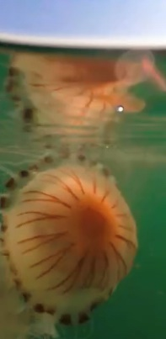
Thank you

