Slide 1

National Parliamentary Workshop
Parliament of Ireland, Houses of the Oireachtas
Europe's vision for a strong economy and a clean future: The elements of the EU Green Deal
Yolanda GARCIA MEZQUITA Head of Unit, Energy Platform Task Force,
Relations with the Member States and the Energy Community, DG ENERGY, EC
22 May 2024

Slide 2


The Climate Target Plan
GDP
2008-2021
GHG 20.5%
GDP 9.3%
The
European Green Deal
2040 Emission: – 90%
10
Emissions

Slide 3
Implementation - Energy Initiatives under Fit for 55
- Amendment to the Renewable Energy Directive (RED)
- Amendment to the Energy Efficiency Directive (EED)
Full
flexibility
- Reducing Methane Emissions in the Energy Sector
- Revision of the Energy Performance of Buildings Directive (EPBD)
Max 280 MtCO2eq
- Hydrogen and Decarbonised Gas Market Package

Slide 4




REPowerEU
A roadmap to reduce the dependence on Russian fossil fuels and fast forward the energy transition
Based on 3 pillars:
Reduce: Energy saving and energy efficiency
Renew: Massive acceleration of investment in renewables
Replace: Diversification of our energy supplies

Slide 5
Renew: EU Targets for 2030 under Fit for 55 and REPowerEU
32%
40%
42.5%
Renewable Energy Directive (RED)
Energy Efficiency Directive (EED)
32.5%*
36%*
9%**
11.7%**
45%
13%
2018
Fit for 55
REPowerEU
March 2023
* relative to 2007 reference scenario
** relative to 2020 reference scenario

Slide 6
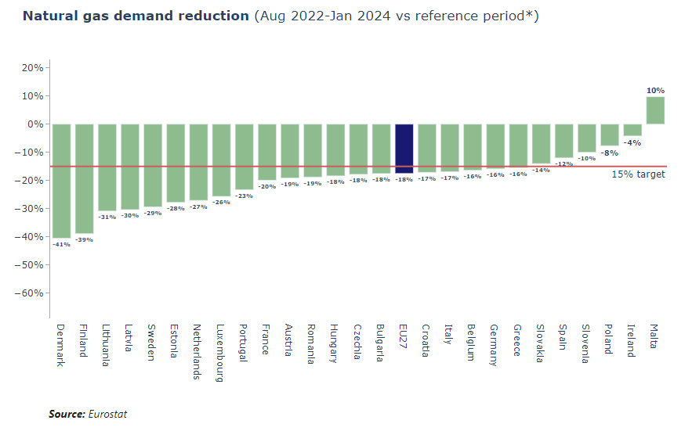
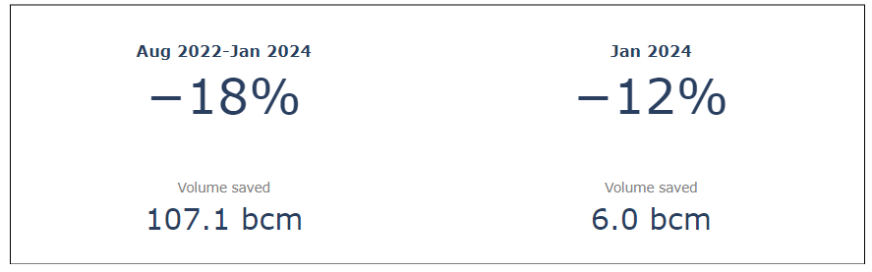
Reduce: Natural gas demand reduction

Slide 7
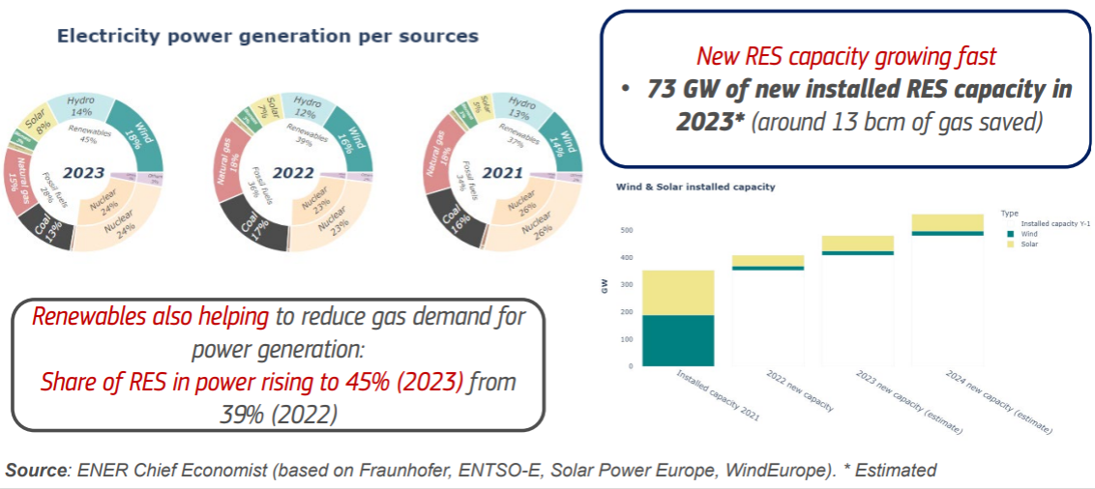
Renewables: record deployment and increased share of electricity

Slide 8
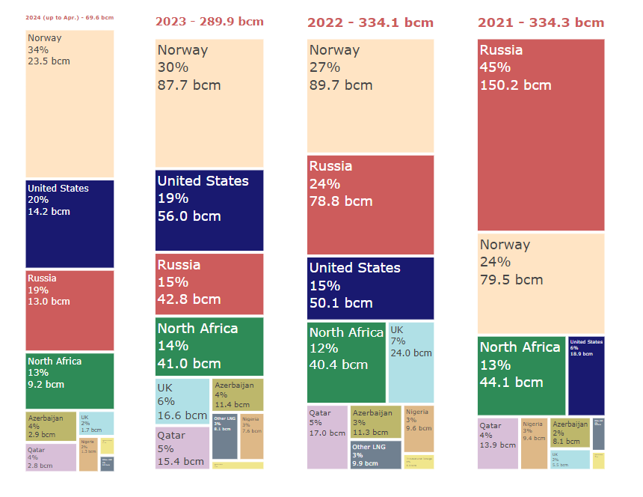
Diversification of Supplies
Annual gas import (LNG & pipeline) in the EU
Source: Refinitiv and ENTSO-G

Slide 9
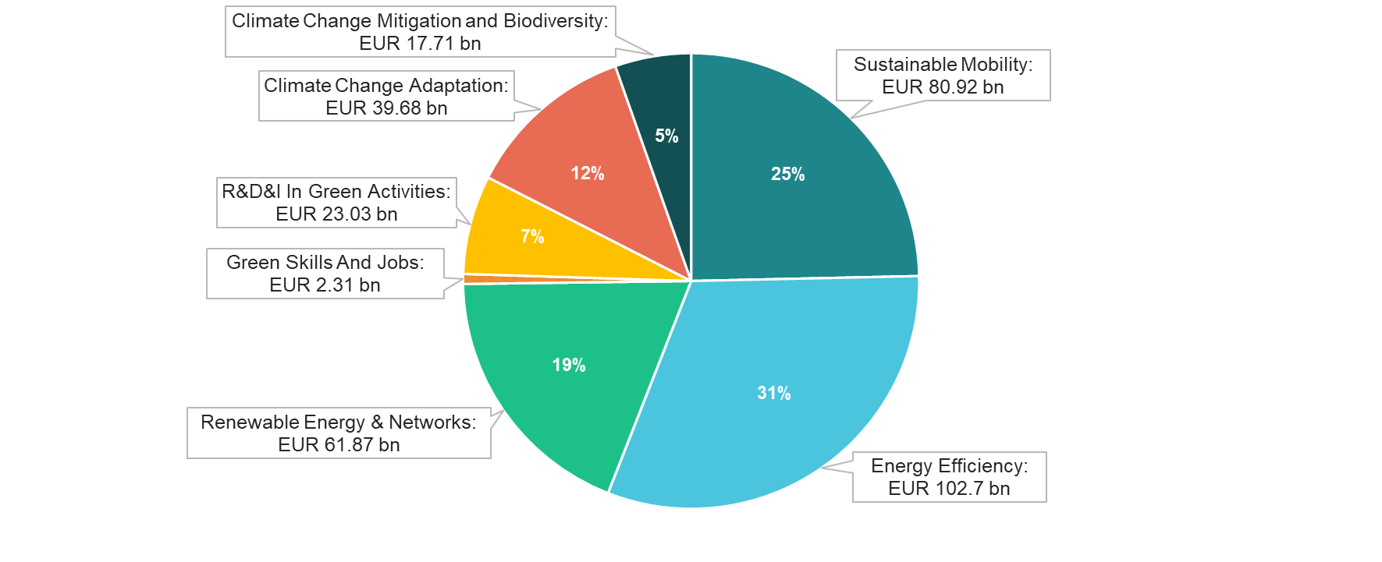
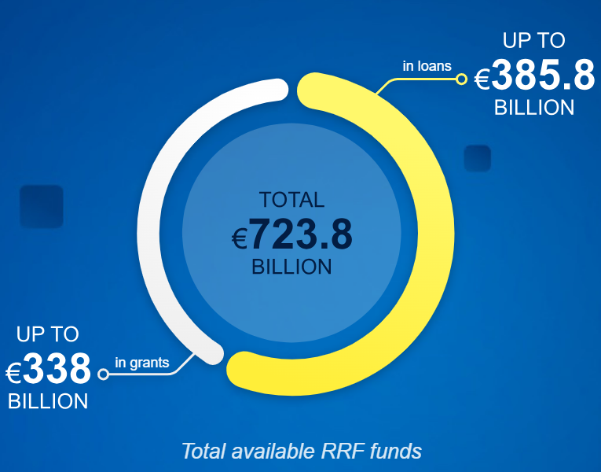
Green investments in the Recovery and Resilience Plans
Over EUR 275 bn
to support the green transition
More than 42% of RRF
50% of green investments to support energy efficiency, renewable energy & networks

Slide 10

Ireland Recovery and Resilience Plan + REpowerEU chapter
The RRP [without new REPowerEU chapter]
0.9€ billion: 42% of available funds to measures that support climate objectives
Commission working for Council to adopt the REPowerEU in June.
Key RRPs reforms & investments on:
Energy Efficiency;
Renewables;
Green skills and jobs.

Slide 11
EU Energy Policy Priorities
Implementation of legislation adopted in 2023 & National Energy and Climate Plans
European industrial competitiveness: Green Deal Industrial Plan (Net-Zero Industry Act + Critical Raw Materials Act)+ dialogues on the transition
EU Wind Power Action Plan
EU Action Plan for Grids
Guidance and recommendations to accelerate renewable energy roll-out
2040 Climate Target (90% reduction in GHG emissions by 2040)
International dimension: Global Pledge on Renewables and Energy Efficiency, Global Methane Pledge, Aggregate EU (hydrogen, critical raw materials)

Slide 12

Thank you
© European Union 2020
Unless otherwise noted the reuse of this presentation is authorised under the CC BY 4.0 license. For any use or reproduction of elements that are not owned by the EU, permission may need to be sought directly from the respective right holders.
Slide xx: element concerned, source: e.g. Fotolia.com; Slide xx: element concerned, source: e.g. iStock.com

