Slide 1

GOVERMENT PLANS FOR ENERGY TRANSFORMATION IN LITHUANIA
Viceminister of Energy
Ms. Daiva Garbaliauskaitė
2024-04-12
Vilnius

Slide 2
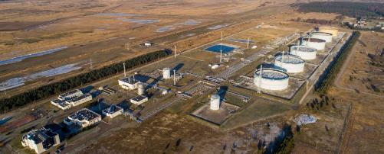
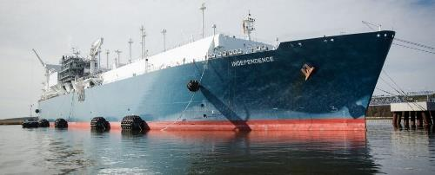
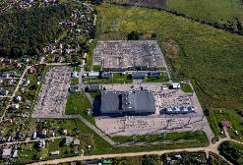
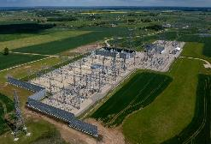
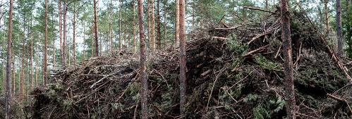
NATIONAL AGREEMENTS IN ENERGY ARE THE BASIS FOR SUSTAINABLE SOLUTIONS FOR THE FUTURE
Butingė oil terminal
Klaipėda LNG terminal
Electricity and gas connections
Independence in Heating sector

Slide 3
CHALLENGES IN LITHUANIAN ENERGY SECTOR
Energy Security
Green Deal
Gas and oil import terminals have been built
Rapid development of RES
Electricity and gas connections have been established
Transition of the heating sector to biofuels
Import a large amount of electricity and other resources
Main energy source – fossil fuel imports
Infrastructure is vulnerable
Low amount of electricity generation
We aim to reach at least 55% of RES in final energy consumption by 2030 and 100% by 2050.

Slide 4
2050 LITHUANIA‘S ENERGY GOALS
To produce all the necessary amount of energy ourselves and to ensure the safety of the infrastructure
Energy independence
100% climate neutral energy
Fully tansition to climate neutral energy
Becoming energy exporting country
Export of energy and high value energy products
Industrial development
To encourage the development of existing and promoting new industrial capacities, taking advantage of the opportunities provided by energy transition
Availability and affordability of energy prices
Ensure that energy changes reach all consumers

Slide 5







NATIONAL STRATEGY BASED ON DATA AND SCIENTIFIC RESEARCH
Hydrogen sector development study (finished)
"Lithuanian energy vision until 2050" study (finished)
Simulation of the "LT100" energy system (in development)
Comprehensive heating and cooling potential assessment study (finished)
Evaluation of the preparation of the electricity distribution network for energy transformation (finished)
Conducted by NREL, who have years of experience in RES and power grid research and state-of-the-art supercomputers.
NEW
NATIONAL ENERGY INDEPENDENCE STRATEGY (2024)
Conducted by DNV, using their Energy Change Model.
Insights from energy sector companies

Slide 6




ENERGY POTENTIAL OF
BALTIC COUNTRIES
Offshore wind potential of the Baltic States – 25,5GW
Onshore wind potential of the Baltic States– 18GW
Solar potential of the Baltic States – 40GW
Production capacity of hydrogen derivative products – 10GW
150 billion EUR investment opportunity in the next 20-25 years.
Hydrogen pipeline
H₂ electrolisers
Electricity connections
TERMINAL
Terminal of CO₂ products
CO₂ pipelines
EH
Energy center
Utilization of carbon dioxide
Offshore/Onshore wind

Slide 7
BIGGEST CHANGES – IN ELECTRICITY ENERGY
Change in electricity generation
Change in enectricity consumption
74,2
11,2
1.6
0,8
0,4
0,3
1,4
2,4
3,4
6,3
9,5
12,6
TWh
18,8
35,5
TWh
28,1
Wind will be the main energy source
Hydrogen production, industry and transport will consume the most electricity
12,6
-8,6
-0,3
12,6
2020
Import
Onshore wind
Offshore wind
Solar
SMRs
Hydro
Biomass & Waste
Hydrogen
2050
Agriculture
Energy
Households
Central Heating
Transport
Industry
Hydrogen Production
Buildings
2020

Slide 8
INFRASTRUCTURE DEVELOPMENT 2030
Construction of onshore wind farms, first offshore wind farms, solar farms, battery capacity, electricity link with Poland (Harmony Link) and first hydrogen pipeline.
Potential of Offshore and Onshore wind – 5,9 GW
Potential of Solar – 4,1 GW
Battery parks– 1,1 GW
Electrolysis devices – 1,3 GW
Electrical transmission connections – 3,1 GW
Power-to-Heat – 1,0 GW
Hydrogen demand – 4,3 TWh
Potential export:
Green synthetic fuel – 0,0 TWh
Hydrogen – 1,4 TWh
Electricity connections
Terminals of CO₂ products
H₂ electrolysis
Offshore/Onshore wind farms
CO₂ pipelines
Energy center
Hydrogen pipeline
Carbon dioxide capture

Slide 9
INFRASTRUCTURE
DEVELOPMENT 2050
Additional electricity connections with neighboring countries, growing electricity consumption in all sectors, expanding energy industry centers using hydrogen.
Potential of Offshore and Onshore wind– 14,5 GW
Potential of Solar – 9,0 GW
Battery park – 4,0 GW
Electrolysis devices – 8,5 GW
Electrical transmission connections – 5,1 GW
Power-to-Heat – 3,6 GW
Hydrogen demand – 24,2 TWh
Potential export:
Hydrogen derived products (including synthetic fuels) – 9,0 TWh
Hydrogen – 1,4 TWh
Electricity connections
Terminals of CO₂ products
H₂ electrolysis
Offshore/Onshore wind farms
CO₂ pipelines
Energy center
Hydrogen pipeline
Carbon dioxide capture

Slide 10
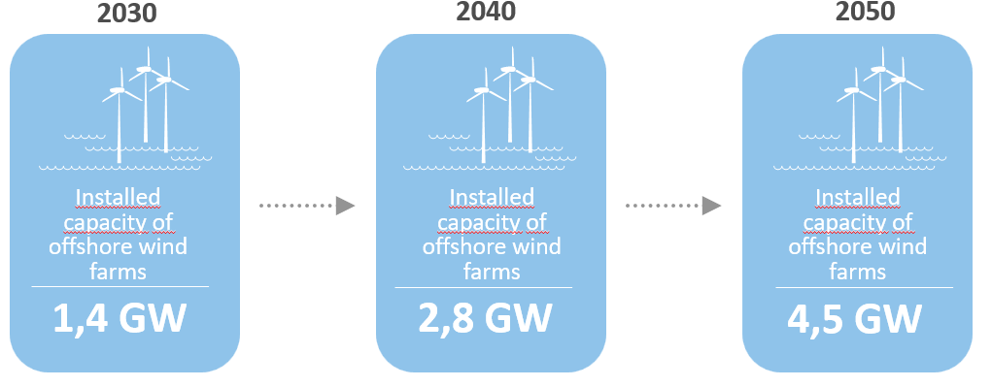
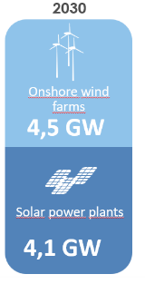
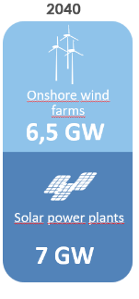
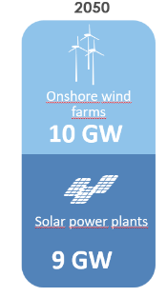
OFFSHORE WIND DEVELOPMENT
6,5 GW
ONSHORE WIND AND SOLAR DEVELOPMENT
7 GW
9 GW

Slide 11
HYDROGEN ECOSYSTEM DEVELOPMENT
Development of Green Hydrogen
Hydrogen derivatives
2030
2050
2050
Installed electrolysis capacity and the amount produced
Installed electrolysis capacity and the amount produced
CO² potential for product production
3,5 mln. tons
1,3 GW
129 000 t.
8,5 GW
732 000 t.
Potential amount of products produced
It is not yet clear on the market which hydrogen derivative products and which specific green fuels will be most in demand in the future
732 000 tons of hydrogen will make up about 32 percent. Lithuania's final energy needs in 2050
12 TWh

Slide 12
PERSPECTIVES OF NUCLEAR ENERGY
Decision is made no later than 2028
First working 0,5 GW SMR from 2038
The total power of SMRs reached 1,5 GW in 2044
2020
2030
2040
2050
Evaluation of possibilities
Construction period
Operations
Construction of 4th generation nuclear reactors
Flexible manufacturing that adapts to RES
Decision is made only after a thorough assessment of the market

Slide 13
PROSUMERS AND ACTIVE CONSUMERS
Aiming to reach at least
Provide financing for the development of prosumers up to the technically and economically acceptable limit.
Carry out an independent evaluation of the prosumer scheme by 2026.
Encourage residents to become not only prosumers, but also active consumers (who would actively participate in the electricity market).
300 000
prosumers and active consumers by 2030.

Slide 14
INCRESING ENERGY EFFICIENCY
2021 m.
2030 m.
The most important goal is to save 1.2% of final energy consumption every year, excluding ambient heat and hydrogen production.
Final
energy consumption
Final
energy consumption
Įrengtų vėjo parkų jūroje galia
1,2 %
65,8 TWh
51,5 TWh

Slide 15
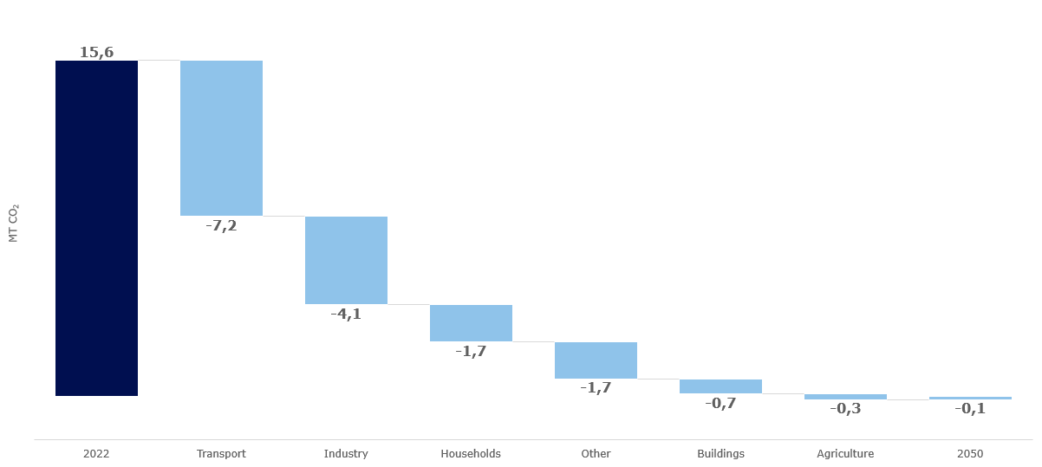






CO2 REDUCTIONS BY SECTOR BY 2050
MtCo₂e
Transport electrification
Electrification of industrial processes
Energy efficiency
Electrification of heating
Heating of buildings
CO2 reduction for energy use
Electrification of heating
Heating of buildings
2022
Transport
Industry
Households
Other
Buildings
Agriculture
2050

Slide 16





SOCIO-ECONOMIC BENEFITS BY 2050
Energy Independence
Export of energy resources
100% Decarbonisation
Industry development
Affordability of energy prices
100%
Of electricity generation in Lithuania
1.4 TWh
Hydrogen export
0 MT
GHG emissions in energy sector
4-11%
GDP growth
-6,3 mlrd. EUR
Decreased costs for importing energy resources
9.1 TWh
Green synthetic fuel export
44,000-140,000
New jobs created
Source: Lithuania's energy vision 2050 study

Slide 17

AFTER IMPLEMENTING THE STRATEGY, LITHUANIA IN 2050 WILL BE...
... A COUNTRY THAT FULLY PROVIDES ONESELF WITH GREEN ENERGY AT AN AFFORDABLE PRICE AND EXPORTS IT.

Slide 18
THANK YOU

