Slide 1

National Parliamentary Workshop
Seimas of the Republic of Lithuania
Europe’s vision for a strong economy and a clean future: The elements of the EU Green Deal
Yolanda GARCIA MEZQUITA
Head of Unit,
Energy Platform Task Force,
Relations with the Member States and the Energy Community, DG ENERGY, EC
Notes:
Ladies and Gentlemen, dear colleagues,
It is my real pleasure to be here today. I want to use this opportunity to take stock of what the EU has done under this Commission and particularly since Russia invasion of Ukraine to address the subsequent energy crisis
Particularly, I will provide an overview of the European gas and electricity market overview more than two years after Russia invasion of Ukraine, looking at the EU response, recent prices development and future market outlooks.
I will also describe the role that Energy plays for the EU competitiveness and will present the EU future priorities in Energy.

Slide 2
1) European Green Deal and response to the energy crisis (REPowerEU)

Slide 3


The Climate Target Plan
GDP
2008-2021
GHG 20.5%
GDP 9.3%
The
European
Green
Deal
2040 Emission: – 90%
10
Emissions
Notes:
Commission’s top priority since 2019 has been the European Green Deal, and its commitment to climate-neutrality by 2050.
How? Setting a higher binding target in the EU Climate Law of a net reduction of at least 55% in greenhouse gas emissions by 2030 in a cost-effective way.
EU has proven that economic growth is possible with GHG emission reduction.
GHG emissions in the EU have decreased by 20.5% between 2008 and 2021.
Over the same period, our economy grew by 9.3%.
On February 6, the Commission has published a detailed impact assessment on possible pathways to achieve climate neutrality by 2050. Based on this assessment, the Commission presented a recommendation for a 90% net greenhouse gas emissions reduction by 2040 and has launched a discussion with all stakeholders. The achievement of the 90% target will put the EU firmly on a path towards climate neutrality by 2050.
A legislative proposal will be made by the next Commission, after the European elections, and agreed with the European Parliament and Member States as required under the EU Climate Law.

Slide 4
Energy Initiatives under Fit for 55 Package
- Amendment to the Renewable Energy Directive (RED)
- Amendment to the Energy Efficiency Directive (EED)
Full
flexibility
- Reducing Methane Emissions in the Energy Sector
ENER initiatives
- Revision of the Energy Performance of Buildings Directive (EPBD)
Max 280 MtCO2eq
- Hydrogen and Decarbonised Gas Market Package

Slide 5
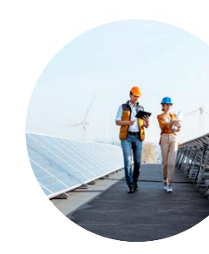



REPowerEU
A roadmap to reduce the dependence on Russian fossil fuels and fast forward the energy transition
Based on 3 pillars:
Reduce: Energy saving and energy efficiency
Renew: Massive acceleration of investment in renewables
Replace: Diversification of our energy supplies
Notes:
In response to Russia’s invasion of Ukraine and the ensuing energy crisis, in March 2022 the EU adopted the REPowerEU Plan to reduce urgently our dependence on Russian fossil fuels, fully aligned with our commitments under the Green Deal.
The plan translates this into 3 pillars of action under Repower:
Focus on energy savings and efficiency.
Accelerate even more our green transition and the rollout of renewable energy.
Ensure diversification of our energy supplies.
This necessitated a short-term response but one which supports long-term clean energy transition. To implement the REPowerEU Plan, the EU has adopted legislation on high energy prices, on solidarity, on permitting, on the famous market correction mechanism.

Slide 6
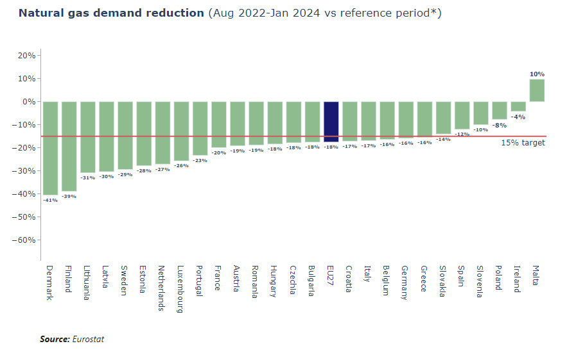
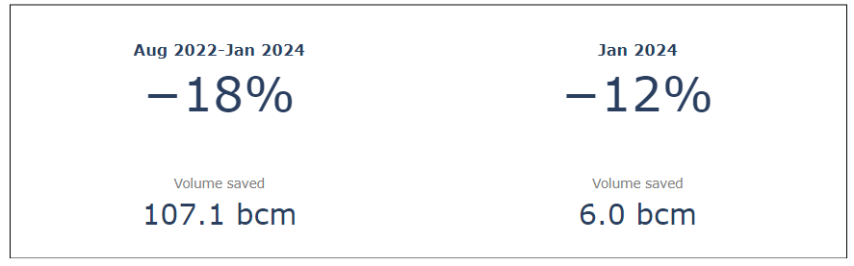
Reduce: Natural gas demand reduction
Notes:
Between August 2022 and January 2024, the EU reduced its gas consumption by 18% compared to the average of 2017-2022, which corresponds to savings of 107 bcm.
On March 25th, the Council has adopted a Recommendation to continue demand reduction until 31 March 2025 and stay within the current safety band.

Slide 7
Renew: EU Targets for 2030 under Fit for 55 and REPowerEU
32%
40%
42.5%
Renewable Energy Directive (RED)
Energy Efficiency Directive (EED)
32.5%*
36%*
9%**
11.7%**
45%
13%
2018
Fit for 55
REPowerEU
March 2023
* relative to 2007 reference scenario
** relative to 2020 reference scenario
Notes:
EU co-legislators adopted new EU energy efficiency target of 11.7% for 2030, exceeding the ‘Fit for 55' proposal of 9%.
For renewables, co-legislators reached a political agreement of an EU renewable energy target of 42.5% by 2030, with an aspiration to reach 45%. This again exceeds the ‘Fit for 55' proposal of 40%.

Slide 8
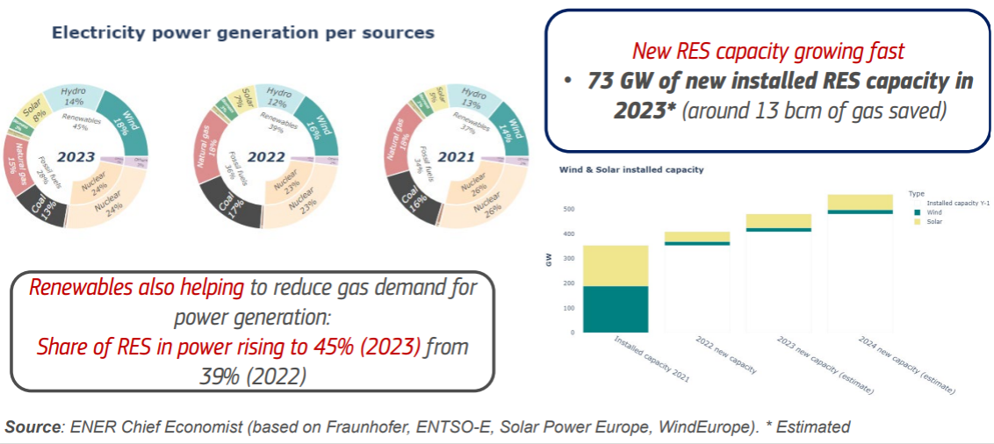
Renewables: record deployment and increased share of electricity

Slide 9
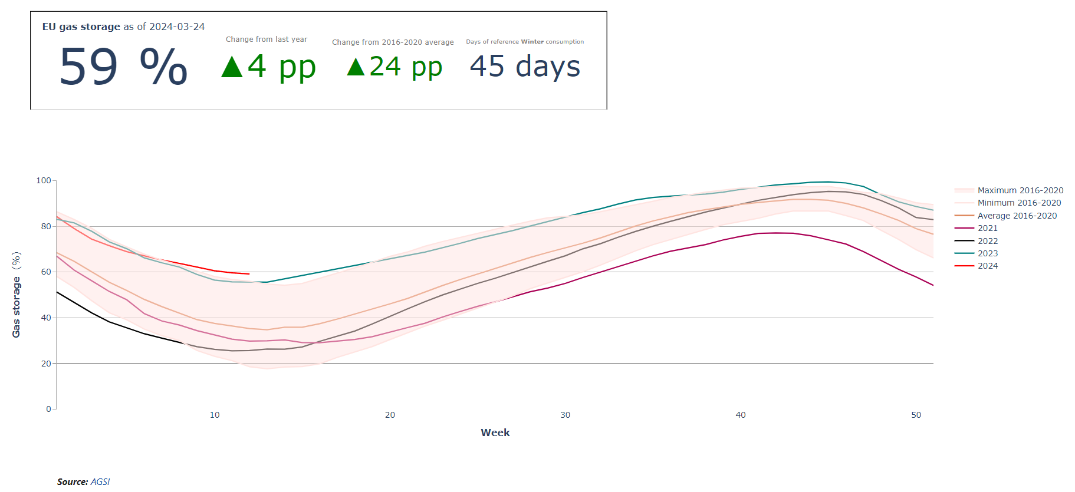
Replace: Filling Level of EU Gas Storage
Notes:
As regards gas, the EU as a whole is expected to enter the storage filling season with 45 to 55 billion cubic meters (bcm) which provides a good basis for 2024/2025 winter preparedness.
EU storages were more than 59 % full on 1 April 2024 (end of the gas winter), a historic high. It was at 58.9% on 26 March (vs 33.8% on average on the same day of years 2016-2022). Storages are on the trajectory to achieve 90% target of 1 November 2024.
All EU countries have met their filling target in February 2024.

Slide 10
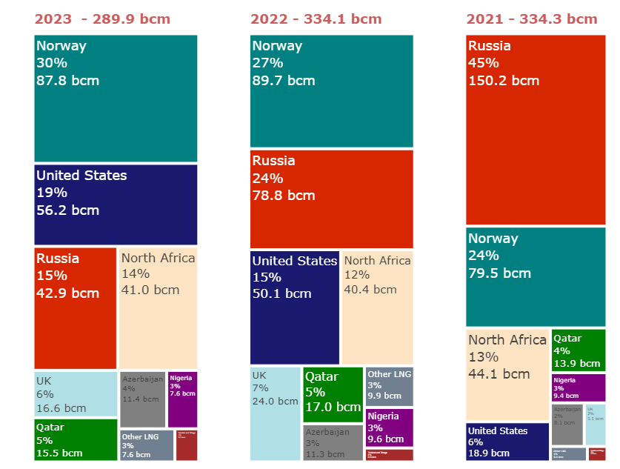

Diversification of Supplies
  Annual gas import (LNG & pipeline) in the EU
Source: Refinitiv and ENTSO-G
Source: Refinitiv and ENTSO-G
Notes:
In the immediate response to this crisis, and faced with the need to replace some 140-150 billion cubic meters of Russian gas, Europe has undergone an unprecedented shift in its energy policy to strengthen our energy security and diversify our sources of supply.
The EU has been successfully replacing Russian gas imports:
Russian share of EU gas imports fell from 45% in 2021 to 24% in 2022 and 15% in 2023.
Thanks to unprecedented efforts, in 2023 Europe managed to reduce Russian gas imports (from 140-150 bcm) to some 43 bcm [N.B. 18 bcm via LNG and 25 bcm via pipeline]. Russian share in pipeline imports reduced from up to 50% in 2021 to less than 10% throughout 2023.
In 2022, the EU managed to compensate more than 70 bcm of Russian gas with increased supplies from non-Russian suppliers, both through pipelines and LNG.

Slide 11

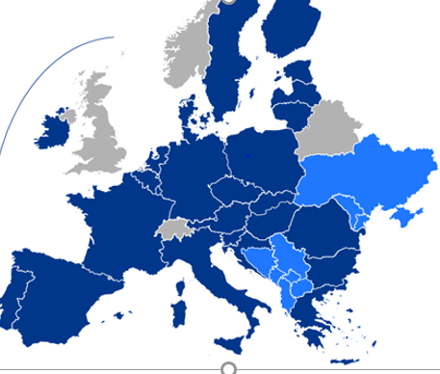
AggregateEU – in a nutshell
Total demand
Matched positions
Total offers
Results
54.2
42.2
61.1
Looking forward:
  Hydrogen → Hydrogen and Decarbonised Gases Regulation
  Critical Raw Materials
Notes:
To secure access to gas supplies in 2024 we will continue organising the joint purchasing of gas on the EU Energy Platform.
This mechanism, launched in the midst of the energy crisis, delivered excellent results in 2023; better than anyone could have expected.
With 182 companies subscribed, the AggreagateEU mechanism has become an additional avenue for buyers and sellers of gas in Europe.
In total, over the four rounds organised in 2023, 113 buyers expressed demand of well over 50 bcm, and offers of more than 60 bcm were put forward by 48 sellers.
*
To secure access to gas supplies in 2024 we will continue organising the joint purchasing of gas on the EU Energy Platform.
This mechanism, launched in the midst of the energy crisis, delivered excellent results in 2023; better than anyone could have expected.
With 182 companies subscribed, the AggreagateEU mechanism has become an additional avenue for buyers and sellers of gas in Europe.
In total, over the four rounds organised in 2023, 113 buyers expressed demand of well over 50 bcm, and offers of more than 60 bcm were put forward by 48 sellers.
We will also continue making improvements to the Platform to ensure that it responds to various signals from the market and better serves the business models of suppliers and the gas purchasing strategies of buyers.
The first improvement will be implemented in February with the introduction of a new mid-term product of 5 years.
Let me highlight the key elements of this product:
Tendering rounds with the mid-term product will complement (not replace) the tendering rounds with short-term products as successfully organised in 2023.
With the new product, users will be able to submit their demand for up to five years.
Buyers will submit their demand for six-months delivery periods, i.e. the summer period (April-September) and the winter period (October-February) of a given year.
Importantly, to ensure even greater confidentiality, the identity of buyers notifying demand on the Platform will be anonymised to encourage European industrial sectors, including chemicals, fertilisers, ceramics, glass, aluminium, steel and paper, to use the joint purchasing on the Platform to seek offers from new suppliers.
And, as has been the case in 2023, the mechanism will be free of charge and voluntary, and the Commission will not be involved in commercial negotiations or the signing of contracts.
In addition to short-term and mid-term products – we will also look into the possibility of creating a long-term product on the Platform.
We plan to organise a market survey in the spring this year to gauge market players’ interest in a product with a duration of up to 20 years.
Through that dedicated survey, we will enquire about (a) the level of interest in such a longer-term product, (b) the preferences regarding its key characteristics, and (c) any additional or innovative conditions linked to this product that could be of interest (e.g. environmental and sustainability factors).

Slide 12
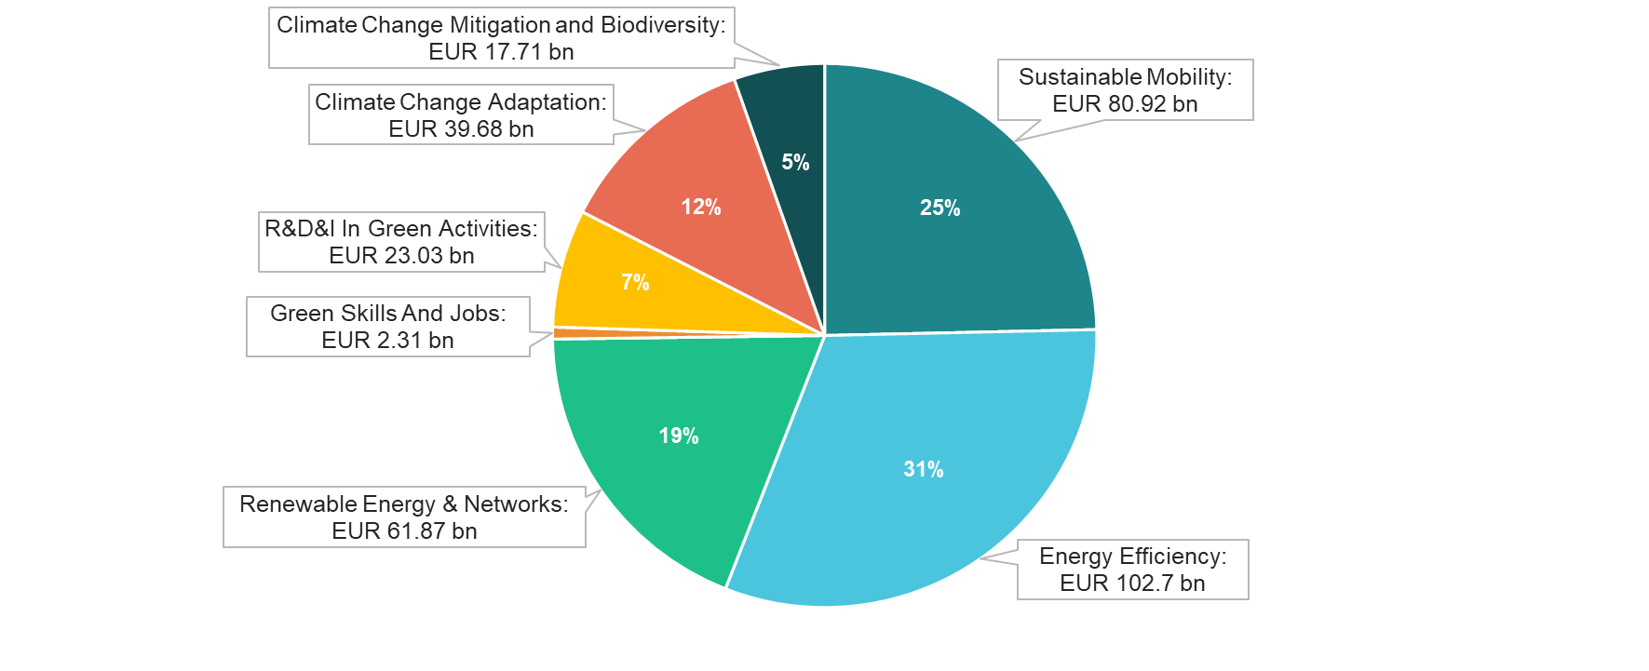
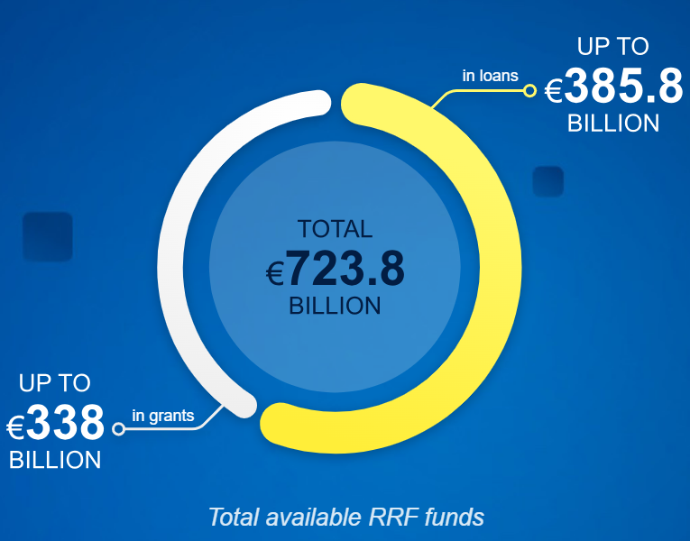
Green investments in the Recovery and Resilience Plans
Over EUR 275 bn
to support the green transition
More than 42% of RRF
50% of green investments to support energy efficiency, renewable energy & networks

Slide 13
  Lithuanian Recovery and Resilience Plan + REpowerEU chapter
The RRP and its new REPowerEU chapter
    3.8€ billion
    new reforms and investments
37% of available funds to measures that support climate objectives
Key new measures include:
  Support to the construction of onshore RES plants (solar and wind power)
  Multi-apartment building renovation
  Study for the preparation of Lithuania’s energy system to energy transition
Notes:
To secure access to gas supplies in 2024 we will continue organising the joint purchasing of gas on the EU Energy Platform.
This mechanism, launched in the midst of the energy crisis, delivered excellent results in 2023; better than anyone could have expected.
With 182 companies subscribed, the AggreagateEU mechanism has become an additional avenue for buyers and sellers of gas in Europe.
In total, over the four rounds organised in 2023, 113 buyers expressed demand of well over 50 bcm, and offers of more than 60 bcm were put forward by 48 sellers.
*
To secure access to gas supplies in 2024 we will continue organising the joint purchasing of gas on the EU Energy Platform.
This mechanism, launched in the midst of the energy crisis, delivered excellent results in 2023; better than anyone could have expected.
With 182 companies subscribed, the AggreagateEU mechanism has become an additional avenue for buyers and sellers of gas in Europe.
In total, over the four rounds organised in 2023, 113 buyers expressed demand of well over 50 bcm, and offers of more than 60 bcm were put forward by 48 sellers.
We will also continue making improvements to the Platform to ensure that it responds to various signals from the market and better serves the business models of suppliers and the gas purchasing strategies of buyers.
The first improvement will be implemented in February with the introduction of a new mid-term product of 5 years.
Let me highlight the key elements of this product:
Tendering rounds with the mid-term product will complement (not replace) the tendering rounds with short-term products as successfully organised in 2023.
With the new product, users will be able to submit their demand for up to five years.
Buyers will submit their demand for six-months delivery periods, i.e. the summer period (April-September) and the winter period (October-February) of a given year.
Importantly, to ensure even greater confidentiality, the identity of buyers notifying demand on the Platform will be anonymised to encourage European industrial sectors, including chemicals, fertilisers, ceramics, glass, aluminium, steel and paper, to use the joint purchasing on the Platform to seek offers from new suppliers.
And, as has been the case in 2023, the mechanism will be free of charge and voluntary, and the Commission will not be involved in commercial negotiations or the signing of contracts.
In addition to short-term and mid-term products – we will also look into the possibility of creating a long-term product on the Platform.
We plan to organise a market survey in the spring this year to gauge market players’ interest in a product with a duration of up to 20 years.
Through that dedicated survey, we will enquire about (a) the level of interest in such a longer-term product, (b) the preferences regarding its key characteristics, and (c) any additional or innovative conditions linked to this product that could be of interest (e.g. environmental and sustainability factors).

Slide 14
2) What’s Next:
Perspectives in EU Energy Policy

Slide 15
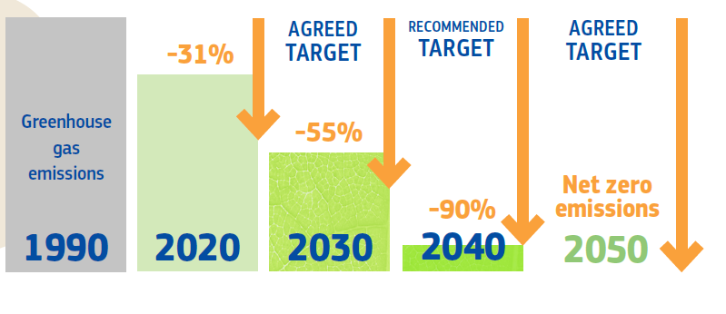
EU Priorities for 2024
European Competitiveness
Legislation Implementation
National Energy and Climate Plan
Ensure European industrial competitiveness: Green Deal Industrial Plan + dialogues on the transition
Implementation of legislation adopted in 2023
National Energy and Climate Plans
EU Wind Power Action Plan
EU Action Plan for Grids
2040 Climate Target (90% reduction in GHG emissions by 2040)

Slide 16
European industrial competitiveness
Progress of the Industrial Plan of the Green Deal:
Net-Zero Industry Act (NZIA) to support the competitiveness of the European clean technology industry + Critical Raw Materials Act (CRMA)
Continuing work on adapting state aid rules to allow Member States to provide support in a flexible, practical, and rapid manner.
On June 20, 2023, the EC proposed the establishment of a Strategic Technologies for Europe Platform (STEP) to support European leadership in strategic technologies.
Supporting the development of capabilities for the transition to clean energy in the context of the European Year of Skills.
On October 20, 2023, the EC updated the Strategic Energy Technology Plan (SET)

Slide 17
National Energy and Climate Plans
National Energy and Climate Plans as a key tool to ensure strategic and coordinated planning.
In December, the Commission published the assessment package of the draft updated NECP:
  Member States are increasing the share of renewables, reducing energy consumption and investing efforts in securing the EU energy system
  There is an ambition gap that needs to be bridged, both as regards greenhouse gas emissions, renewables, and energy efficiency
Notes:
With the adoption of all the energy-related legislative files under the Fit for 55 package, we now have a strong and stable framework in place at EU-level to deliver on our 2030 climate and energy targets.
This framework now needs to be implemented as a matter of urgency, as 2030 is only a few years away.
In this context, I want to underline the importance of the National Energy and Climate Plans as a key tool to ensure strategic and coordinated planning and implementation of our collective EU-framework for energy and climate on the ground.
The National Energy and Climate Plans are also crucial for providing stakeholders with the necessary investment certainty to trigger the massive private investments needed towards 2030. The Commission estimates that additional annual investments of EUR 620 billion are needed to achieve the objectives of the European Green Deal and Repower EU. Public funding alone will not be able to deliver.
In December, the Commission published the assessment package of the draft updated NECP which were due in June 2023. The assessment package included both country-specific assessments and recommendations for the 21 Member States submitted by mid-November, as well as an aggregate EU-wide assessment (based also on figures received from 4 more Member States) of what we can expect to achieve by 2030 based on the national ambitions put forward by Member States in their draft plans.
On a positive note, the December NECP assessment shows that Member States are increasing the share of renewables, reducing energy consumption, and investing efforts in securing the EU energy system.
For instance, in its draft updated NECP Hungary puts an emphasis on interconnections, setting out the target to increase electricity connections to 60% by 2030
However, the assessment also clearly demonstrates that there is an ambition gap that needs to be bridged, both as regards greenhouse gas emissions, renewables, and energy efficiency.
For renewables, the ambition put forward by the Member States in the draft updated NECPs amounts to around 39% in 2030 at Union level, which is significantly lower than the binding target of 42.5%.
As regards the energy efficiency, Member States´ contributions to the 2030 final energy consumption at Union level corresponds to a reduction of 5.8%, falling significantly short of the recently revised target of 11.7%. Hungary puts forward 17.9Mtoe contribution in its draft updated NECP.
In other words, most Member States, and Hungary too, need to step up their ambitions and efforts to deliver on our 2030 targets!
The good news is that Member States still have 4 months to update their ambitions, as the final updated NECPs are due in June 2024.

Slide 18

Thank you
© European Union 2020
Unless otherwise noted the reuse of this presentation is authorised under the CC BY 4.0 license. For any use or reproduction of elements that are not owned by the EU, permission may need to be sought directly from the respective right holders.
Slide xx: element concerned, source: e.g. Fotolia.com; Slide xx: element concerned, source: e.g. iStock.com

