Slide 1
PERSPECTIVES OF EFFICIENT ENERGY CONSUMPTION IN THE FIELD OF INDUSTRY
EFEKTYVAUS ENERGIJOS VARTOJIMO PRAMONĖS SRITYJE PERSPEKTYVOS
Vidmantas Janulevičius
President of the Lithuanian Confederation of Industrialists
2024 April 12

Slide 2
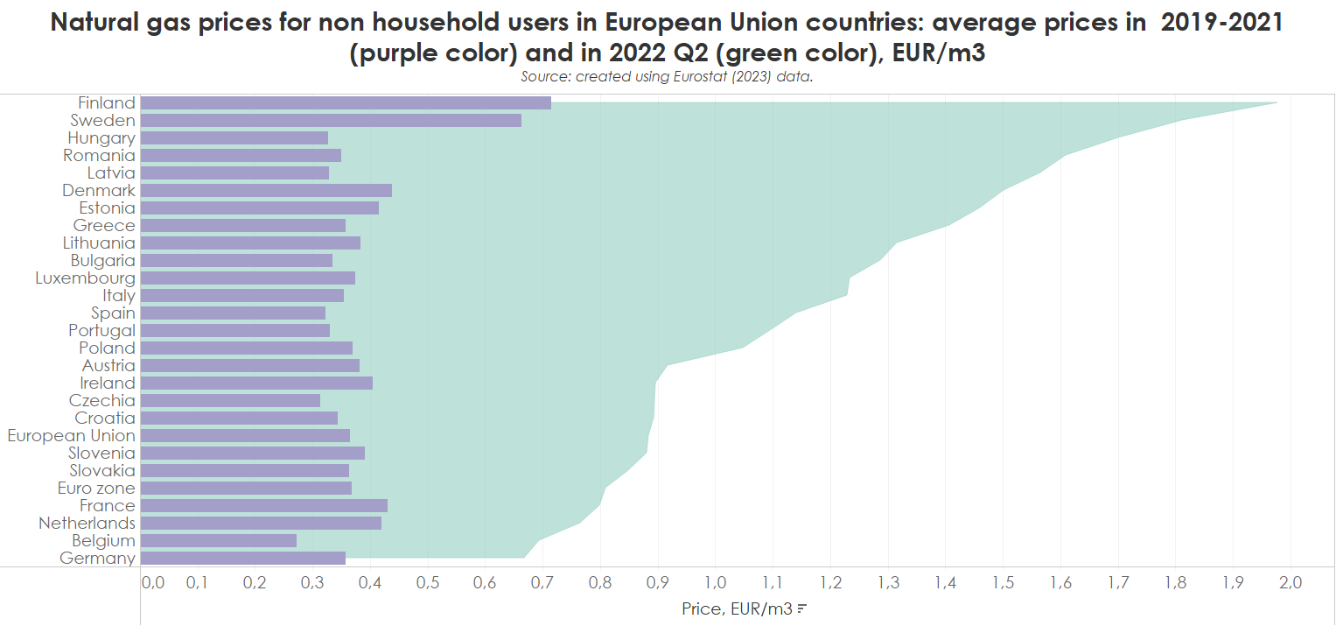
Natural gas prices in 2022 increased multiple times.

Slide 3

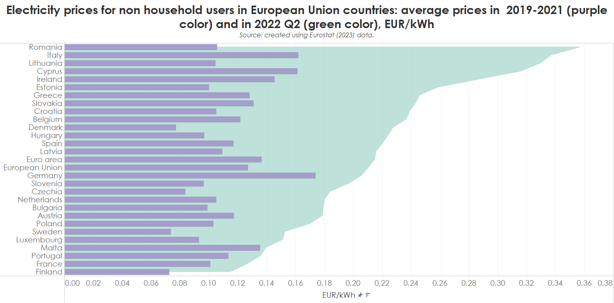
Electricity prices were breaking records.

Slide 4
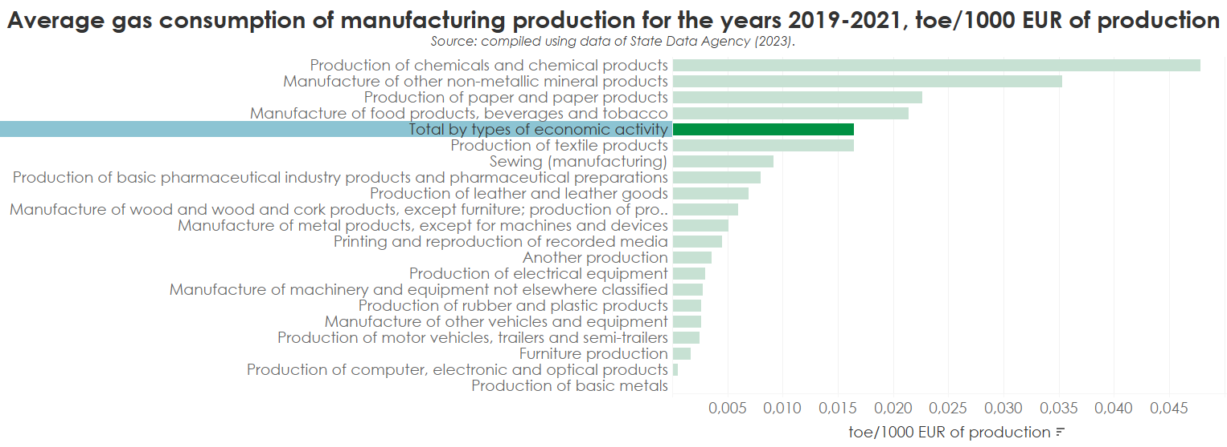
Not all sectors are sensitive to natural gas prices.

Slide 5
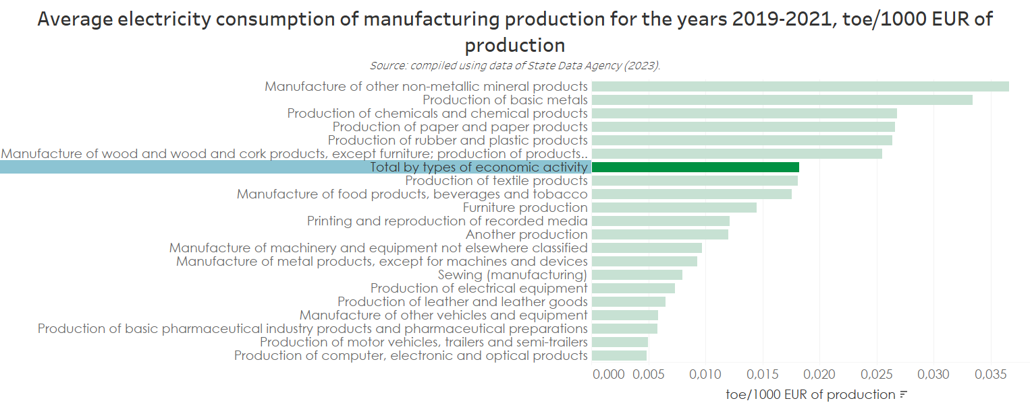
Electricity consumption is more consistent than natural gas.

Slide 6


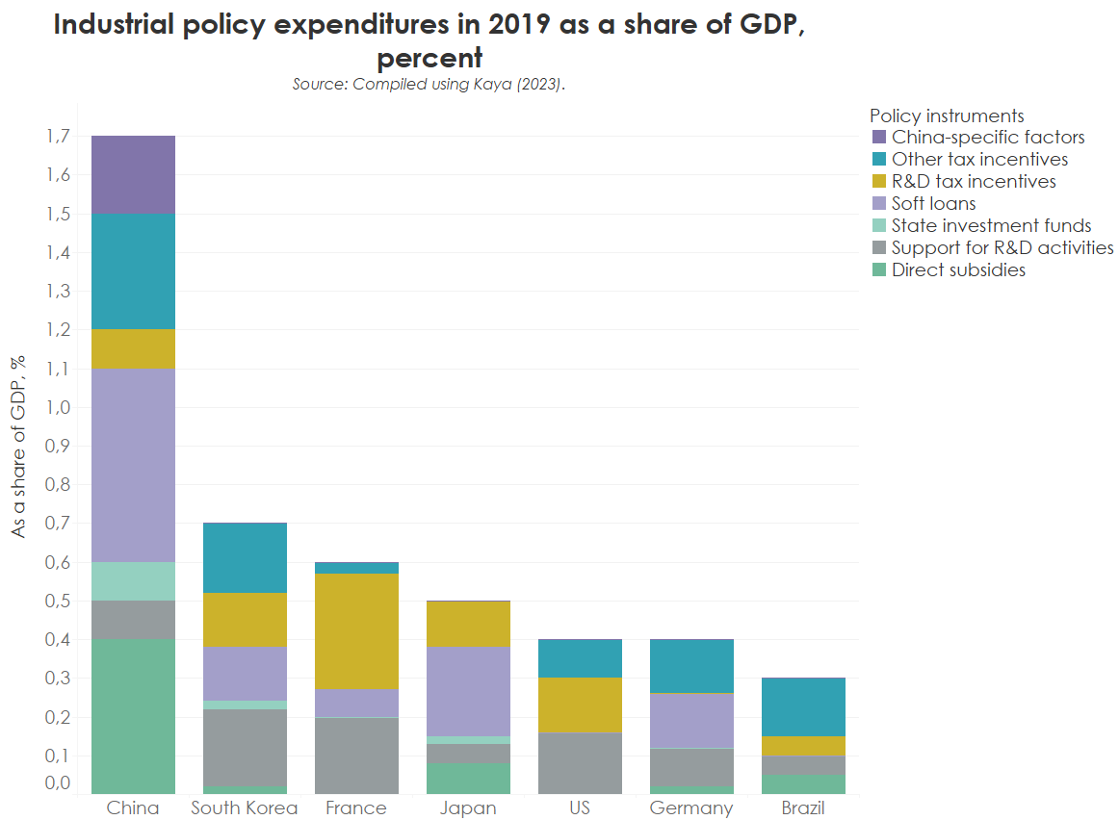
China's support for the industry is the biggest

Slide 7








And the renewable energy sector today is highly dependent on China…
China dominates China‘s dominance is lower

Slide 8
Our mission is to create a geopolitically, economically and climate sustainable energy sector and industry.
+370 5 243 10 67
sekretoriatas@lpk.lt
Vilniaus g. 31, Vilnius
lpk.lt

