Slide 1
Barriers and Opportunities for Solar in Lithuania
Andrius Karazinas, Lithuanian Solar Energy Association
“The EU Green Deal as driver for economic prosperity and the energy transition in Lithuania” , Vilnius, 12 of April 2024

Slide 2
To reach 5GW of Solar in Lithuania in 2030 goal?
To review and recall controversial limitations that have come in force with the “Breakthrough package” of the RES law in 2022
To develop of the grid capacities by DSO and TSO proactively, to develop the international grid connections as fast as possible
To regain a trust of potential prosumer by discussing and defining clear perspectives of the net-metering model
To review and optimize the financing means to comply the real needs of the market (residential, business and public)

Slide 3
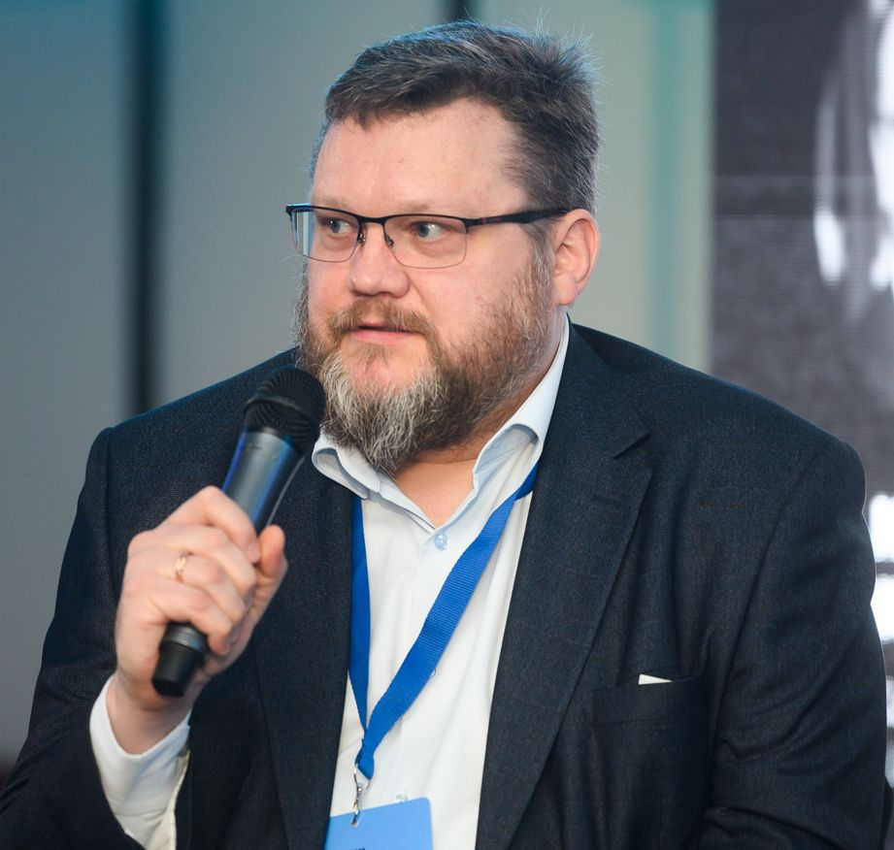
Thank you.
Andrius Karazinas
President
Lithuanian Solar Energy Association
andrius.karazinas@lsea.lt
+370 611 56011

