Slide 1
Energy Efficiency in the Lithuanian Buildings Sector
Laura Lukoševičienė
Head of the Housing Policy Group of the Ministry of the Environment of the Republic of Lithuania
2024-04-12
Notes:
.

Slide 2

LONG-TERM BUILDING RENOVATION STRATEGY (2021-03-31)
Target for 2050
BUILDING STOCK
● 660 000 buildings
● Total area of 201 million m²
● 64 % residential use
● Only 2 % of public ownership
● 85 % of the buildings were built before 1992.
EFFICIENT ENERGY CONSUMPTION
FOSSIL-FUEL FREE SECTOR
CONDITIONS FOR TRANSITION TO NZEB
ENERGY CONSUMPTION OF THE BUILDING STOCK
● 66 % are lower than energy performance class C;
● 85 % are lower than energy performance class B;
● A++ class ~ 2312 buildings;
● 40,8 TWh/year primary energy consumption;
● 5.3_{mt}CO²/year;
● 78 % of the total primary energy of the building stock is consumed by buildings of energy performance class D and lower.

Slide 3
Goals
2020
2050
(with changes in the energy sector)
Primary energy
40,8 TWh
>-70 %
> 11.9 TWh
Primary energy from fossil fuels
26.4 TWh
>-90 %
> 2.1 TWh
CO₂ emissions
5.3 mtCO₂
—100 %
0 mtCO2

Slide 4
Context
The complex geopolitical situation and high energy prices encourage increasing ambitions in the field of energy efficiency of buildings;
Proposal for a new version of the Energy Performance of Buildings Directive (EPD). Implementation of the European Green Deal and the Fit for 55 package;
8/5/2019 EC recommendations (EU) 2019/786 on building renovation and 2021-2027 EU fund investment program requirements – higher energy efficiency, development of financial mechanisms, mobilization of financial institutions;
There are limited possibilities of providing support for the renovation (modernization) of multi-apartment buildings with the funds of the state budget

Slide 5
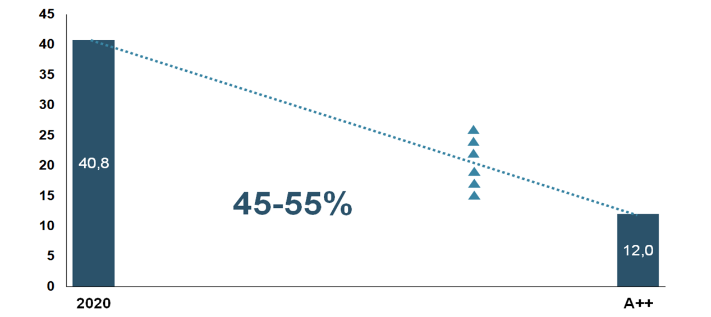
Lithuania’s long-term building renovation strategy
COST-EFFECTIVE RENOVATION
The highest economic return:
renovation to A/B energy performance class + Renewable energy sources
Primary energy consumptions, TWh/year

Slide 6
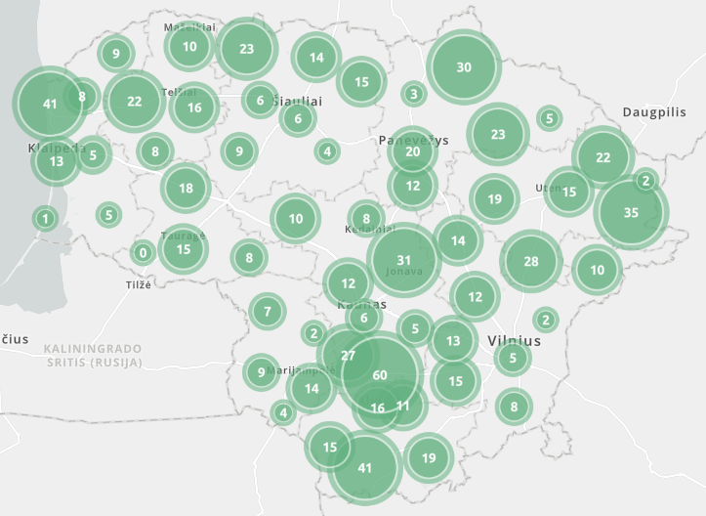





Renovated Multi-apartment Buildings
Leading municipalities

Slide 7

Renovated Multi-apartment Buildings and Future Projections

Slide 8
Renovated individual home and new invitation applications for support

Slide 9
Renovated municipal public buildings

Slide 10
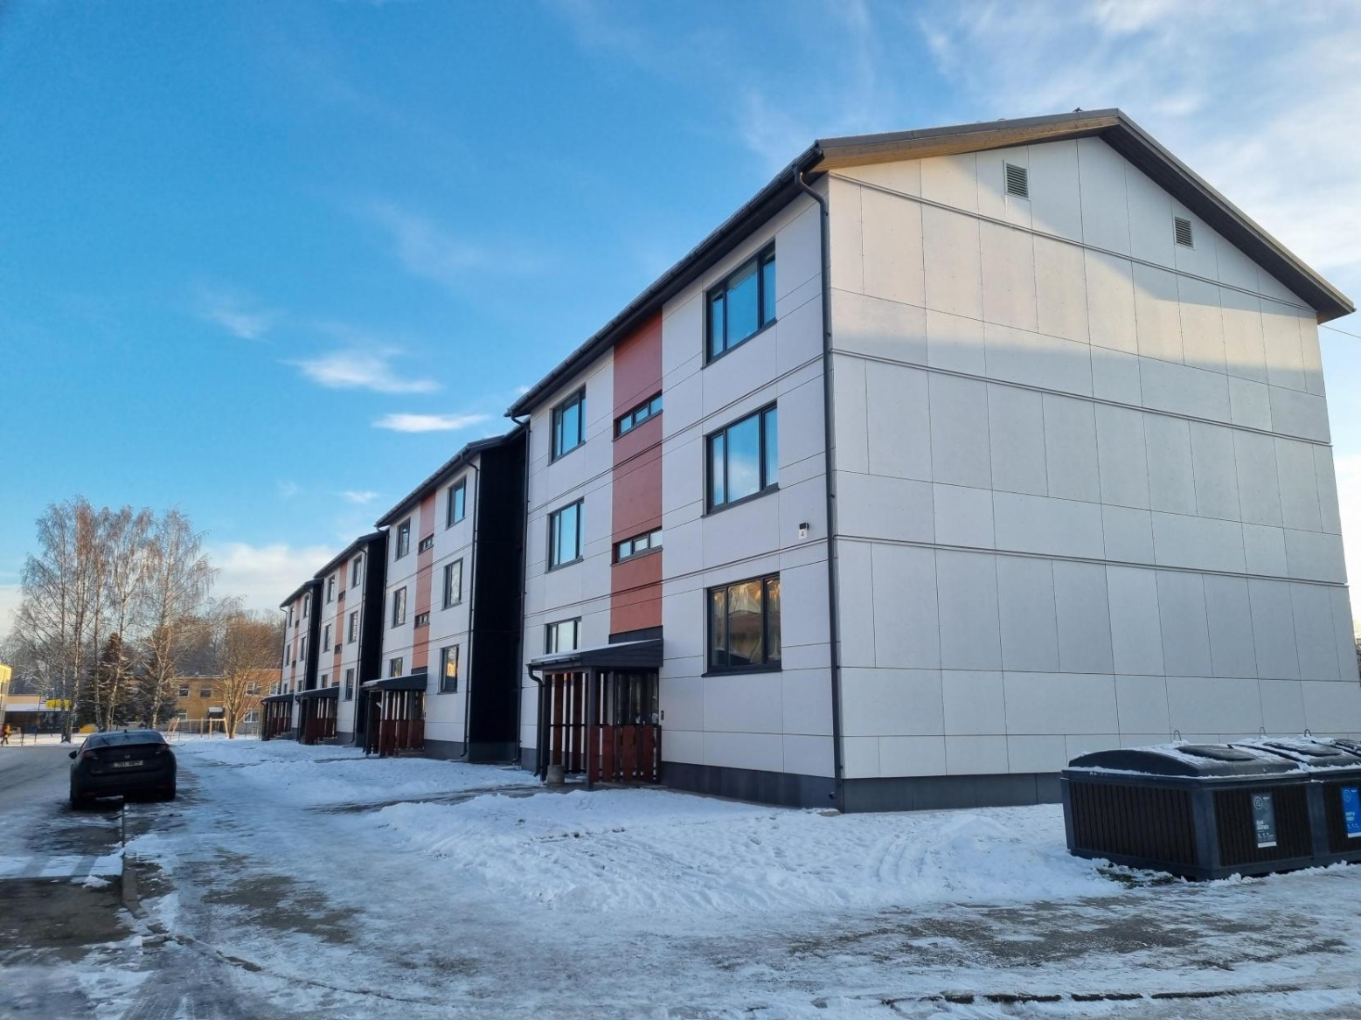
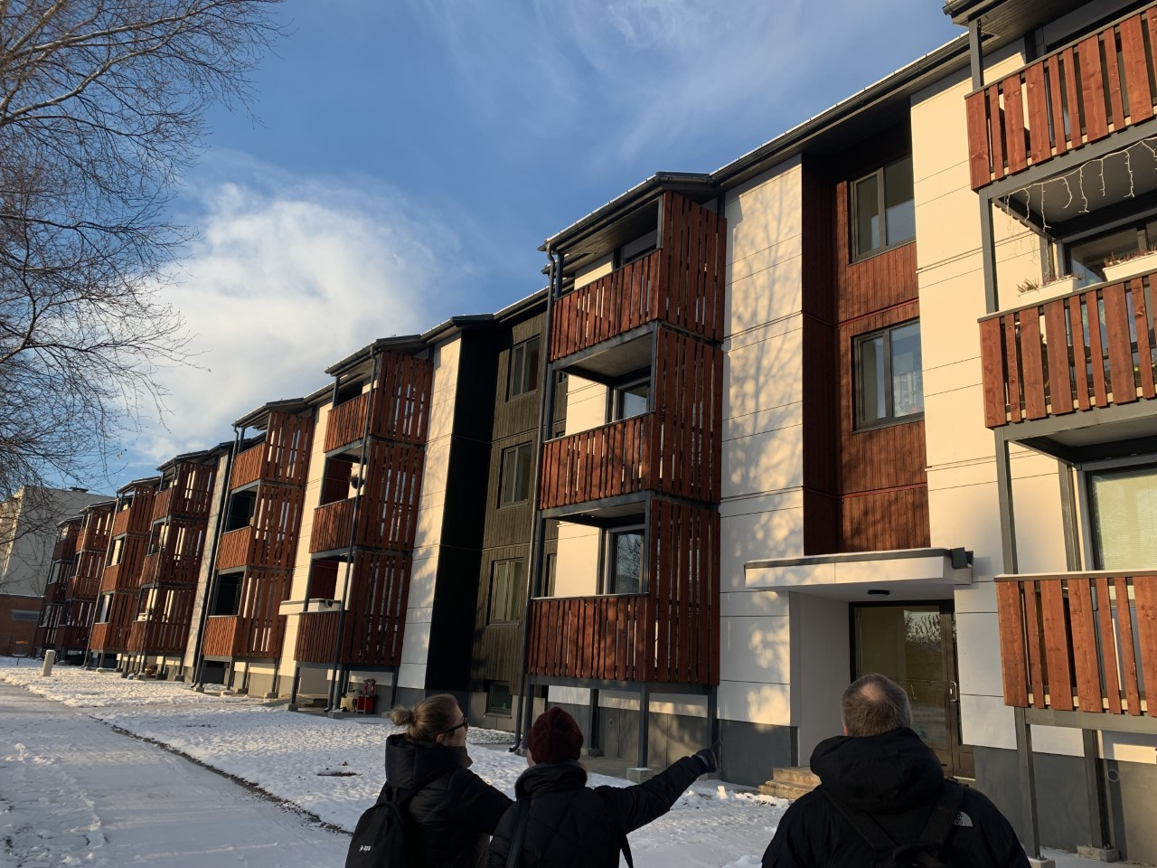
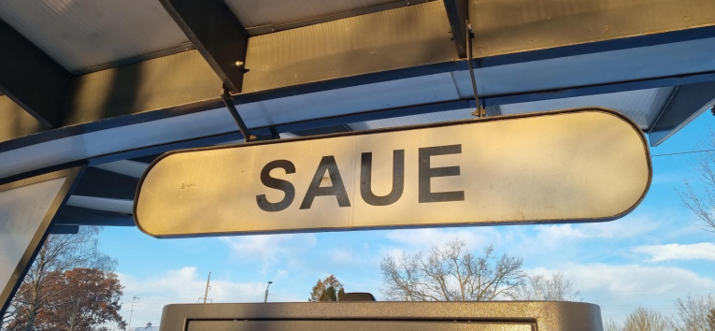
Future of Renovation
Serial Panel (industrial) Renovation

Slide 11
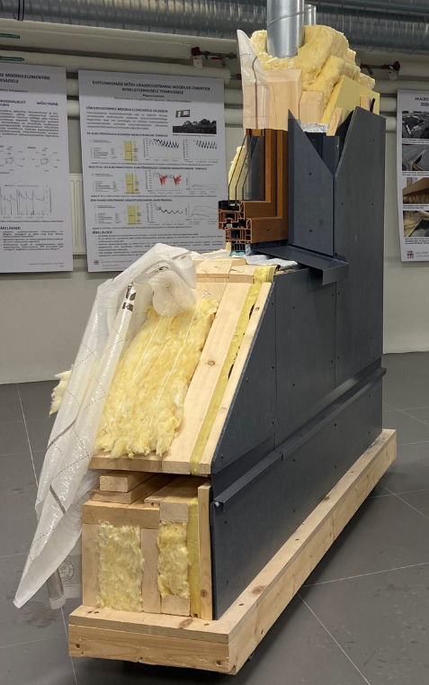
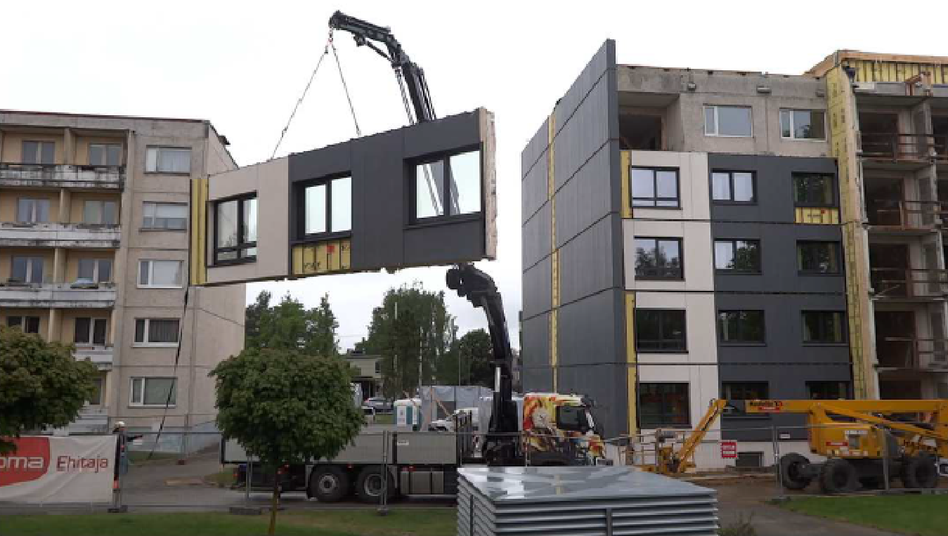
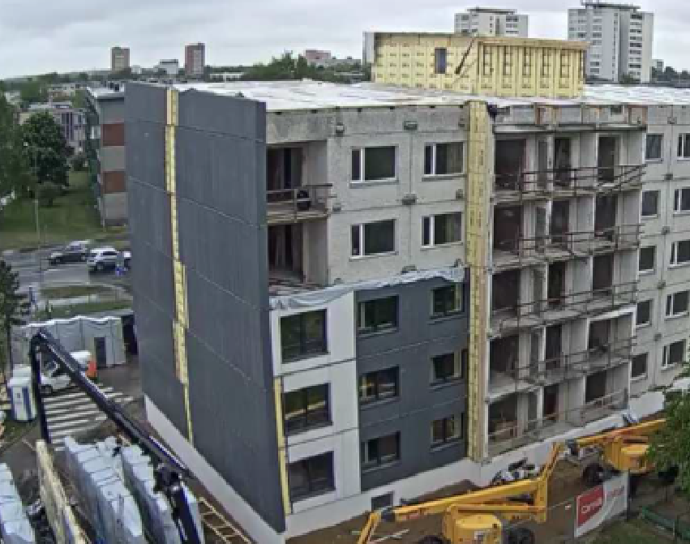
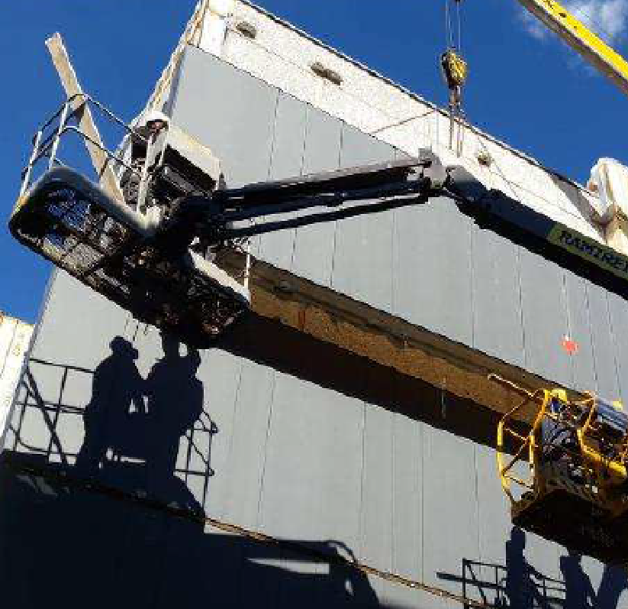
Future of Renovation
Serial Panel (industrial) Renovation

Slide 12
Industrialization of Renovation
(Recovery and Resilience Plan)
  Develop production capacity for serial panel (industrial) renovation based on renewable organic materials;
  Implement pilot projects (multi-apartment and public) for the renovation using series panel (industrial) based on renewable organic materials (+BIM, LCA);
  Create Building Data Bank (Information System);
  Support for renovation of multi-apartment buildings using serial panel (industrial) renovation solutions/EPC “B”

Slide 13
New challenges and tasks
More value with the same resources
Further digitization of the process (APVIS, Building Data Bank, BIM)
Constant review of the renovation process and solutions to make it shorter and more efficient
Flat-rate renovation support (depending on the energy performance class achieved)
Review of the model of Neihgbourhoods renovation and related change management

Slide 14
Thank you!
laura.lukoseviciene@am.lt
2024-04-12

