Slide 1

National Parliamentary Workshop
Parliament of Ireland, Houses of the Oireachtas
The new Renewables Energy Directive and Ireland’s leading role for the European energy transition
Paula REY GARCIA Deputy Head of Unit, Renewables and Energy System Integration Policy
DG ENERGY, European Commission
22 May 2024

Slide 2


The Climate Target Plan
GDP
2008-2021
GHG 20.5%
GDP 9.3%
The
European Green Deal
2040 Emission: – 90%
10
Emissions

Slide 3




REPowerEU
A roadmap to reduce the dependence on Russian fossil fuels and fast forward the energy transition
Based on 3 pillars:
Reduce: Energy saving and energy efficiency
Renew: Massive acceleration of investment in renewables
Replace: Diversification of our energy supplies

Slide 4
Overall target– the EU-level target (Article 3)
REDII
REDII revision
Overall RES share
At least 32%
EU binding
MS contributions + indicative formula
At least 42,5%
EU binding
MS contributions + indicative formula
+ additional indicative target of 2,5%
REDII revision
REDII
actual
+ New indicative target for the deployment of innovative technologies: 5% in 2030

Slide 5
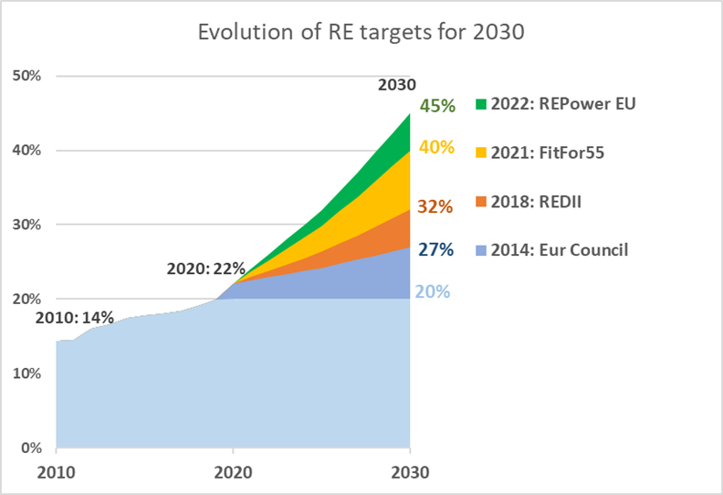
Revised Renewable Energy Directive
Revised EU-level target: doubling ambition over next 8 years
New provisions/revised targets on:
Permitting
Heating and cooling
Industry
Transport
Buildings
Bioenergy

Slide 6
Revised RED: strengthened horizontal measures
Permitting
Spatial planning
Shorter and simpler procedures
RES acceleration areas
Power Purchase Agreements
Assess and remove barriers
Promote uptake
Guarantees of Origin
Ensure that they can be transferred to the buyer in the PPA
Energy System Integration
Facilitate electrification, sector coupling flexibility of energy systems
Art. 20&20a
Cross-border cooperation
Framework for projects
Joint projects (including use of RES Financing Mechanism)
Strengthened sustainability criteria for bioenergy
Apply to smaller installations
New no-go areas to forest biomass
Cascading principle: limitations to direct financial support

Slide 7
Timeline for the final National Energy and Climate Plans
Member States submit final updated NECPs
June 2024
2023
Commission assesses draft updated NECPs
31 December 2023:
Commission assesses the final updated NECPs
MS submit draft updated NECPs for 2021-2030 + support contracts
June 2023
MS submit Progress Reports
15 March 2023
2024

Slide 8

Thank you
© European Union 2020
Unless otherwise noted the reuse of this presentation is authorised under the CC BY 4.0 license. For any use or reproduction of elements that are not owned by the EU, permission may need to be sought directly from the respective right holders.
Slide xx: element concerned, source: e.g. Fotolia.com; Slide xx: element concerned, source: e.g. iStock.com

