Slide 1


NATIONAL PARLIAMENTARY WORKSHOP
ENERGY EFFICIENCY AT LOCAL LEVEL
Mayor of Elektrenai, Vice-Chair of ALAL Housing and Energy Committee
Gediminas RATKEVIČIUS
12 April 2024

Slide 2

ENERGY EFFICIENCY IMPROVEMENT AT LOCAL LEVEL
2022 m. “Breakthrough package” („Proveržio paketas“)
Energy efficiency at local level:
7 GW from renewables by 2030
€ 1 billion to green energy and energy efficiency by 2030
Local Renewable Energy Development Action Plans
11-80% share of RES of total energy consumption in different municipalities

Slide 3
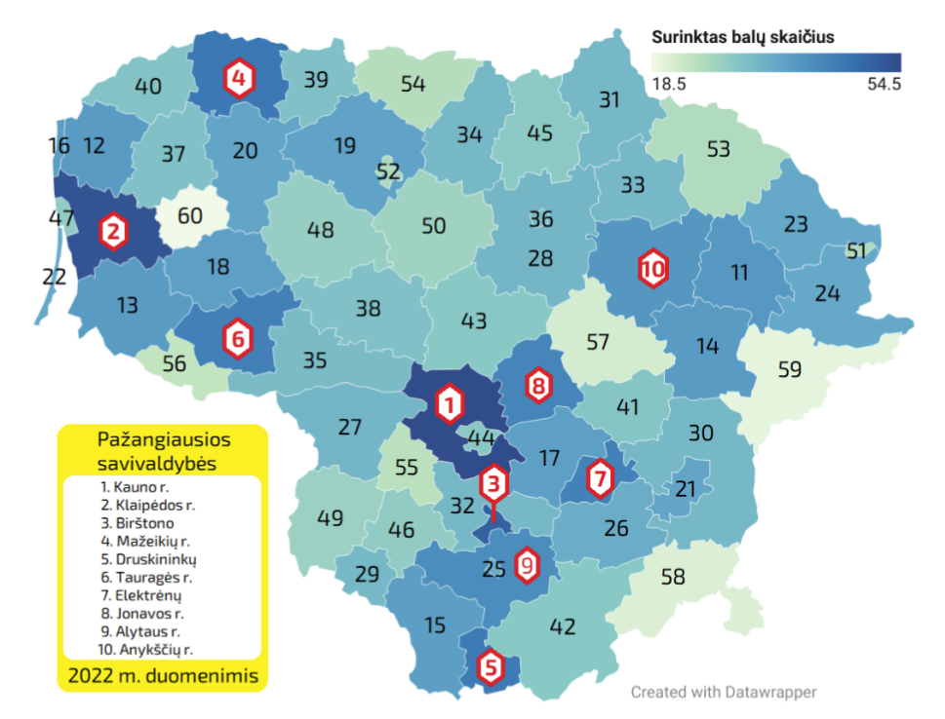
ASSESSMENT OF SUSTAINABLE ENERGY DEVELOPMENT IN MUNICIPALITIES
Criterion | Max points
1. Renewable Energy Development Action Plan | 8
2. Wind power installations of producers | 11
3. Solar power installations of producers | 10
4. Power of installations of producing consumers | 9
5. Real estate tax on RES power plants | 4
6. Share of renovated multi-apartment buildings | 20
7. Average heating price | 8
8. Length of cycling paths | 6
9. Number of electric cars | 5
10. Number of elektric cars charging stations | 6
11. Funded projects | 9
12. Energy poverty | 4
Energy efficiency at local level:
Source: Lithuanian Energy Agency

Slide 4
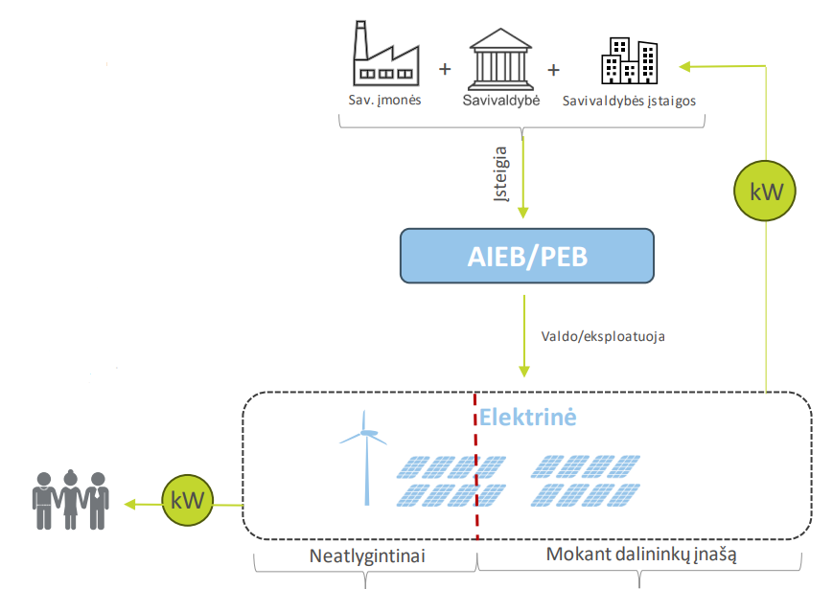
RENEWABLE ENERGY COMMUNITIES and CITIZEN ENERGY COMMUNITIES
Communities oriented to energy poverty reduction
€ 206,64 mln from State budget for financial instrument
Founders/stakeholders: municipalities and/or municipal institutions and municipal companies
What is funded? Installation of solar or wind power plants or purchasing of remote renewable energy park
At least 30 % of generated power to people on social allowances
At least 1 kW per person facing energy poverty
Funding: up to 50 % grant + soft loan (up to 3% interest rate and up to 15 years loan term)
At least 30 %
70 %

Slide 5

ENERGY COMMUNITIES - CHALLENGES
Soft loan will be included into municipal debt limits
Electricity demand of potential energy community is higher than free power of transmission network in that municipality
No proper plots of land
Additional costs to municipalities in relation to new establishments
Municipality-controlled companies can‘t be stakeholders in Renewable Energy Communities only in Citizen Energy Communities

Slide 6
RESULTS OF SURVEY IN MUNICIPALITIES
Survey was carried out by INVEGA in 2023:
73 MW overall need of power capacity indicated by 37 municipalities which took part in a survey
12 municipalities are planning to establish energy community without cooperation and other 12 in cooperation with other municipalities
Readiness for this project of most municiaplities is at basic level
Project implementation limitations due to the municipal debt limits and complicated administration of the project due to the changing situation of deprived persons

Slide 7

BUILDINGS RENOVATION
EU building stock accounts for 40% of energy consumption and 36 % of CO2 emissions.
In 2020 European Commission adopted a Renovation Wave strategy which aims to at least double the annual energy renovation rate by 2030.
„Renovation Wave – 1 000 renovated multi-apartment buildings per year” is the the goal of Lithuanian Government as well.
Multi-apartment buildings in Lithuania account for 54% of total energy consumption.
In 2013 new renovation model introduced in Lithuania putting municipalities at a central role.
Less than 500 buildings renovated in the period of 2005-2013
More than 3700 projects within 10 years (2013 – 2023)
More than 4500 contracts for renovation at the moment

Slide 8
RENOVATION – CHALLENGES (1)
Funding
Lack of loan providers in the process.
Funding problems – biggest bottleneck in implementation of already approved and new projects.
Changes in terms of providing soft loans for renovation.
Due to the constantly increasing requirements for renovation projects and the increased prices of construction works and materials in recent years, housing renovation is becoming a growing financial burden for residents.

Slide 9

RENOVATION - CHALLENGES (2)
Renovation using prefabricated modular panels
Lack of accurate information.
No legal framework in place.
Pilot projects not implemented yet.
More expensive than regular renovation.

Slide 10

RENOVATION – CHALLENGES (3)
A class renovation. Excessive requirements?
From 2022 amendments in regulation - more stringet requirements for state compensation (30 % of investment on certain energy-efficiency measures).
It is planned to further tighten the requirements for the energy class of renovated buildings leaving only A class.
At the moment call only for A class renovation. B class renovation call only using prefabricated modular panels.
Increased renovation costs, not attractive for residents preventing them to take decision for renovation
Lack of skilled and reliable construction companies in renovation process.

Slide 11
CONCLUSIONS
In order to achieve tangible results in energy efficiency and other green goals, it is necessary:
A clear long-term perspective.
Sustainable funding.
Stable legal framework and regulation.
Close cooperation at all levels.

Slide 12
Thank you
for your attention!

