Slide 1

Wind energy potential in Lithuania: opportunities and challenges
2024 04 12
Vilnius

Slide 2
Installed capacity in Lithuania by type of power plant 2015-2024/01

Slide 3
Electricity generation 2015-2023

Slide 4
Electricity production and consumption in Lithuania 2015-2023, TWh

Slide 5
Installed capacity in Lithuania by type of power plant 2015-2050

Slide 6
Electricity generation 2015 - 2050, TWh

Slide 7
Renewable energy generation, national consumption and the (day-ahead) electricity price 2024-04-10

Slide 8
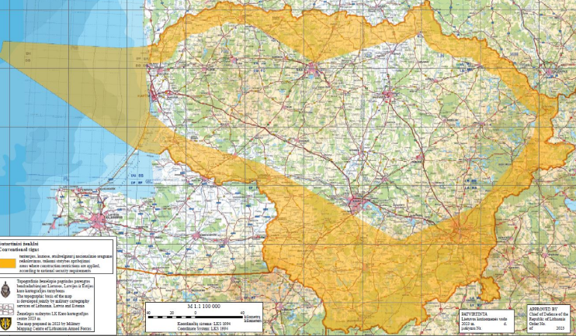
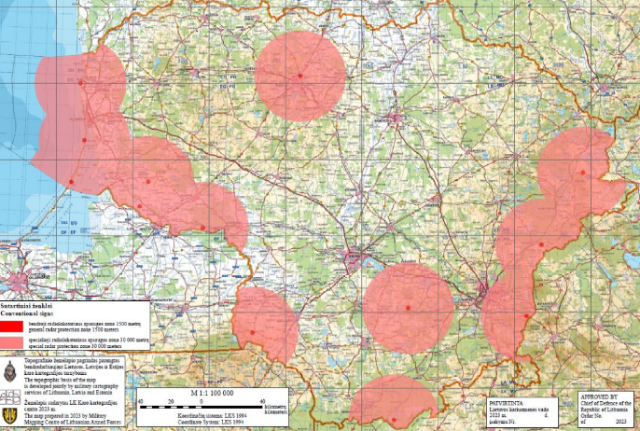
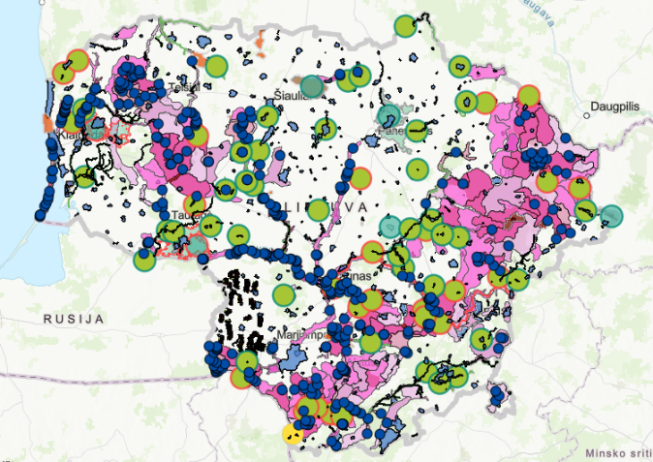
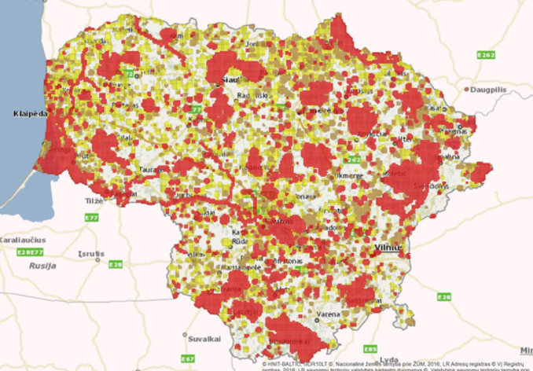
Energy and environment
Currently over 3TW of wind energy projects in Lithuania are stuck due to one or another constraint.
Incompatibility with military objectives,
Different assessments of environmental requirements and mitigation measures,
Landscape requirements,
Landowner requirements,
Malicious undermining of various NGOs,
Competition for equipment in the world (power stations, transformers, etc.),
Export opportunities (LitPolLink, Harmony link, hydrogen?)

Slide 9
Regulation
Replaced several times a year (both yes and no)
  On average, a wind power project takes 5 years to complete,
  The land use for the power plant does not need to be changed, but the substation does,
Changing the realestate tax base from 0.3 to 3% (as for derelict, unmaintained properties),
In all cases, the risk of changes in the law is the developer's responsibility,
Renewable electricity is taxed more (€1/MWh) than fossil fuels.
  Network operator plans.

Slide 10
What next?

Slide 12
Production, imports, consumption 2023

