Slide 1

Domantas Tracevičius
The fast way forward: How to sustainably boost renewables in Lithuania
2024-04-12
Notes:
Aaaa

Slide 2




Latest: https://circulareconomy.lt/energetika3.pdf

Slide 3

100 % Electricity from RES by 2030
Better regulatory framework for Renerable energy communitie

Slide 4
No-go zones!
Acceleration areas???

Slide 5
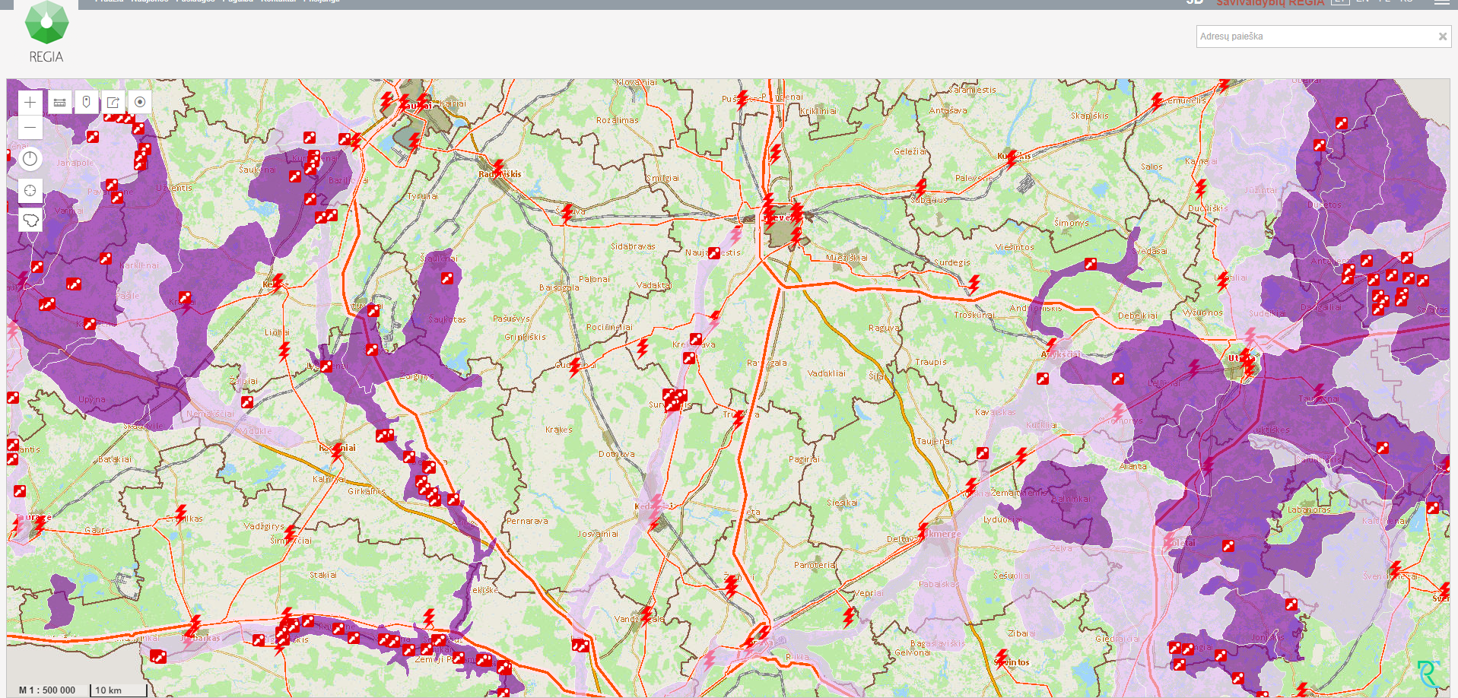
Acceleration areas???

Slide 6
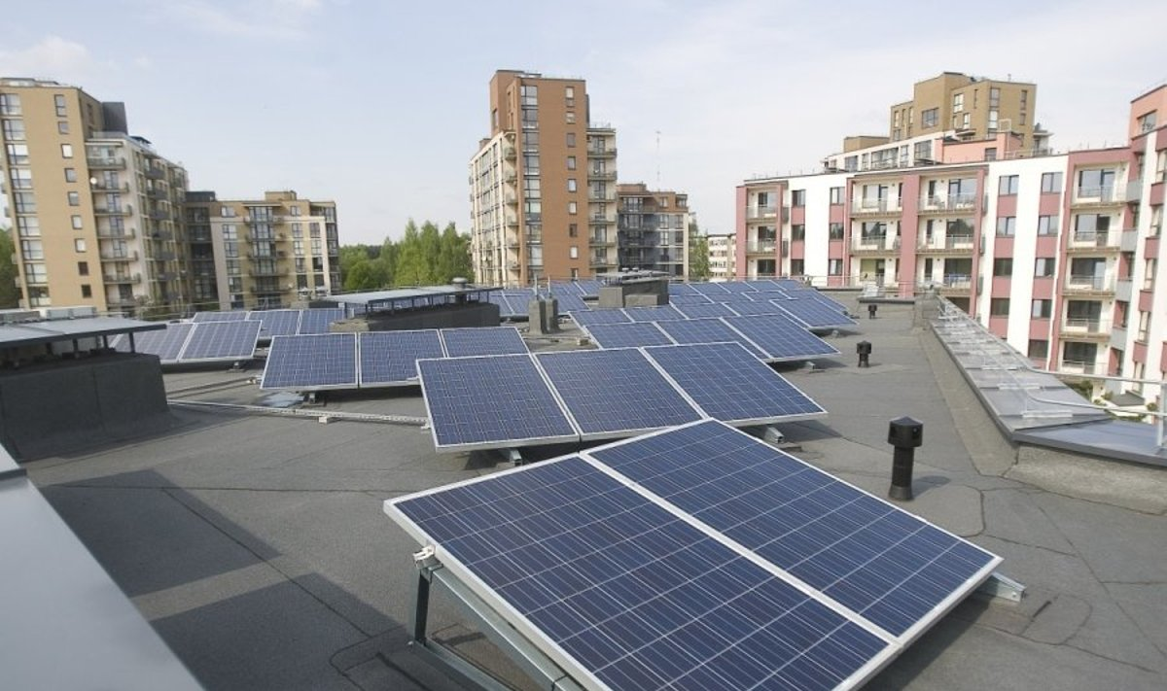
Solar mandate

Slide 7





REMOTE PROSUMER (pay full DSO tariff)

Slide 8
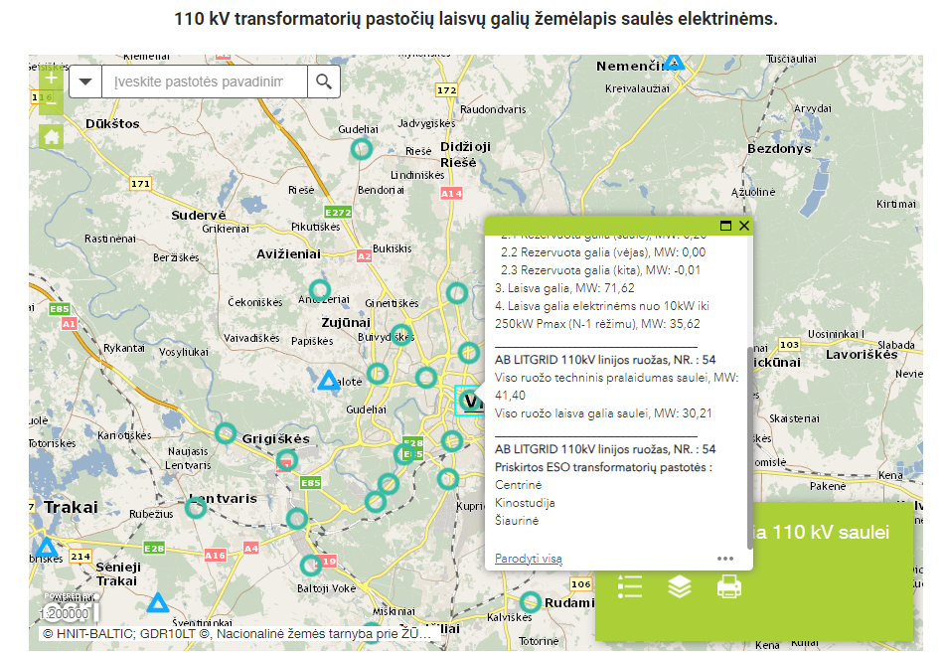

Slide 9
Fixed rate for new prosumers and remote prosumers
Prosumer protection from discrimination
Battery capacity with prosumers & EVs
Compensation for people living close to electricity from RES (built prior to 2023-07-01)

Slide 10

Thank you!
www.circulareconomy.lt

