Slide 1
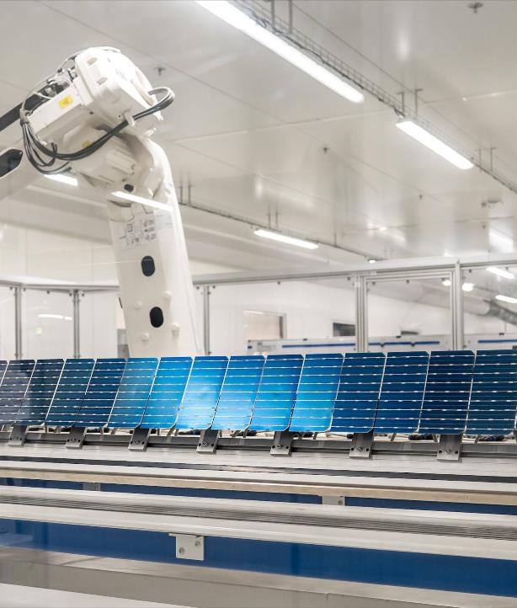
PV manufacturing status quo and potential in Lithuania and the EU
Copyright: Voltec Solar
Žygimantas Vaičiūnas, Policy Director, ESMC
NATIONAL PARLIAMENTARY WORKSHOP
12 April 2024

Slide 2
Demythization of European solar pv manufacturing
Myth No. 1 – PV module production of EU PV manufacturers is meaningless!
Actually, the EU demand is high and EU PV production diminishing, but 10–40% of the EU demand could be covered by the EU PV production (2024–2030).
Myth No. 2 – EU PV manufacturers are not able to produce competitive PV production!
Actually, EU PV manufacturing costs are higher due to subsidized imports from China, higher labour costs and environmental frameworks in the EU. We cannot produce cheaper, but we can produce resilient PV modules, in line with ecodesign and other criteria – 20–30% price difference is still acceptable for the consumers.
Myth No. 3 – There is no need to invest and support EU PV manufacturing industry, we have to rely on subsidized PV modules import from China!
Actually, we can benefit from unsustainably low PV modules prices, but we cannot rely on 100% import dependence on the strategic asset for the EU Green Deal implementation.
Myth No. 4 – Rescuing of the EU PV module manufacturers is too expensive!
Ensuring operational capacities of the current PV module production capacities (6 GW) till 2026 would cost EUR 880 million.
Myth No. 5 – There are no instruments to support EU PV manufacturing!
Actually, till now there were no concrete instruments, but the legislative measures are under way: Net-Zero Industry Act, Forced Labour Regulation, Ecodesign and Energy labelling, support frameworks and programs in the Member States.

Slide 3

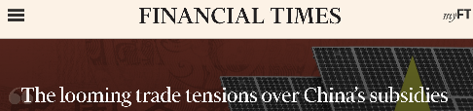
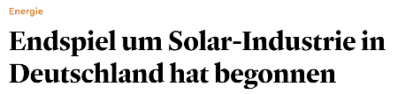




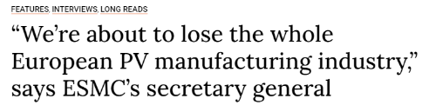



A solar Industry In Crisis

Slide 4
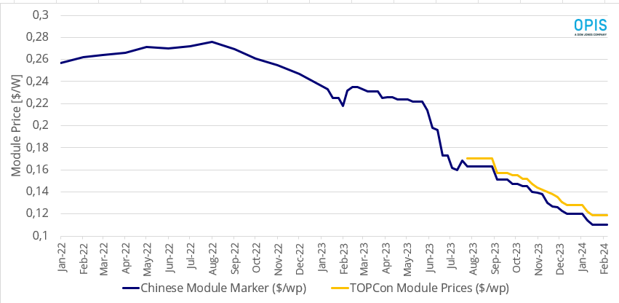
PV module Price collapse in June 2023
Jinko Q3 2023 manufacturing cost
Source: OPIS APAC Solar Weekly Report

Slide 5
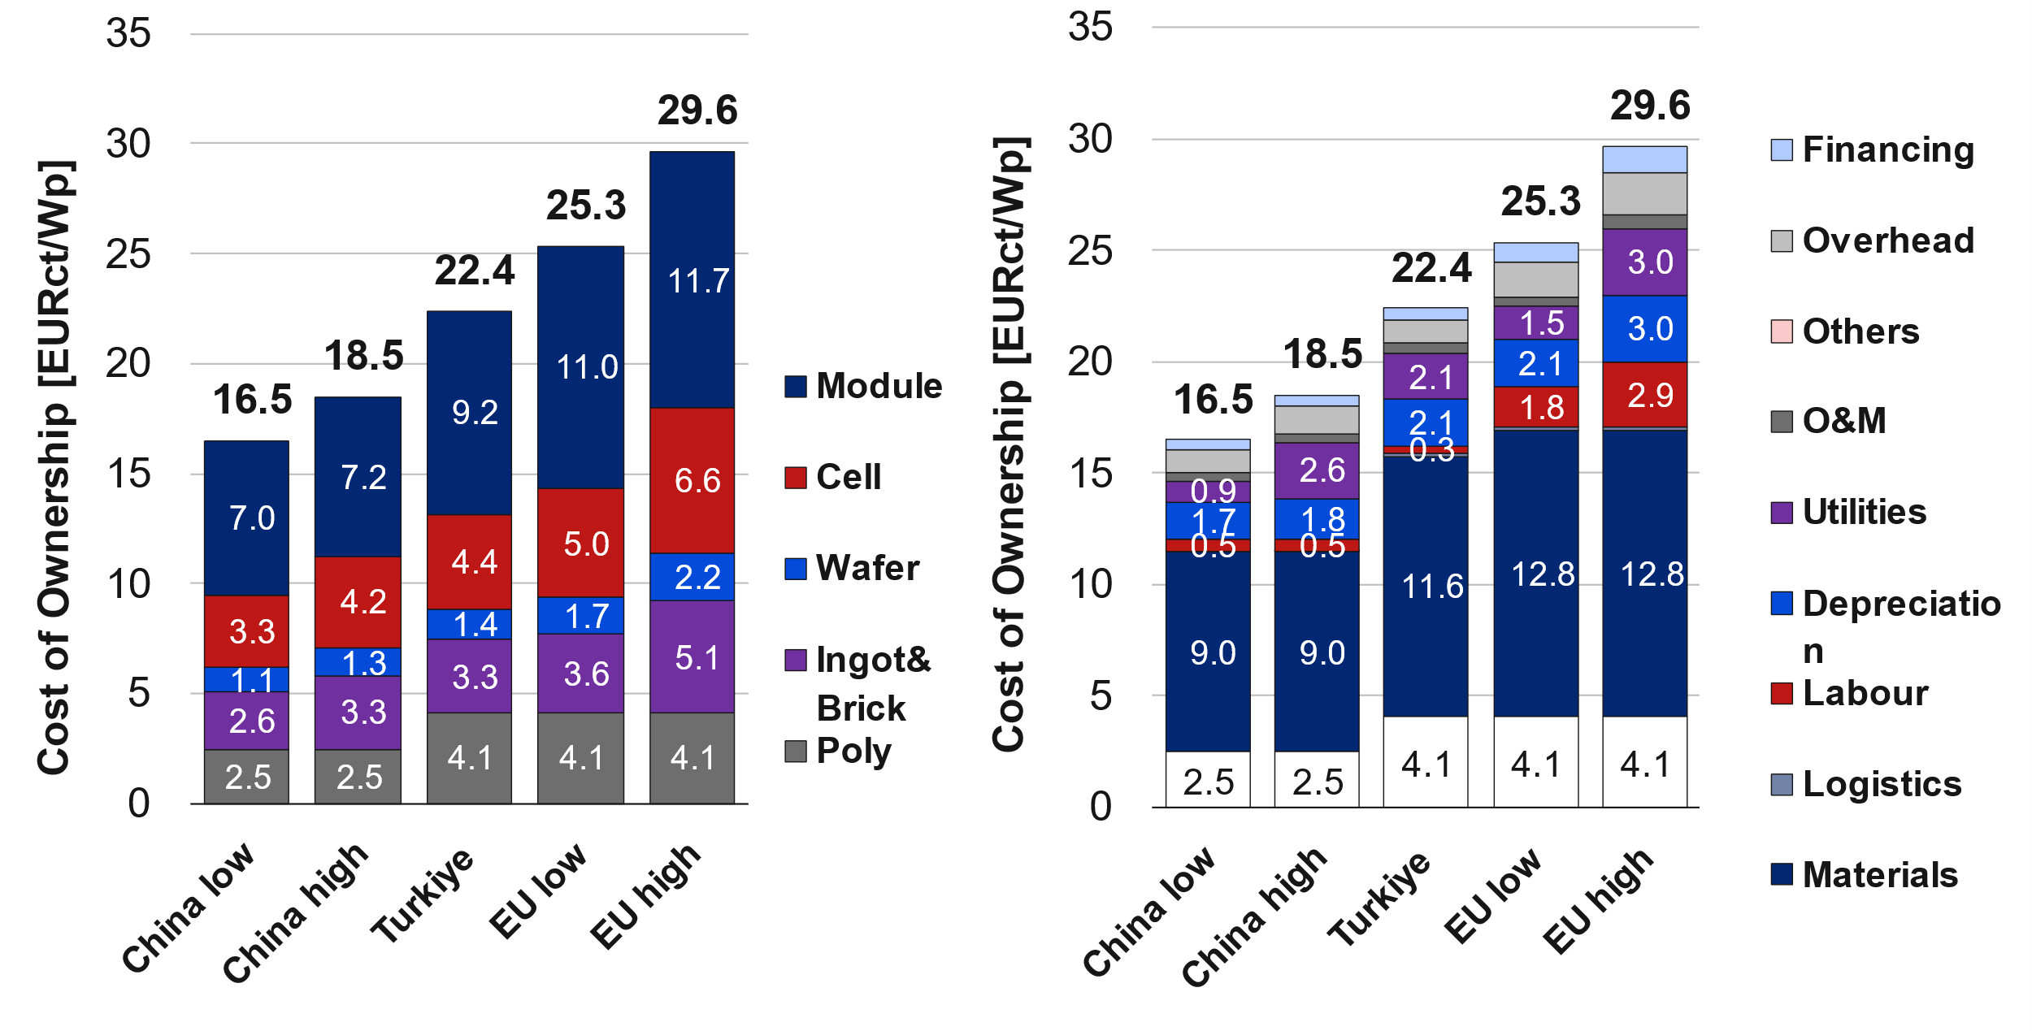
PV manufacturing COSTS — Simulated
3rd April 2024 – Commission launched investigation under Foreign Subsidies Regulation on 110 MW PV tender in Romania.
9th April 2024 – Commission announced launching investigation into Chinese suppliers of wind turbines – investigating the conditions for the development of wind parks in Spain, Greece, France, Romania and Bulgaria.
5th October 2023 – Commission launched anti-subsidy investigation on EVs from China.
From production costs to Average Selling Price (ASP)
Manufacturing costs must be augmented with Selling General and Administrative (SG&A) costs of approximately 7%, Research and Development (R&D) costs of up to 5% and transport costs — around 0,01 EUR/W_{p}.
In the case of Jinko Solar again, this positions the sales prices around 0.198 in USD/W_{p} Q3 2023.
Source: RCT Solutions, Becquerel Institute and Fraunhofer ISE

Slide 6
internal demand and pressure for export in china
Source: IEA PVPS — Trends in Photovoltaic Applications — 2023

Slide 7
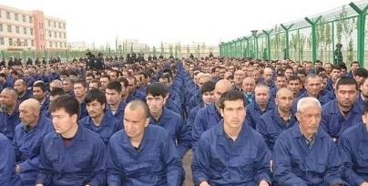
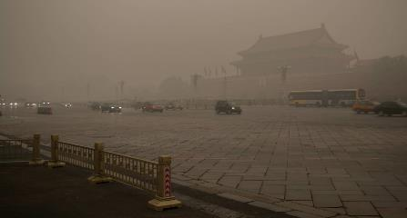
Major structural Disadvantage to Be a Western Manufacturer
Industrial policy spending in key economics in 2019 in percentage of GDP
Weak labour laws and slave work in Xinjiang
Weak environmental laws
Source: Estimating Chinese Industrial Policy Spending in Comparative Perspective, Center for Strategic and International Studies

Slide 8
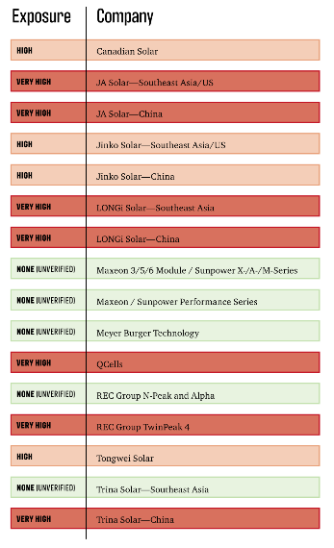
Forced Labour in the Chinese PV Value Chain
The Xinjiang region accounted for 42 % and 50 % of the national metallurgical-grade silicon and polysilicon production capacity in 2020. Currently the number increased to more than 75%.
In Xinjiang the local population of Uyghurs have been subjected to arbitrary detention and forced labour by the Chinese government.
Estimations suggest that over the last few years, Chinese authorities have built or expanded over 380 re-education camps, detention centres and prisons. Up to 1.5 million Turkic Muslims are arbitrarily detained in internment camps of various security levels.
During imprisonment in the camps, detainees are exposed to physical and psychological torture, sexual violence, and other forms of ill- treatment. Detainees have reported being forced to stay in stress positions for hours every day, sleep deprivation, lack of access to food, water, and sanitary conditions, being subjected to health-related procedures without their consent, including mass sterilisation.
The situation extends beyond the geographical region of Xinjiang. According to civil society research, more than 80,000 Uyghurs were transferred out of Xinjiang to work in factories across China in recent years.
The extent of violations has prompted parliaments around the world to launch debates on the question of genocide. The French, Dutch, American, British, Canadian and Lithuanian parliaments have voted to call it a genocide.
Source: Sheffield Hallam University — Over-Exposed: Uyghur region exposure assessment for solar industry sourcing
Löning – Human Rights & Responsible Business Reducing Risks in Solar Supply Chains — What companies should know and what they can do

Slide 9
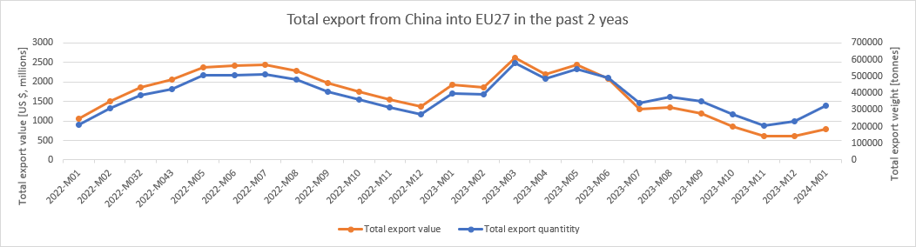
PV module oversupply to the Eu
In 2022, the world's leading solar manufacturing nations exported modules worth $22.9 billion to EU countries, with the majority originating from China. In 2023, China exported $19.1 billion worth of solar panels to the EU, despite considerable drops in module prices.
Between 80–90 GW of solar modules were imported from China to the EU in both 2022 and 2023 respectively, possibly more, while installations amounted to approximately 40 GW in 2022 and 57 GW in 2023.
~ 85 GW of imported module capacity is currently sitting in stock in the EU.
Source: TradeMap, a database managed by the International Trade Centre (ITC) & Becquerel Sweden

Slide 10
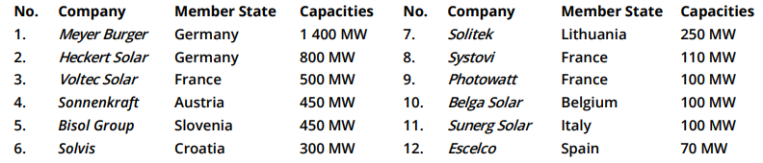
European Manufactures under severe Pressure
In 2023 in the EU installed 57 GW of PV modules. EU is capable to produce ~10% of the needs. Without commitments for the EU PV modules off-take these capacities will be reduced drastically.
In recent months, we have already witnessed the loss some of the larger European PV manufacturers, such as Norwegian Crystals, REC Norway, Norsun, Exasun, Valoe, Energetica, SunPower France, Flisom.
Without immediate intervention, the risk intensifies, and there is a looming danger of forfeiting an additional 3.5 GW (Meyer Burger, Heckert Solar, Solarwatt, among others) of operational PV module production capacities.
No. | Production type | Capacities
1. | PV module production capacities in the EU | ~ 11 GW
2. | Actual operational PV module production capacities | ~ 6 GW
3. | Produced in 2023 | ~ 2 GW
4. | In stocks | ~ 1 GW
Source: How to address the unsustainably low PV module prices to ensure a renaissance of the PV industry in Europe

Slide 11
ESMC recommendation for the European Commission
Establishment of an EU level buy-out facility for accumulated EU PV module inventories.
Immediate modification of Temporary Crisis and Transition Framework (TCTF) to empower financing the projects with EU-produced PV modules or operational expenditures of the EU PV module producers.
Accelerated implementation of the EU PV producers’ supportive elements outlined in the legislative initiatives of the Net-Zero Industry Act (NZIA) and Forced Labour regulation (FLR) from July 2024 by creating a simplified and effective resilience auctions system for a temporary period.
In the event that the proposed emergency measures would not be possible for a swift adoption within the next months, the activation of trade defence measures could be initiated.
Source: How to address the unsustainably low PV module prices to ensure a renaissance of the PV industry in Europe

Slide 12
Next steps – promising but not yet assured good news for the EU PV manufacturers
Net-Zero Industry Act (NZIA) – possibilities for resilient EU PV production through public procurements and auctions (up to 30% non-pricing criteria, pre-qualification and award criteria). Unfortunately, in practice from 2026.
European Solar Charter (expected signature on 15th April) – earlier implementation of NZIA and committed grounds for off-takers to commit to the EU produced PV modules.
Member States off-take and off-takers commitments are critical – 5–10% of EU produced PV modules would not have a negative impact for the PV deployment but would preserve EU PV manufacturing capacities.
EU energy security needs – EU electricity system should be protected from the external influence.
Member States already framed financial support programs (Italy, Netherlands, Spain, Germany) – success also depends on the aforementioned actions.
Source: How to address the unsustainably low PV module prices to ensure a renaissance of the PV industry in Europe

Slide 13
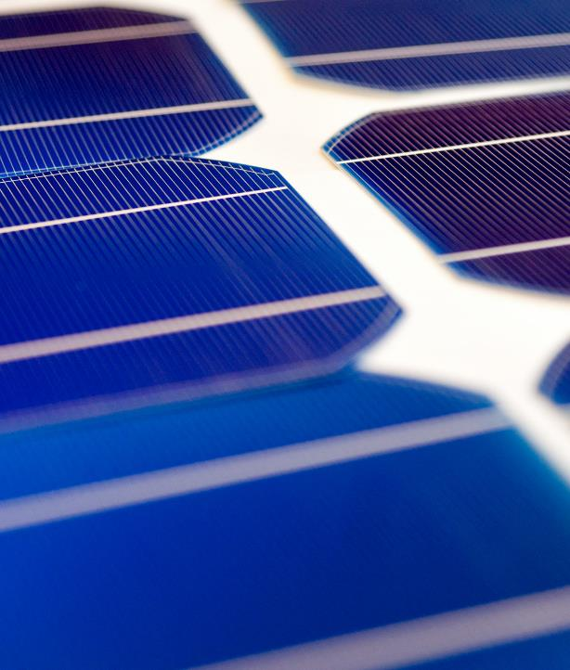
Thank you for your attention!
Žygimantas Vaičiūnas, Policy Director, ESMC
NATIONAL PARLIAMENTARY WORKSHOP
12 April 2024

