Slide 1

Energy Efficiency Policies in Lithuania: the Plans of the Government
Energy vice-minister Inga Žilienė
National Parliamentary Workshop “The EU Green Deal as driver for economic prosperity and the energy transition in Lithuania”
12/04/2024

Slide 2
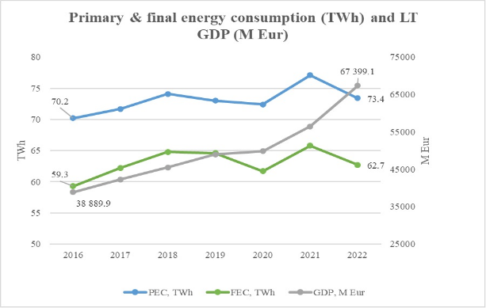
ENERGY CONSUMPTION AND GDP
!
Direct dependence remains between GDP and energy consumption in Lithuania

Slide 3


NEW ENERGY EFFICIENCY DIRECTIVE
New Energy Efficiency Directive 2023/1791:
Energy efficiency first principle is a fundamental principle of EU energy policy, giving it legal status for the first time.
EU MS must take energy efficiency into account in all relevant policy areas and when making important investment decisions in the energy and non-energy sectors.
REPowerEU, which aims to decarbonise the EU from Russia’s fossil fuels imports, is taken into account.
Government is about to prepare a package of amendments to the laws on the transposition of the directive and submit it to the Parliament for consideration:
Entry into force
10.10.2023
Transposition
by 10.10.2025
Q2 2024
Consideration and approval
by the Government
2024 Autumn session
Consideration and adoption
in the Parliament

Slide 4

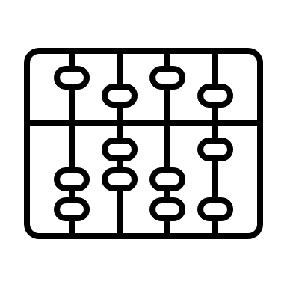
MAIN CHANGES IN NEW EE DIRECTIVE
EEF PRINCIPLE
PUBLIC BUILDINGS RENOVATION TARGET: +108 %
PRESENT EE DIRECTIVE
applicable only to central state
public bodies
NEW EE DIRECTIVE
applicable to all public (state/municipal) bodies
PRESENT EE DIRECTIVE
NEW EE DIRECTIVE
In all sectors, when projects value > 100 M EUR or 175 M EUR in transport infrastructure projects
1,06
M
m²
Applies only to energy network operators
0,51
M
m²
Renovated public buildings >> nearly zero energy buildings
ENERGY AUDITS
DATA CENTRES (DCs)
PRESENT EE DIRECTIVE
NEW EE DIRECTIVE
PRESENT EE DIRECTIVE
NEW EE DIRECTIVE
Enterprises consuming > 28 GWh (~6,7 M Eur annual bill) implement energy management systems
Enterprises consuming > 2,8 GWh and not implementing management systems (~670 thousand Eur annual bill) are subject to energy audits
≥500 kW DCs annually submit and make publicly available information on EE indicators
≥1 MW DCs should utilise waste heat
Large enterprises
(> 250 employees and income >50 M EUR)
-
Notes:
As regards the renovation of public buildings, the current EE Directive requires the annual renovation of 3% of the area of central government buildings up to class C;
According to the new EE Directive:
There is an obligation for public entities to save 1.9% of their energy consumption each year;
Every year, 3% of the area of public buildings, which are over 250 m2 and which are not nearly zero-energy(NZEB) buildings, should be renovated to NZEB.
DCs with an installed IT power of ≥500 kW shall annually provide and make publicly available information on:
the name of the owner, users and DC, the date of the start of the activity, the municipality;
size (area, installed power), data flows;
DC’s energy efficiency indicators, i.e. energy consumption, electricity use, temperature settings, waste heat utilisation, water consumption and the use of renewable energy, etc.
To our knowledge, there are 4-5 DCs in Lithuania with installed IT power ≥500 kW, operated (owned) by 3 companies.
DCs with an installed IT power of ≥1 MW:
have to utilise waste heat unless objectively impossible;
are encouraged to take into account the best practices of the European Code of Conduct on Data Centre Energy Efficiency.

Slide 5

ENERGY EFFICIENCY TARGETS
EU annual final energy consumption in 2030
-21,1 % v. 2021 consumption
EU CONSUMPTION 2021
NEW EE DIRECTIVE
11 248 TWh
8 874
TWh
LT annual final energy consumption in 2030
-22,5 % v. 2021 consumption
LT CONSUMPTION 2021
NEW EE DIRECTIVE
65,8 TWh
51,0
TWh

Slide 6
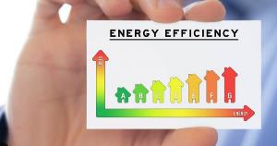
GOVERNMENT IS IN THE PROCESS OF NECP RENEWAL
46,4 TWh
Present measures 34,5
Planned measures 11,9
Fuel excise
8,66
Change of boilers
7,62
Renovation of multiapartment buildings
6,31
Renovation of multiapartment buildings
5,27
Renovation of individual houses
5,51
Renovation of public buildings
0,3
Other measures
11,91
Other measures
0,82
Additional financing is needed
The target of cumulative end-use energy savings set in new EE Directive – 39,3 TWh – is planned to be reached
Notes:
The Government is updating the National Energy and Climate Plan for 2021-2030. The plan will have to be approved by the Government by 30 June 2024 and submitted to the European Commission.
The plan shall detail the energy efficiency improvement measures and the energy savings TWh planned for each measure.
For 2030, the indicative LT FEC target is <51 TWh energy consumption.
In 2030 , the total energy savings of 39.3 TWh is planned to be achieved by implementing existing and planned policy measures.
The target of renovating at least 3% of the area of buildings owned by public bodies each year by 2030 will be achieved by implementing existing and planned policy measures.

Slide 7


GOVERNMENT SAVINGS PLAN (1)
On 07.09.2022 Government approved the Energy Savings Plan (energy saving measures and recommendations) developed by the Ministry of Energy (hereinafter – Savings plan):
ambitious Savings plan – savings in 2 Years period:
Savings plan is obligatory for central government institutions
Eur allocation for the implementation in 2021-2027:
1 332 M EUR
20% of energy
207 M EUR
public sector
225 M EUR
business
900 M EUR
residential
Notes:
Plan is recommended for municipalities, business and residents.
900 M Eur for residential is allocated to: 1) multiapartment buildings renovation; 2) individual houses renovation; 3) change of boilers; 4) renovation and automation of heat points in multiapartment buildings.

Slide 8
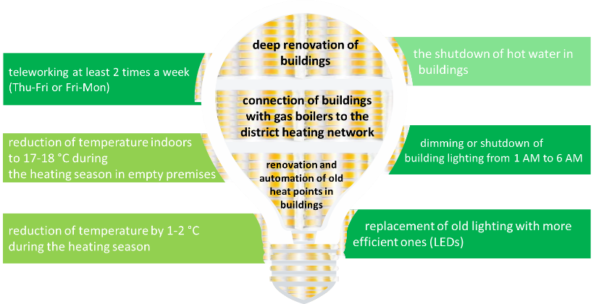
GOVERNMENT SAVINGS PLAN (2)
Public sector exemplary energy saving measures:
Notes:
The plan proposes behavioural change, fast impact and long-term saving measures, with the biggest savings (30-50%) coming from long-term measures (e.g. building renovations).

Slide 9
IMPLEMENTATION OF GOVERNMENT SAVINGS PLAN (1)
In the implementation of Savings plan agreements on energy saving were concluded between the Ministry of Energy and state/municipally owned enterprises:
33 agreements are already in place:
Savings
Annually
Up to 2030
Avg.
68 GWh
of energy
Up to
20-33 M Eur
Up to
3.75 TWh of energy
Up to
0.7-1.2 B Eur
Lithuanian Energy Agency:
has also prepared Energy Savings Guidelines, which are primarily intended for residents and refer to behavioural change measures/actions
has established Energy Efficiency Competence Centre, which advise end-users on energy efficiency.
Notes:
Even 28 agreements were concluded in 2022-2023.
Among best known state owned undertakings, which concluded energy savings agreements, Ignitis Group, EPSO-G, KN Energy, Vilniaus šilumos tinklai, Lietuvos geležinkeliai, Lietuvos oro uostai, Turto bankas, Registrų centras can be mentioned.
The most active municipal enterprises were in Šiauliai city municipality.
The municipal enterprises, which concluded the agreements, operate in water supply, public transportation and district heat supply sectors.

Slide 10
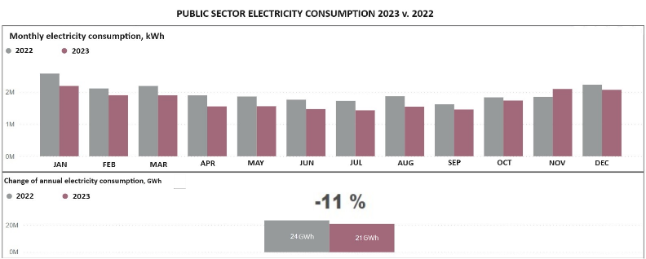
IMPLEMENTATION OF GOVERNMENT SAVINGS PLAN (2)
Public sector achievements are monitored by a public scoreboard prepared by SE Turto bankas, which manages state buildings.
Source: SE Turto bankas scoreboard

Slide 11
Thank You!

